Slide 2
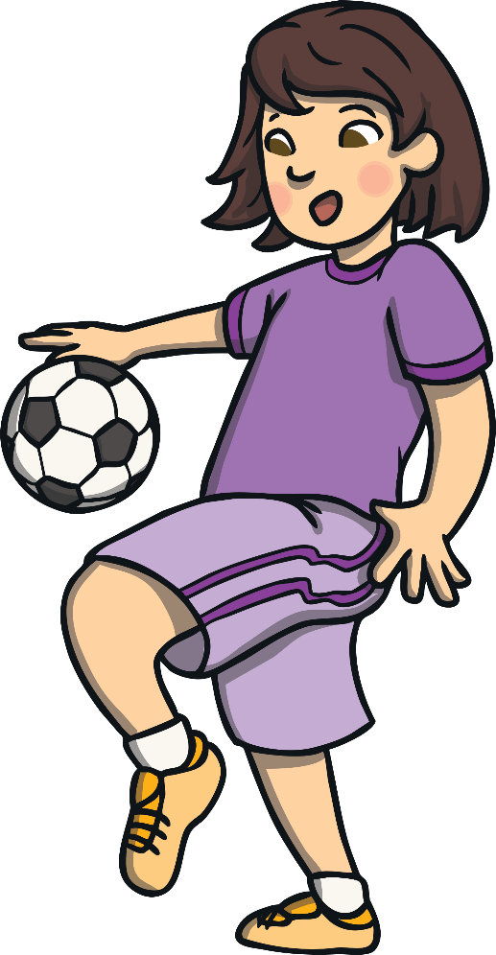
Hi there!
My name is Kim and I’m a huge fan of different sports!
I’d like to share some of my favourites with you. Can you guess what they are?

Slide 3
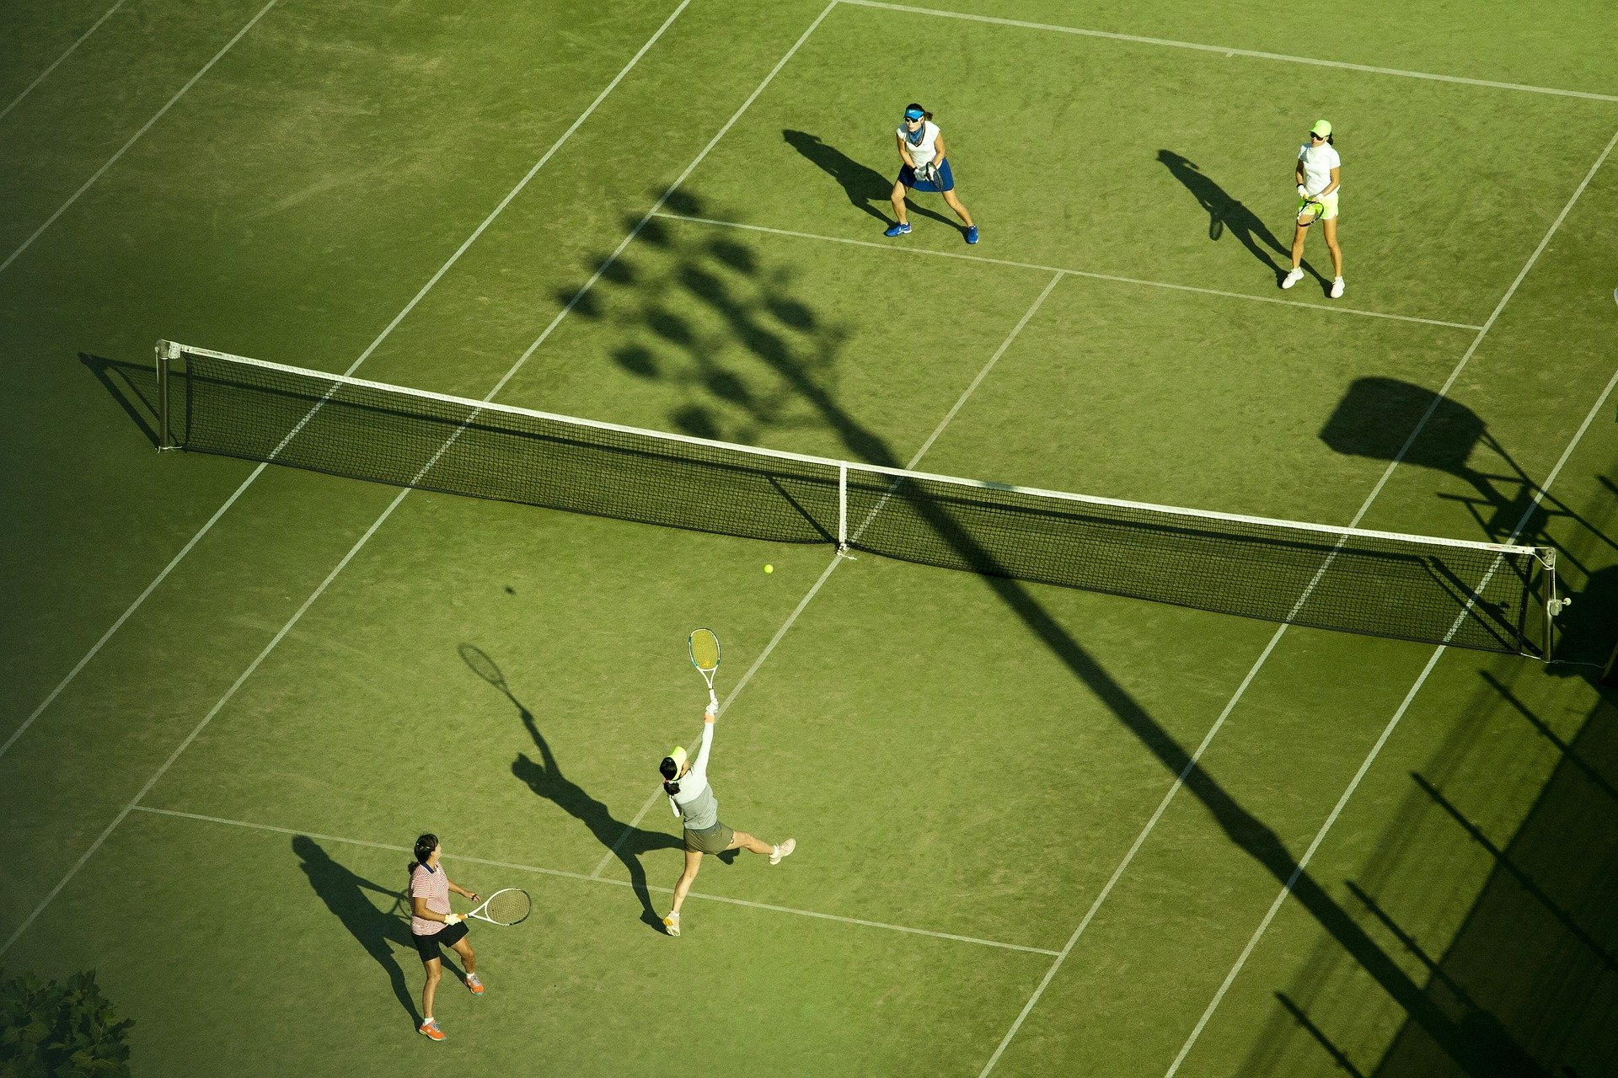
What am I looking at?
Tennis
Reveal Answer

Slide 4
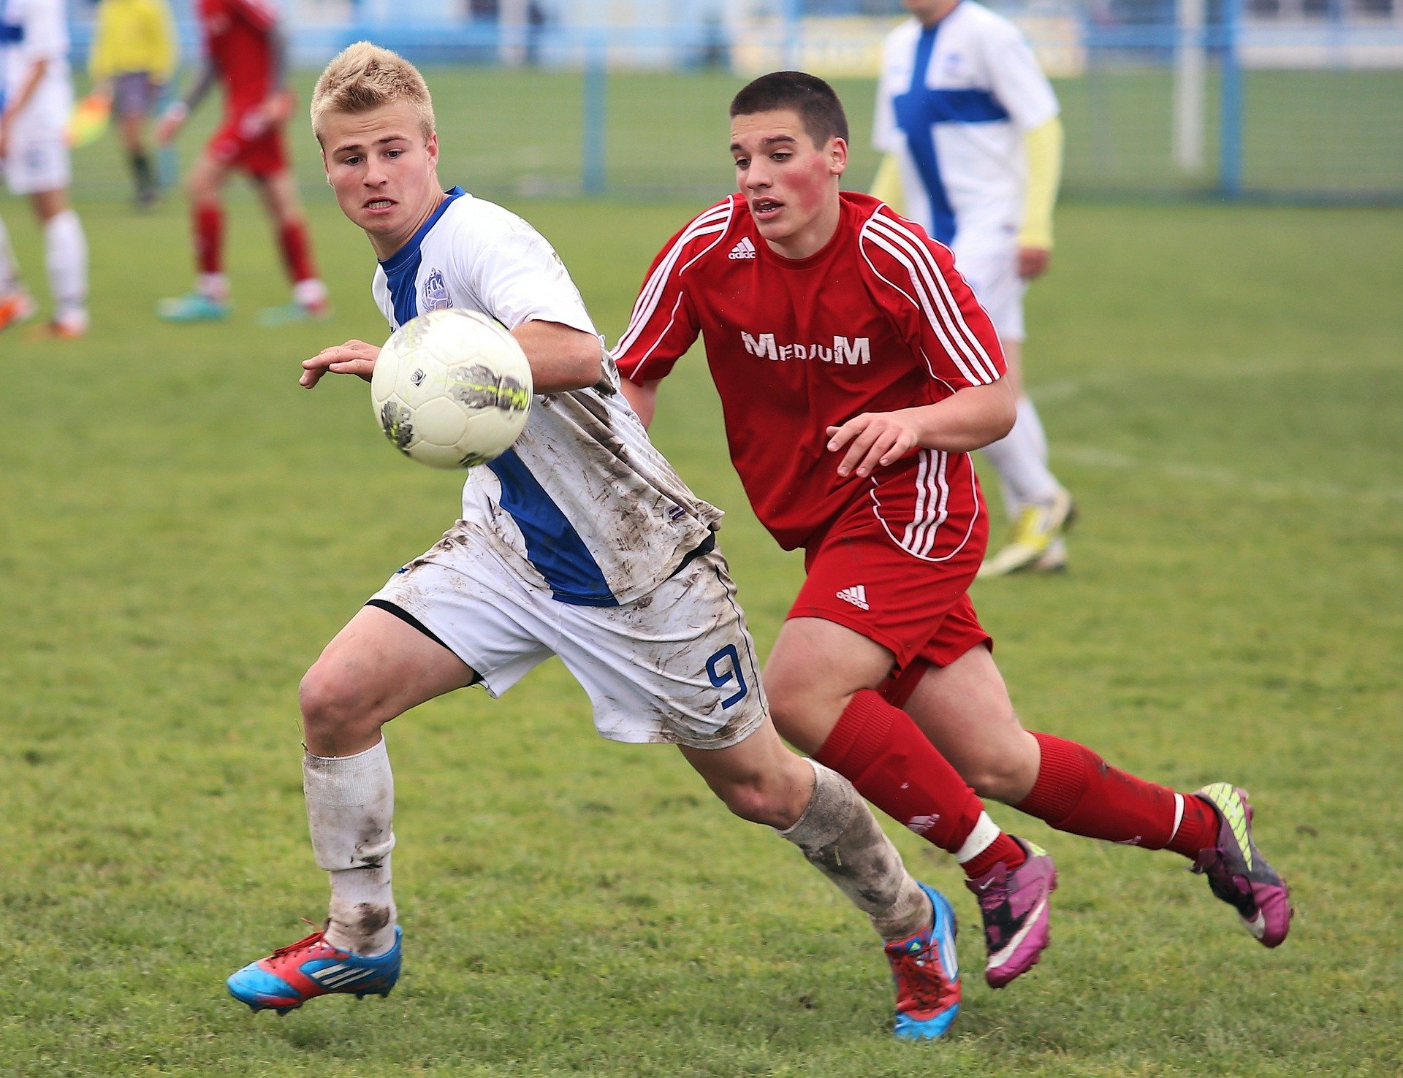
What am I looking at?
Football
Reveal Answer

Slide 5
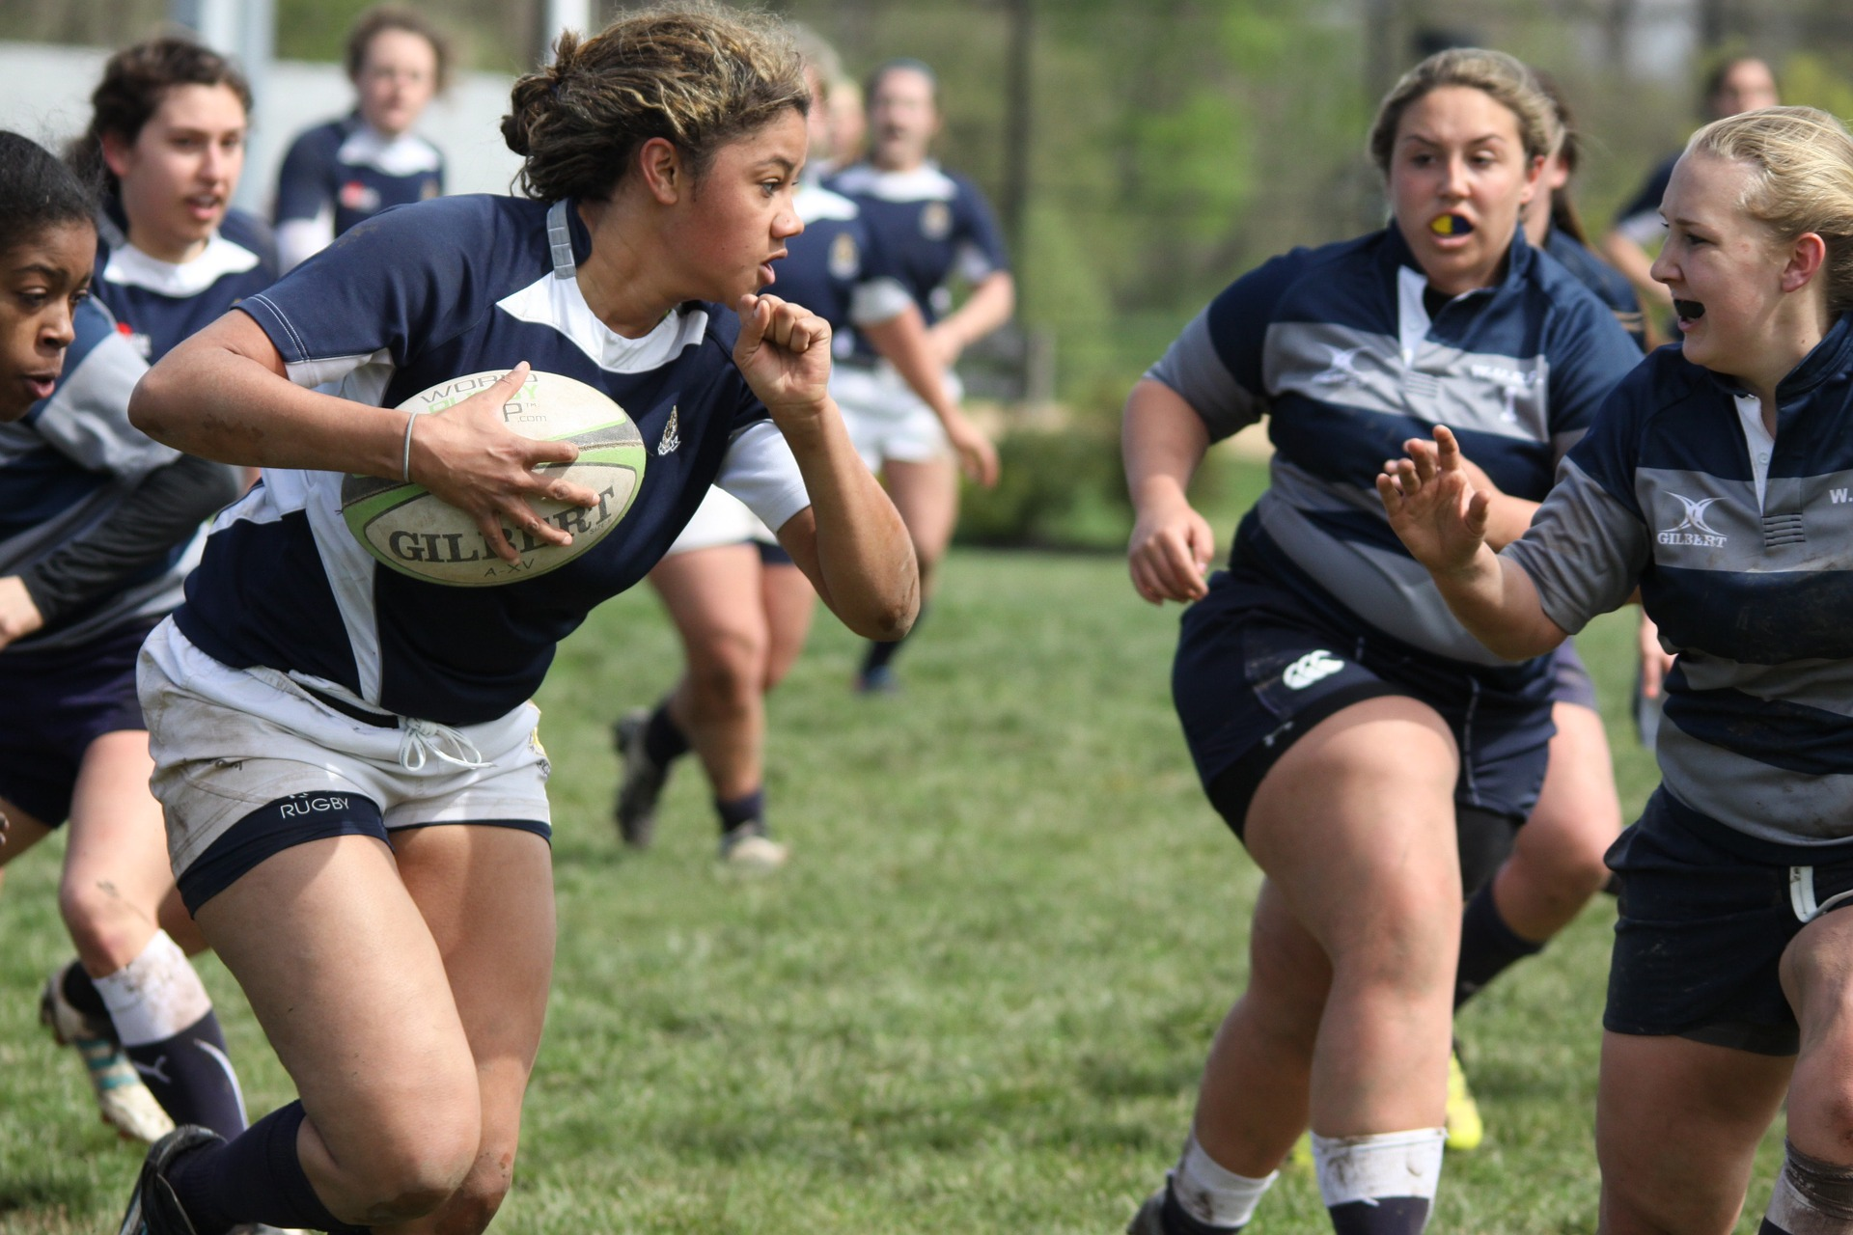
What am I looking at?
Rugby
Reveal Answer

Slide 6
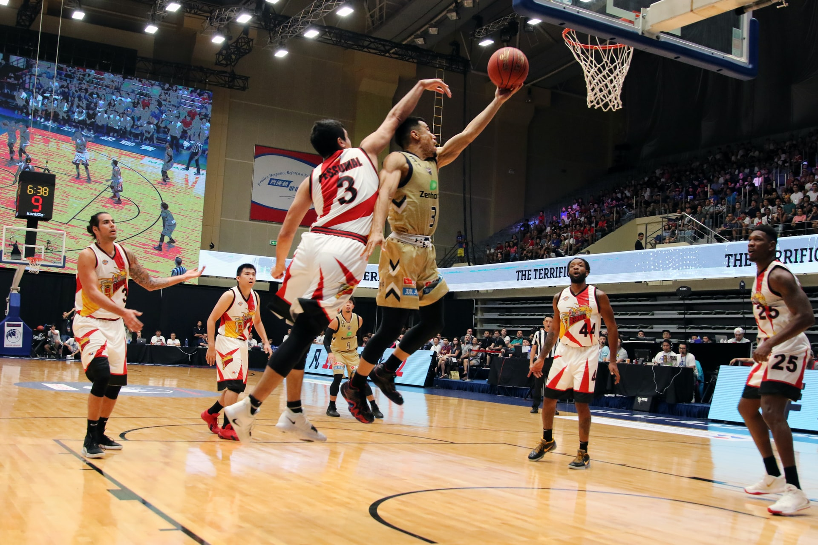
What am I looking at?
Basketball
Reveal Answer

Slide 7
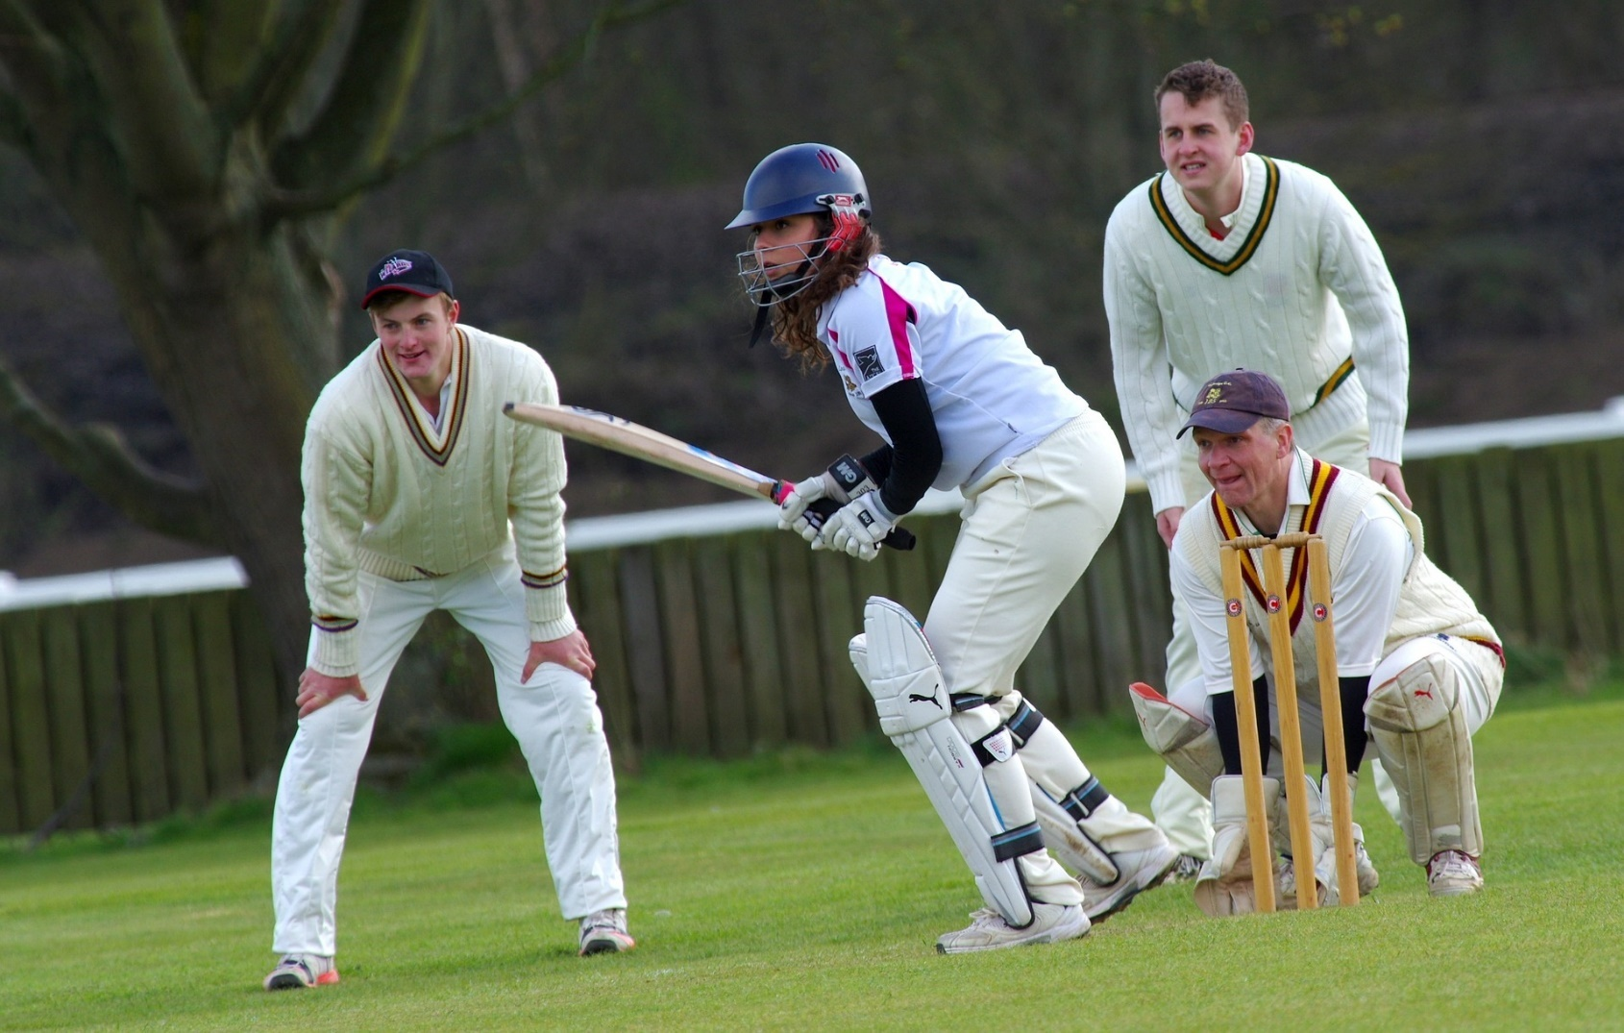
What am I looking at?
Cricket
Reveal Answer

Slide 8
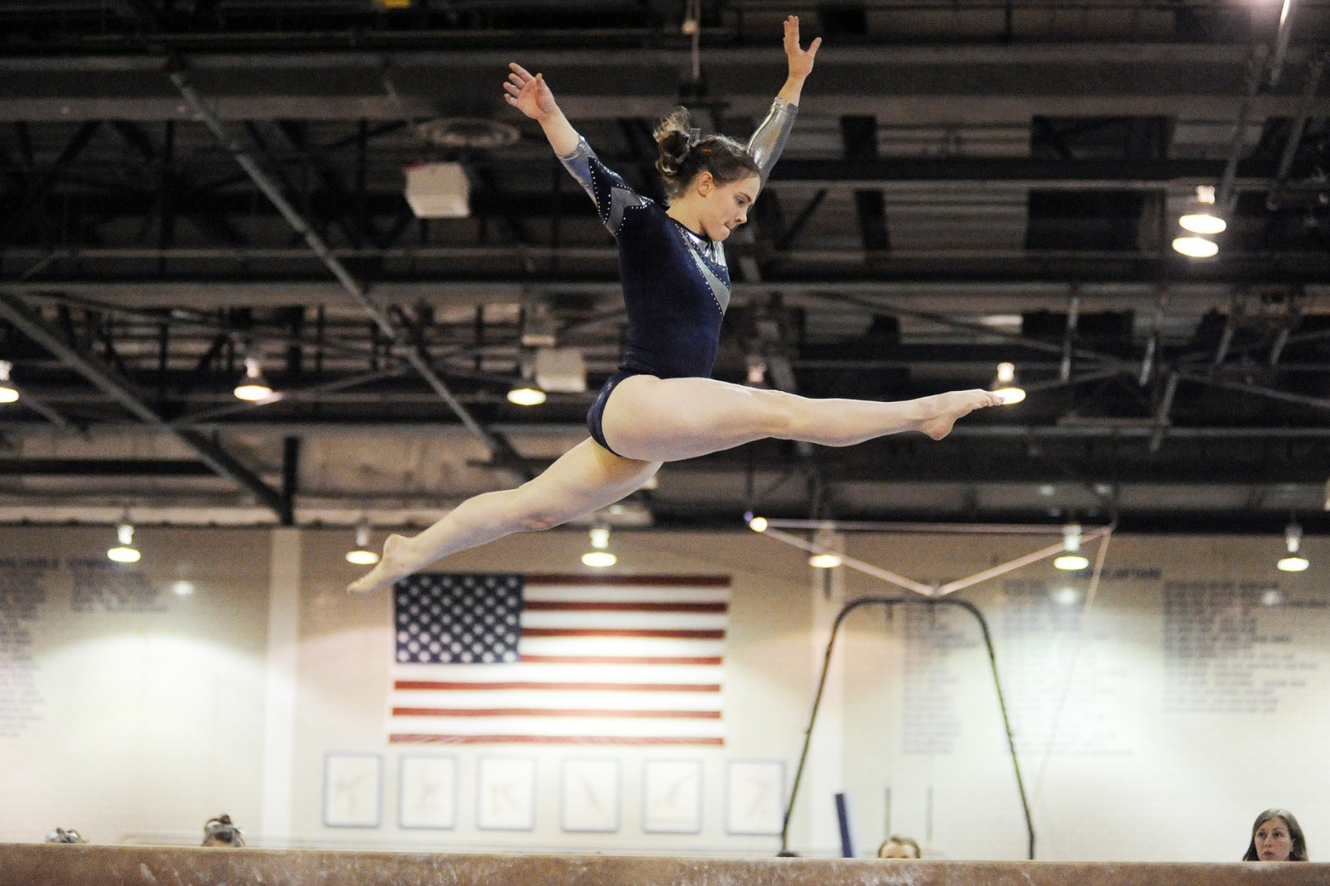
What am I looking at?
Gymnastics
Reveal Answer

Slide 9
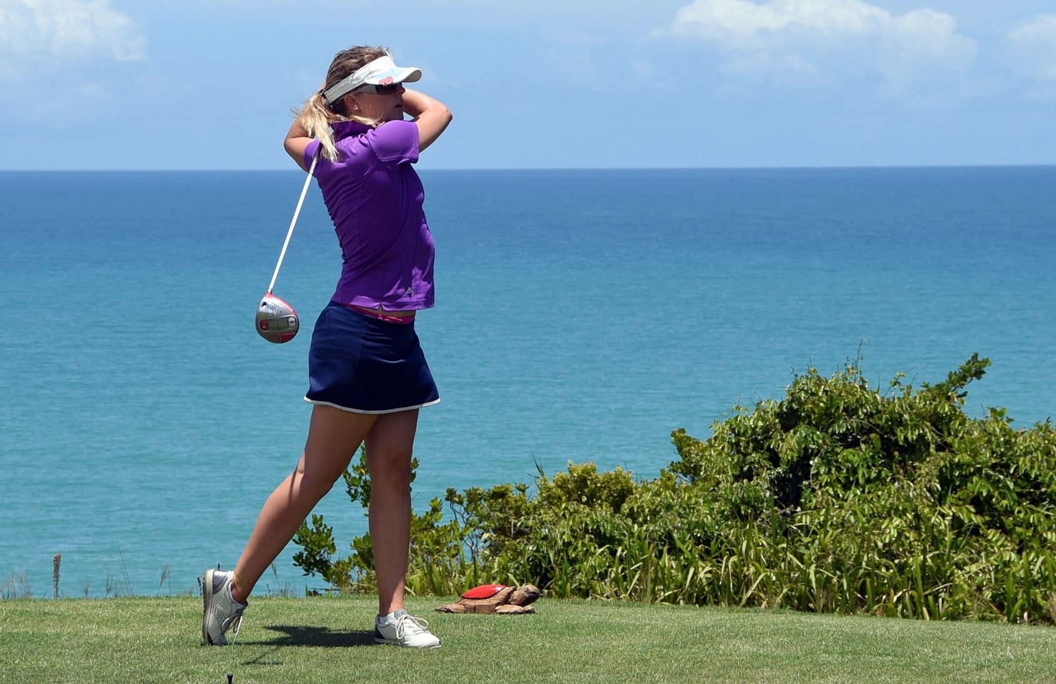
What am I looking at?
Golf
Reveal Answer

Slide 10
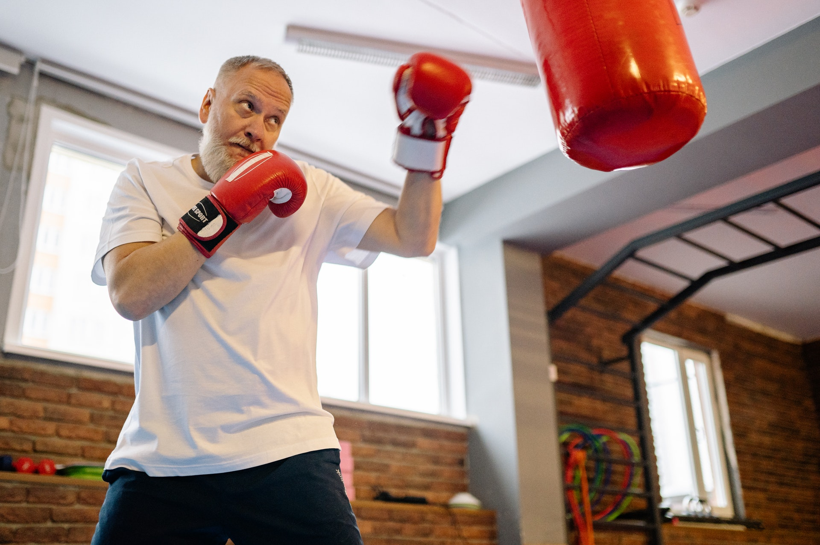
What am I looking at?
Boxing
Reveal Answer

Slide 11
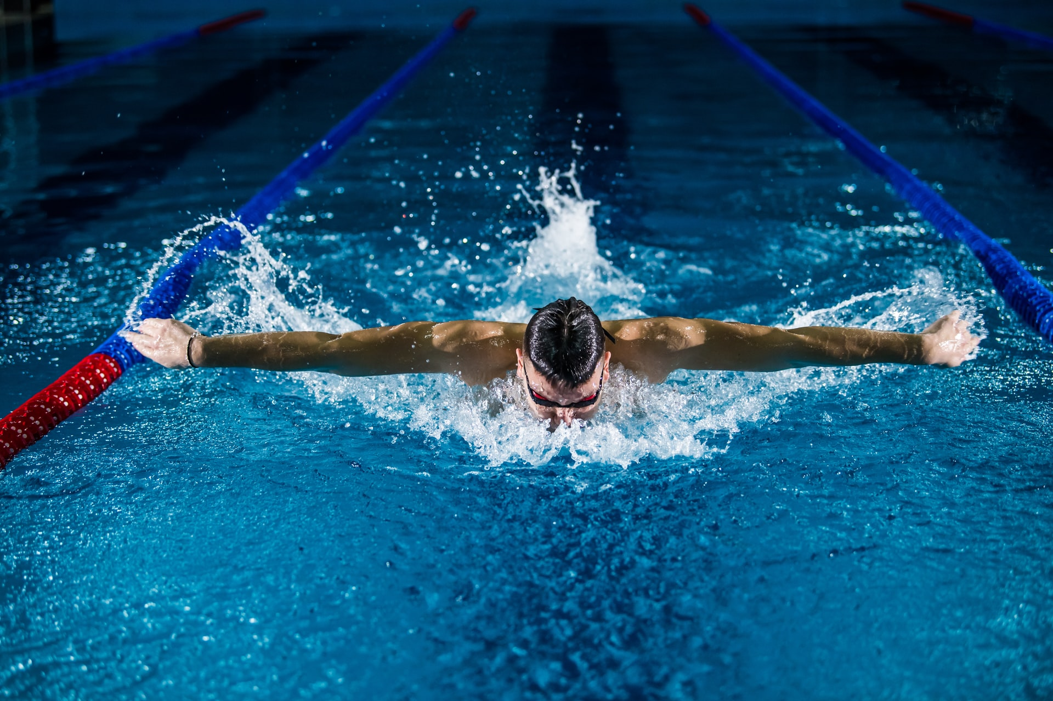
What am I looking at?
Swimming
Reveal Answer

Slide 12
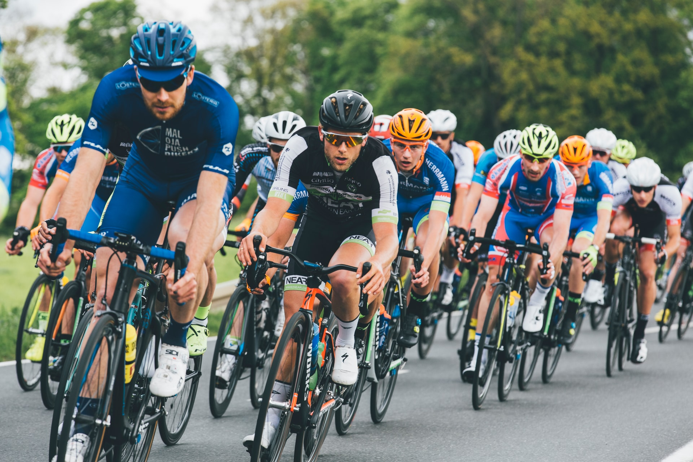
What am I looking at?
Cycling
Reveal Answer

Slide 13
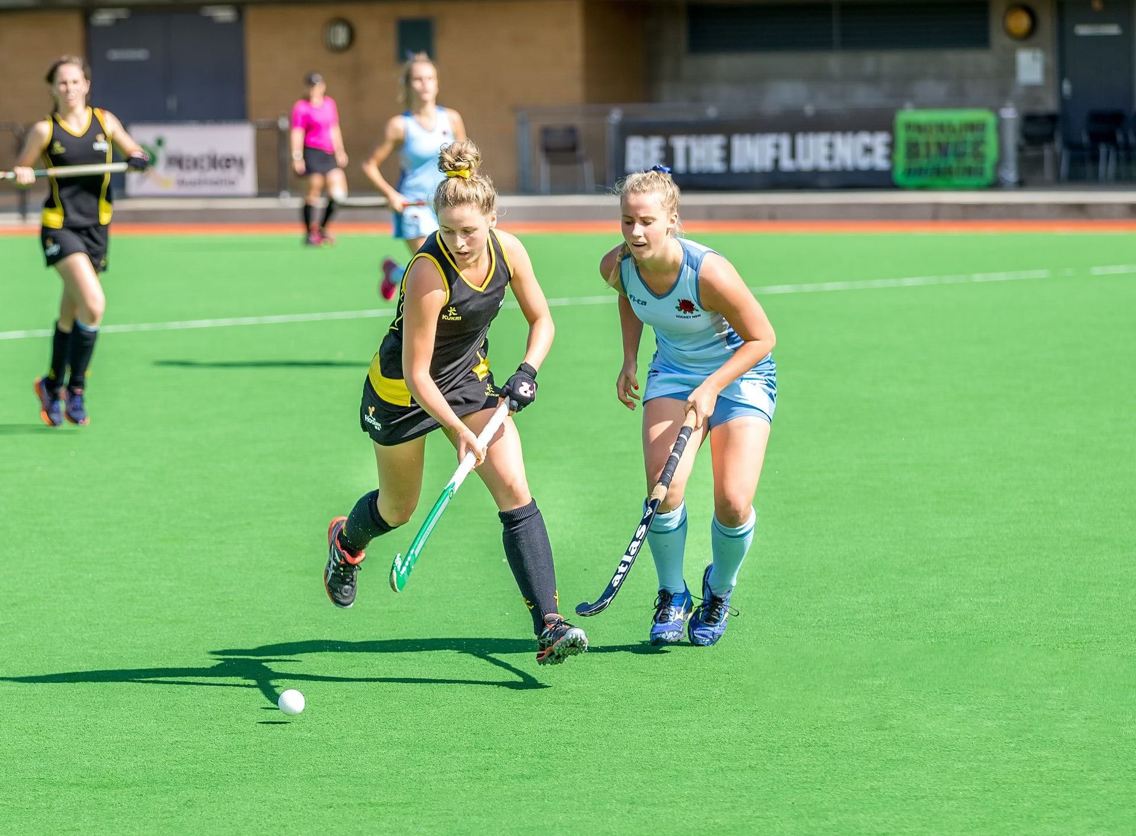
What am I looking at?
Hockey
Reveal Answer

Slide 14
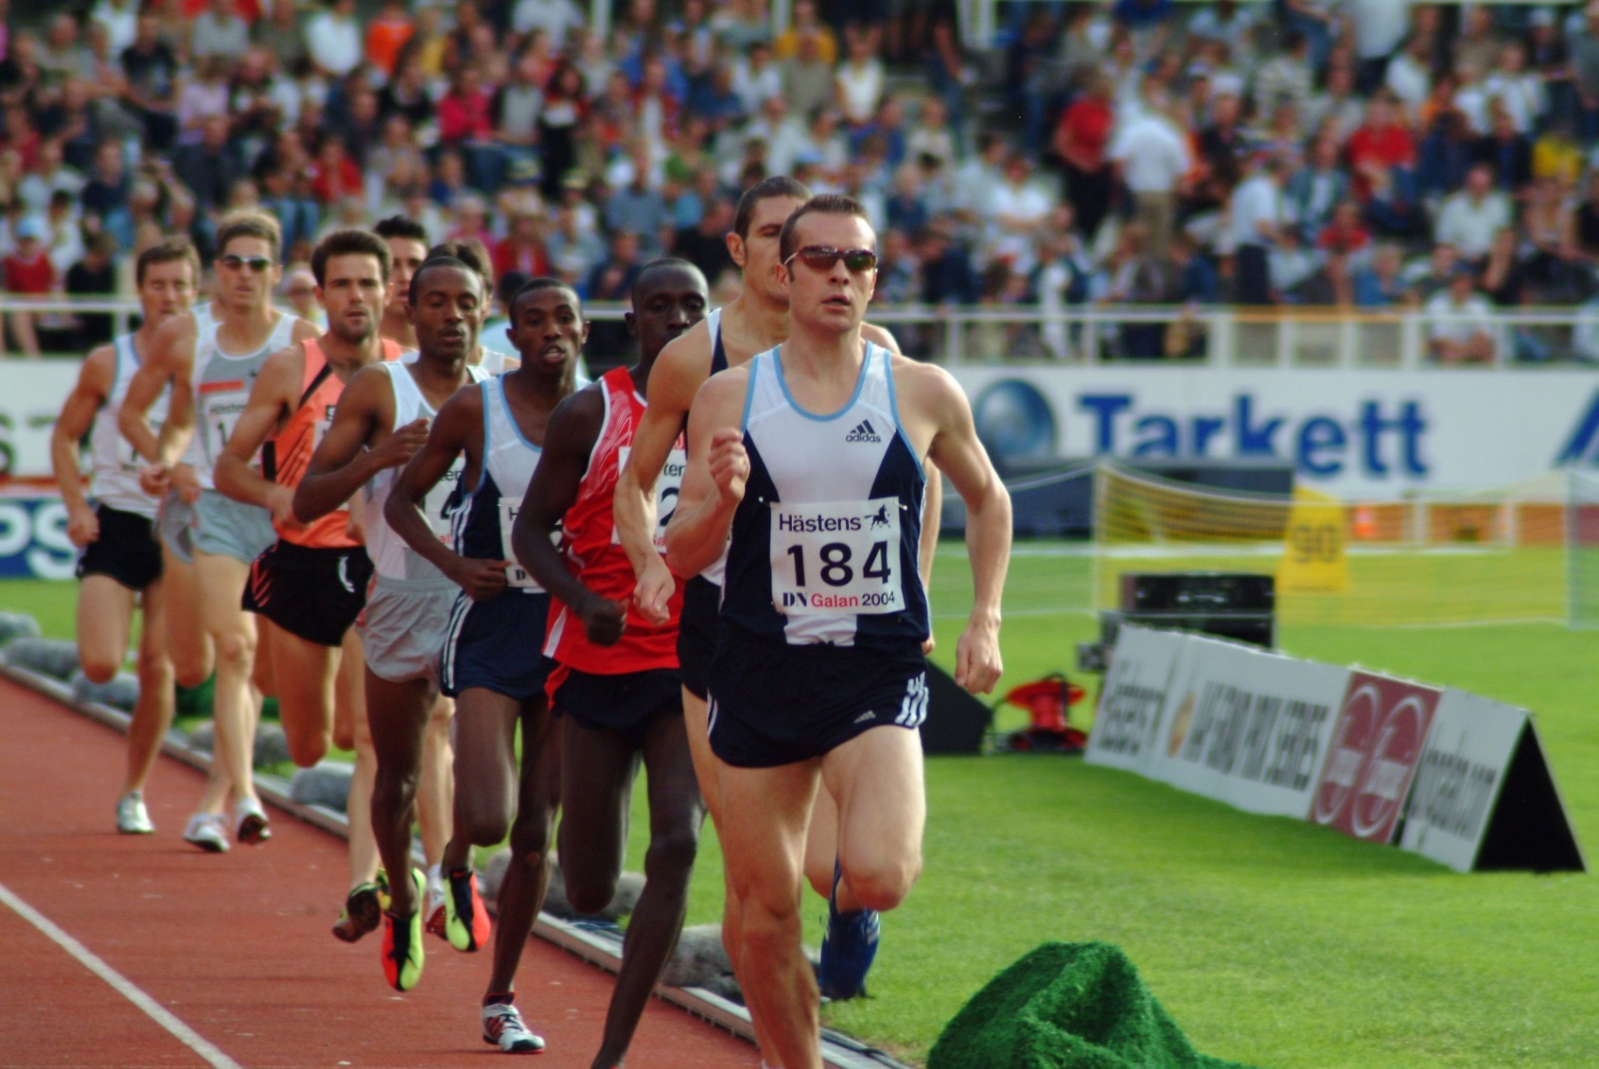
What am I looking at?
Running
Reveal Answer

Slide 15
You are so good at identifying sports!
How many of these have you played before?
Maybe you could try and find out about some other sports you could play?

