Slide 1
Disclaimer/s
We hope you find the information on our website and resources useful.
Animations
This resource has been designed with animations to make it as fun and engaging as possible. To view the content in the correct formatting, please view the PowerPoint in ‘slide show mode’. This takes you from desktop to presentation mode. If you view the slides out of ‘slide show mode’, you may find that some of the text and images overlap each other and/or are difficult to read.
To enter slide show mode, go to the slide show menu tab and select either from beginning or from current slide.
You may wish to delete this slide before beginning the presentation.

Slide 3
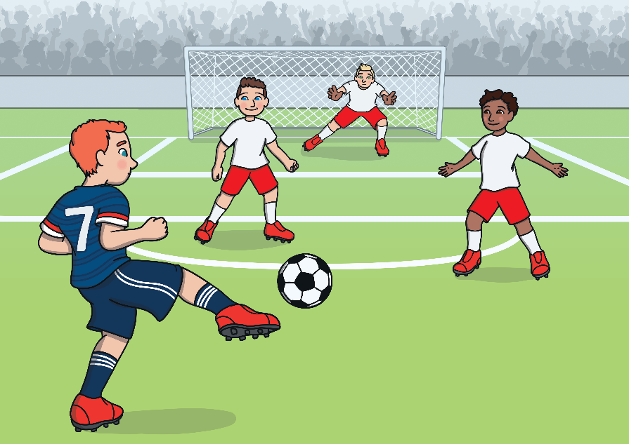
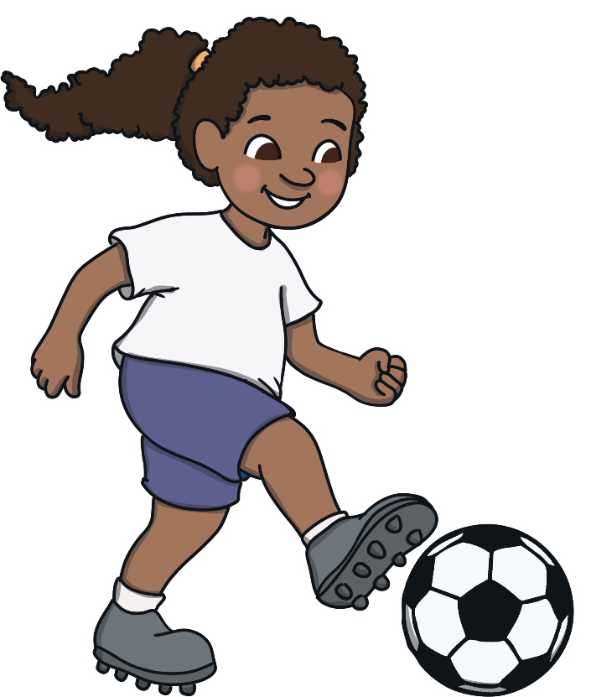
What Is Football?
Football is a sport which is played with two teams and one ball. Each team has to try and get the ball into the other team’s goal.
They work as a team to pass the ball using different parts of their bodies, apart from their arms and hands.
When the ball goes into the net, it is called scoring a goal. The team with the most goals wins.
Have you ever played football? Do you support a football team?

Slide 4
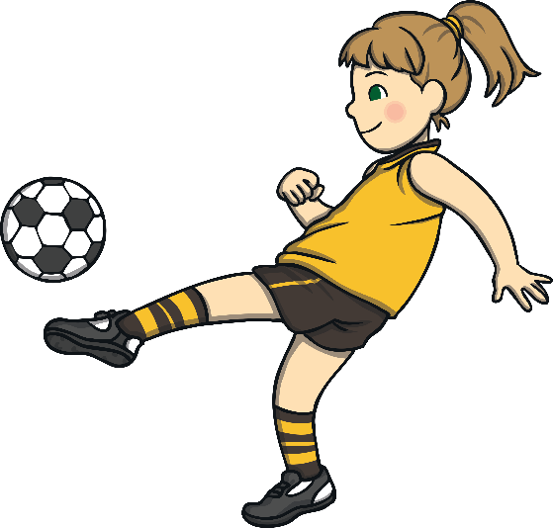
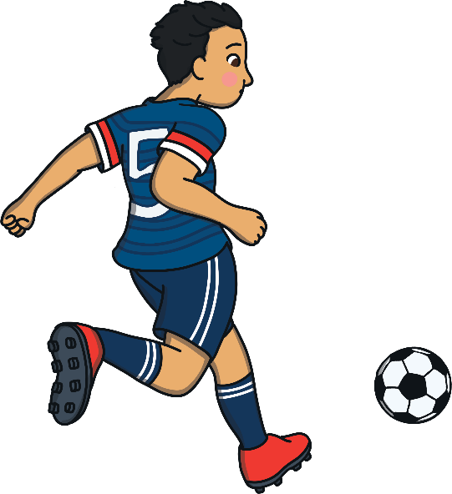
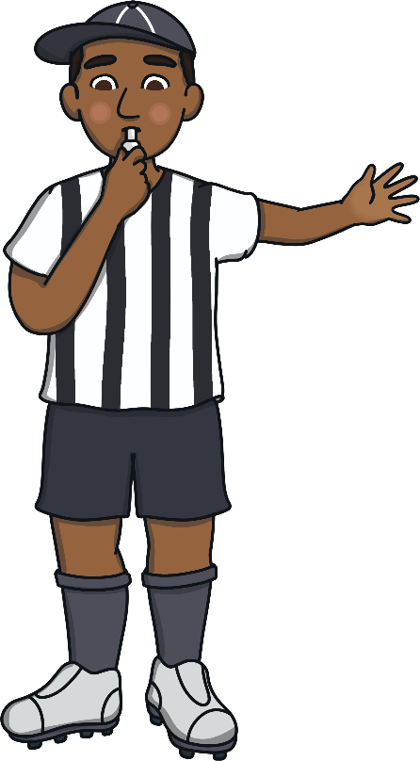

What Is Football?
Each team has their own football kit and they are all different. Some kits might include a special badge or a flag.
Everyone in the team wears the same kit. Wearing the same football kit is really important because it shows which players are part of each team.
There is also a referee in each match. The referee makes sure that both of the teams are following the rules and the game is fair.
If you could create a football kit, what would it look like?

Slide 5
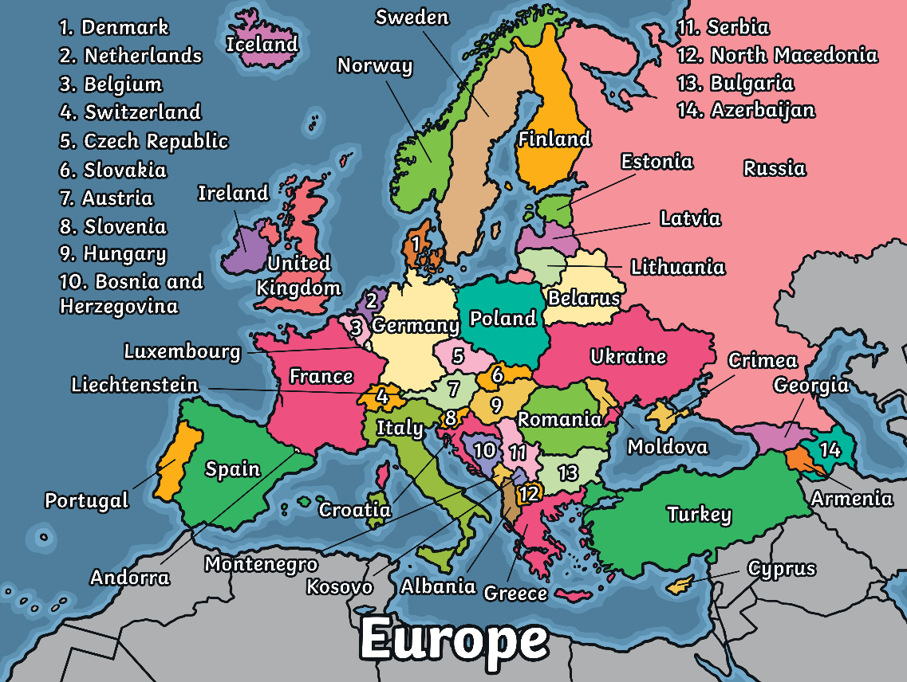
Euro 2020
The European Championship is a football competition. The Men’s European Championship takes place this year and there are 24 teams taking part. The teams represent 24 countries from around Europe.
This map of Europe shows where each team is from. There are three teams from the United Kingdom: Scotland, Wales and England.

Slide 6
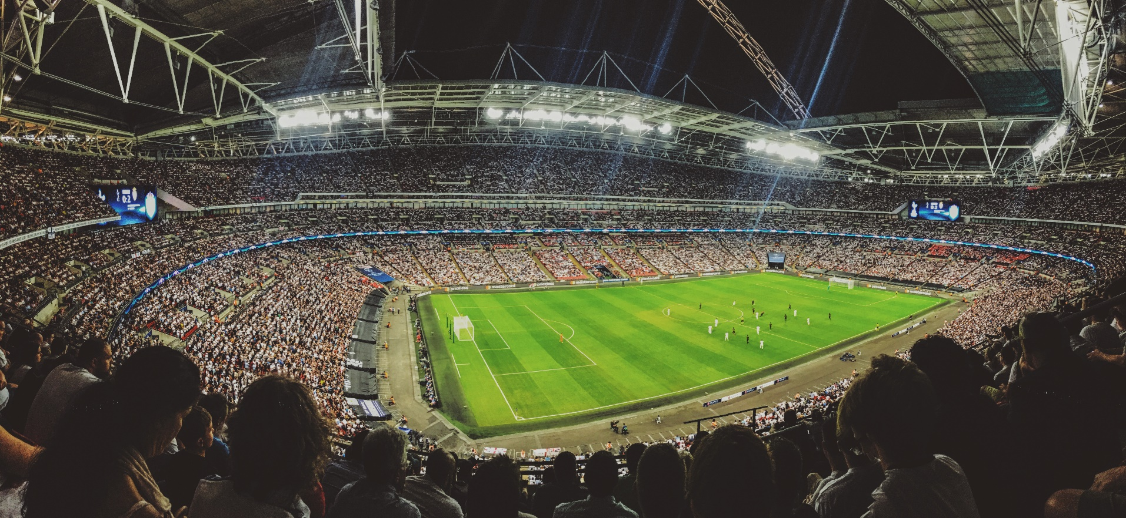
What Happens During the Competition?
The matches will be played inside different stadiums. The final match will be played at Wembley Stadium in London.
What do you think you might hear in this stadium?

Slide 7


What Happens During the Competition?
First, the teams are sorted into groups. There are 24 teams in total and they have been sorted into six groups.
The teams play each other once in their groups. The top teams in each group go through to the next round.
The next round is called the ‘knockout stage.’ Teams are drawn to play against each other. The winner goes through to the next round and the losing team is out of the competition.
When there are only two teams left, it is the final. The team
that wins the final will be the winners of the competition.
They will win the Henri Delaunay Trophy.
How do you think it feels to be a part of the winning team? Have you ever won something?

Slide 8
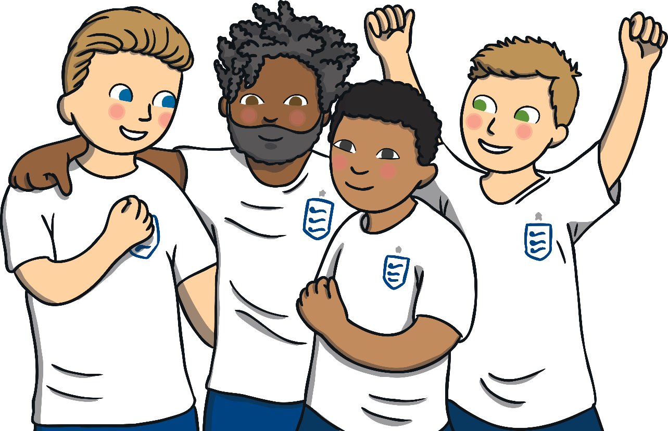
Will You Be Watching?
Lots of people will watch the football matches at home. They might wave flags or wear football shirts to show they support a team.
What do you think people do when their team score a goal?
Can you pretend your team have just scored a goal? What would you do?

