Slide 1

PHONICS
Parents Workshop

Slide 2
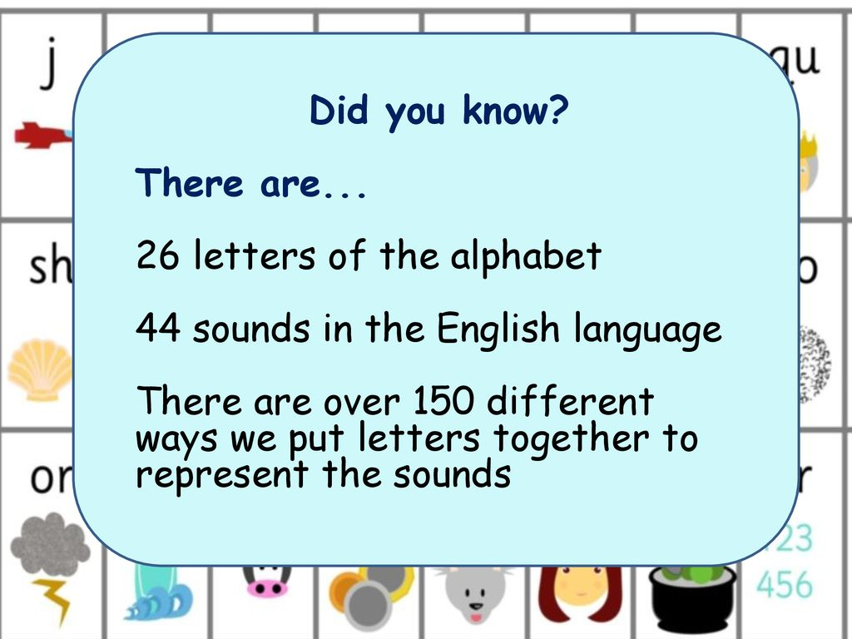

Slide 3
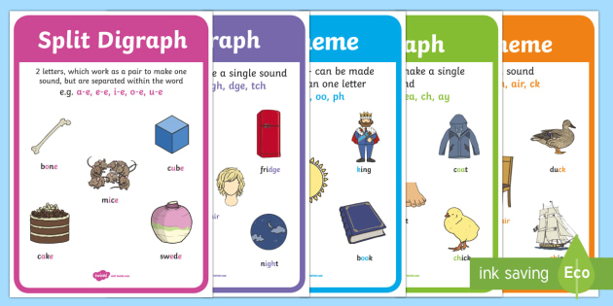
TERMINOLOGY
Letter and Sounds suggest the correct terminology should be used from Year 1 onwards. *
Notes:
Correct terminology should be introduced from YR onwards.
Children do not have a problem using phonic terminology (in fact they are often very proud of their ability to do so).
we wouldn’t teach 3-D shapes to children and using the word ‘ball’ instead of ‘sphere’ or ‘box’ instead of cube/cuboid.
Using phonic terminology from the outset ensures accuracy and promotes shared understanding between practitioners and practitioners and children.

Slide 4

PHONEME
A phoneme is the smallest unit of
sound in a word.
C-u-p c-a-t d-o-g

Slide 5
DIAGRAPH
2
Two letters, which make one sound
A consonant digraph contains two consonants
sh ck th ll
A vowel digraph contains at least one vowel
ai ee ar oy

Slide 6
TRIGRAPH
3
Three letters, which make one sound.
igh dge

Slide 7
GRAPHEME
A way of writing down a phoneme. Graphemes can be made up from:
1 letter e.g. p
2 letters e.g.sh
3 letters e.g. tch
4 letters e.g ough.

Slide 8
GPC
This is short for Grapheme Phoneme Correspondence. Knowing a GPC means being able to match a phoneme to a grapheme and vice versa.

Slide 9
ORAL BLENDING V BLENDING
Blending
This involves looking at a written word, looking at each grapheme and using knowledge of GPCs to work out which phoneme each grapheme represents and then merging these phonemes together to make a word. This is the basis of reading.
Oral Blending
This involves hearing phonemes and being able to merge them together to make a word. Children need to develop this skill before they will be able to blend written words.

Slide 10
ORAL SEGMENTING V SEGMENTING
Oral Segmenting
This is the act hearing a whole word and then splitting it up into the phonemes that make it. Children need to develop this skill before they will be able to segment words to spell them.
Segmenting
This involves hearing a word, splitting it up into the phonemes that make it, using knowledge of GPCs to work out which graphemes represent those phonemes and then writing those graphemes down in the right order. This is the basis of spelling.

Slide 11
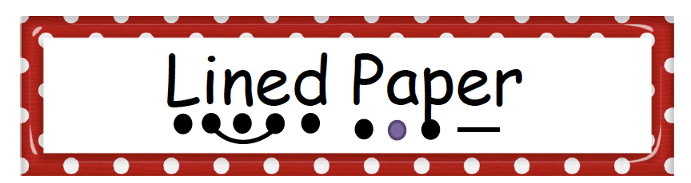
SOUND BUTTONS

Slide 12
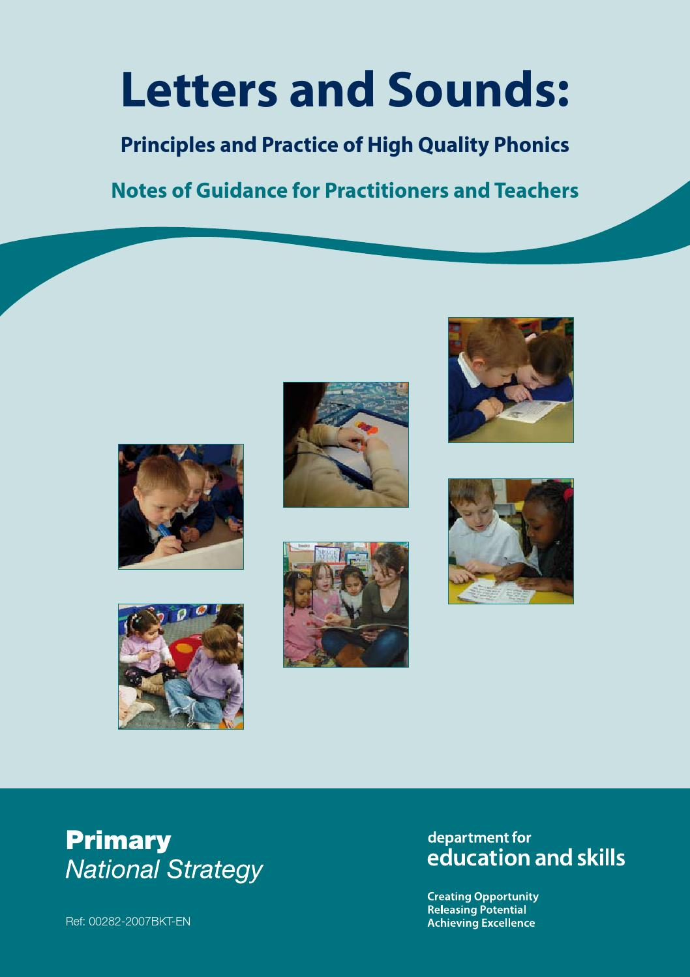
LETTERS AND SOUNDS
At Holy Trinity we use the Letters and Sounds scheme.
It is split into 6 phases and provides a breakdown as to what to do in each stage.
https://assets.publishing.service.gov.uk/government/uploads/system/uploads/attachment_data/file/190599/Letters_and_Sounds_-_DFES-00281-2007.pdf
Notes:
Some schools do not follow the ‘Letters and Sounds’ scheme or they supplement it using other phonics schemes.
Examples include ‘Letterland’, ‘Jolly Phonics’ and ‘Read Write Inc.’.
All these schemes have the same ultimate aim, which is to use a synthetic phonics approach to teach children to read quickly, fluently and with understanding.

Slide 13

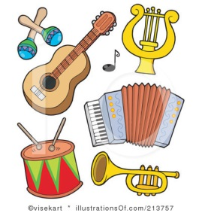
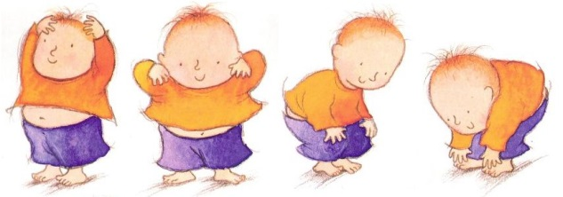
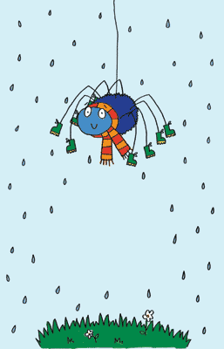

PHASE 1
Crucial phase in developing speaking and listening skills and phonological awareness
Paves the way for a systematic phonics programme to begin
Continues well beyond the introduction of phase 2
Needs to be shared with parents and carers
Vital for all children including those with special educational needs and those learning English as an additional language
Notes:
Point out the vital importance of phase 1 in developing speaking and listening skills and phonological awareness and explain how it ‘paves the way’ for a phonic programme to begin.
Remind practitioners that phase 1 continues well beyond the introduction of phase 2.
Talk about the necessity of sharing this vital stage in children’s literacy development with parents and encouraging parents to promote children’s speaking and listening skills.
Remind staff that they need to think constantly about early intervention for children with special educational needs (SEN) or children learning English as an additional language (EAL).

Slide 14
Phase 1 has seven aspects, with a focus on listening skills.
Aspect 1: Environmental sounds
Stories – Walk around local area
Aspect 2: Instrumental sounds
Bag of instruments – Add sound effects
Aspect 3: Body percussion
Action songs and rhymes
Aspect 4: Rhythm and rhyme
Rhyming stories – What rhymes with…?
Aspect 5: Alliteration
Having fun with names – Story characters
Aspect 6: Voice sounds
Adding different voices to stories
Aspect 7: Oral blending and segmenting
Robot speech c-a-t and Put it together
Notes:
Environmental sounds – sounds we hear around us every day; listening to and imitating sounds; how to be a good listener. Ideas – make sounds to copy, e.g. sh sh sh, zzzzzz, p-p-p-p; go on a ‘listening walk’ – what can you hear?; talk about how to be a good listener; sing songs that require repetition and response, e.g. ‘Old MacDonald’.
Instrumental sounds – listening to and discriminating the sounds made by different instruments. Ideas – make sounds with a range of different instruments (non-musical instruments such as pots, pans, home-made shakers will all do); play an echo game where children have to copy a rhythm; hide an instrument behind a box or screen and play it, children have to say which instrument you are playing.
Body percussion – using the body to create sounds and follow a song, rhyme or beat. Ideas – sing songs that require actions, such as ‘Wind the Bobbin Up’, ‘Heads, Shoulders, Knees and Toes’, ‘If You’re Happy and You Know It, Clap Your Hands’; pass a body percussion sound around a group, e.g. sit in a circle or opposite one another, take turns to produce a body percussion sound which is then passed on, e.g. tap on shoulders, clap hands, stamp feet.
Rhythm and rhyme – recognising rhythms and rhymes in songs, speech and nursery rhymes. Ideas – sing and chant rhyming songs; read stories with repetition and rhyme, e.g. ‘The Gingerbread Man’, ‘Each Peach Pear Plum’; play a matching game with pictures of rhyming objects, e.g. frog/dog, hat/cat, mouse/house; clap the rhythm of phrases and rhymes or the syllables in words or names; play ‘I Spy’ – ‘I spy, with my little eye, something that rhymes with….’ Example game on next slide.

Slide 15
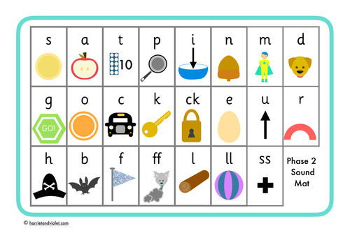
PHASE 2
Introduces 19 grapheme-phoneme correspondences (GPCs)
Decoding and encoding are taught as reversible processes.
Most of the first sounds are single-letter sounds but there are also several digraphs, where one sound is represented by two letters, e.g. ‘ck’, ‘ll’, ‘ss’.
https://www.youtube.com/watch?v=7UulWEhsQgE
Notes:
Children also begin to blend the sounds to make words. By the end of Phase 2, children will be able to read some ‘vowel-consonant’ (vc) and ‘consonant-vowel-consonant’ (cvc) words, e.g. up, in, cat, pin.
VIDEO

Slide 16
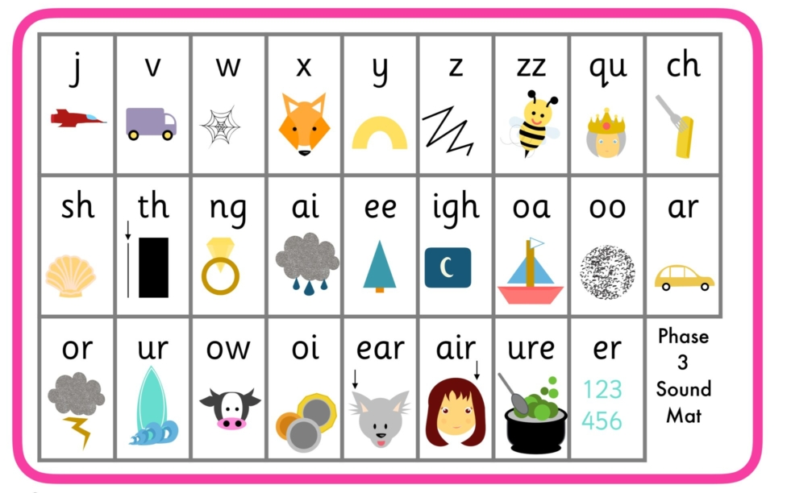
PHASE 3
Children also continue to learn how to blend and segment CVC words using the new sounds, e.g. tail, sheet, night – note that these words still only have three sounds.
Children will then move on to blending and segmenting two-syllable words such as cooker, eating, broken.
Notes:
teaches 25 graphemes
children will be able to represent about 42 phonemes by a grapheme
continue to practice CVC blending and segmentation
application of their knowledge of blending and segmenting to reading
learn to read some more tricky words
learn to spell some of these words

Slide 17
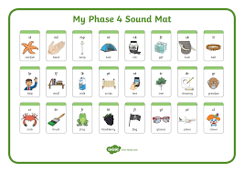
PHASE 4
Phase 4 is about consolidation of the previous phases.
It will increase the children’s knowledge of blending and segmenting by introducing adjacent consonants blends.

Slide 18
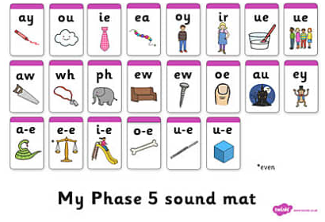
PHASE 5
Alternative Spellings
Same letters, different sounds
e.g. mean, bread, read
Alternative pronunciation
Same sounds, different letters
e.g. may, make, pain
Notes:
Children will broaden their knowledge of graphemes and phonemes.
They will learn alternative ways of spelling the phonemes they have already learnt.
They will learn strategies to help them choose the correct grapheme for spelling.
Children will be reading with more and more fluency, no longer needing to ‘sound out’ most familiar words.

Slide 19
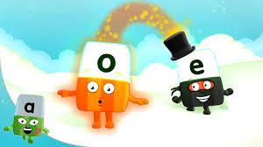

PHASE 5
Split diagraph
A diagraph in which the two letters making the sound are not adjacent.
(e.g. make)
Notes:
Alphablocks magic e

Slide 20

PHASE 6
Phase 6 is mainly taught as children progress through Year 2.
The focus is on spelling patterns such as :
Prefixes and suffixes
Contracted forms of words
Compound words
Common usage words e.g. days of the week
Notes:
At this stage, children can read hundreds of words automatically. They are now reading for pleasure and reading to learn rather than learning to read.
They can decode words quickly and silently and only need to sound out longer or more unfamiliar words.
Children should be able to read the 300 high-frequency words.
At this point, it is important that comprehension strategies are developed so that children clarify meaning, ask and answer questions about the texts that they are reading, construct mental images during reading and summarise what they have read.

Slide 21
TRICKY WORDS V HIGH FREQUENCY WORDS
Tricky words (CEW)
There is a set of tricky words for each phase. They are not decodable using phonics alone.
High Frequency Words
The majority of high frequency words are phonically regular.
Some exceptions – for example the and was – should be directly taught.

Slide 22
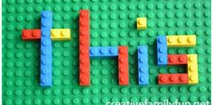
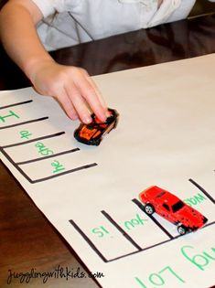
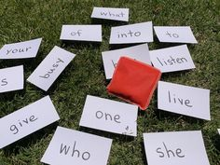
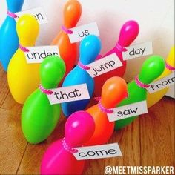
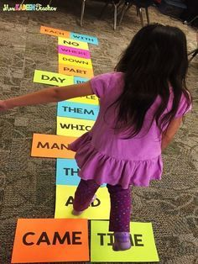
TEACHING TRICKY WORDS
Write the word on paper, cut out each letter and put the word back together.
Write the word three times. Trace over it in different colours.
Look, say, cover, visualise, write, check.
Play bingo with the words.
Small word inside the word
Write the word in a nonsense sentence.
Find words with similar patterns. e.g. the, them, they
Write the word, draw around the shape of the word and cut out.
Can you add ing or s to any words.
Put words into alphabetical order.
Cosmic writing
Write in playdough

Slide 23
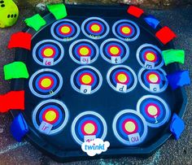
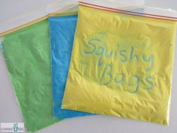
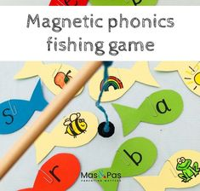
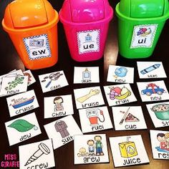
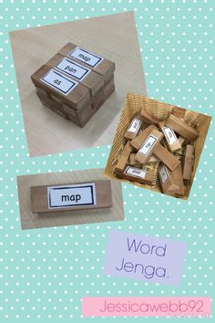
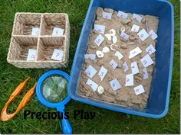
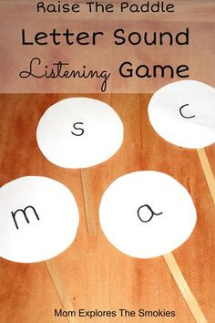
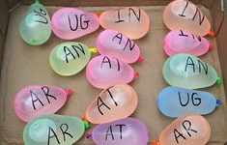
REVISIT AND REVISE
Pass the bag – balls/pebbles/cards with taught phonemes
Grapheme dice
Objects: say the phoneme - show it on a phoneme fan, find the letter, write it on the white board
Beach ball key word recognition
Notes:
Show example activities

Slide 24



RESOURCES
- Phonics Queen
Phonics family
Phonics frolics
Phonics made easy
Physical phonics activities
All things phonics
Notes:
Use document

Slide 25
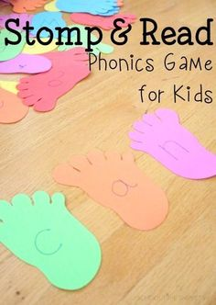
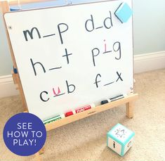
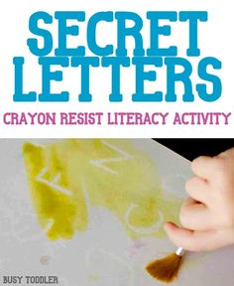
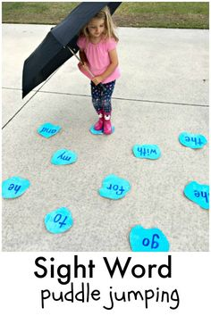
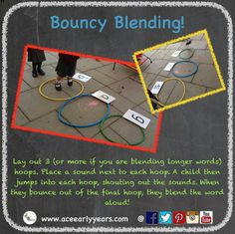
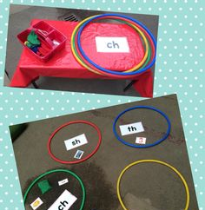
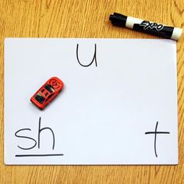
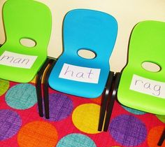
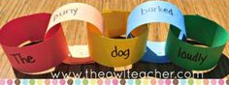
READ/BLEND
SPELL/SEGMENT
Phoneme fingers
Letter tiles make words
Magnetic letters make words
Grapheme pebbles make words
Full circle
Whiteboards – write words, phrase, sentence (link to puppet, story title etc. where possible)
Labels
Signs
Sentences / silly sentences
Reading names
Book titles / using favourite books
Word match using cards and objects
Sound buttons
Captions
Lists
Notes
Letters
Envelope
Instructions
Tabards / full circle
Paired reading of words / word sorts

Slide 26
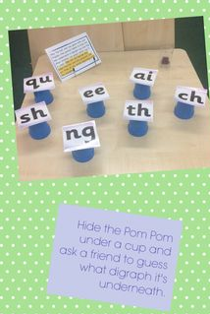
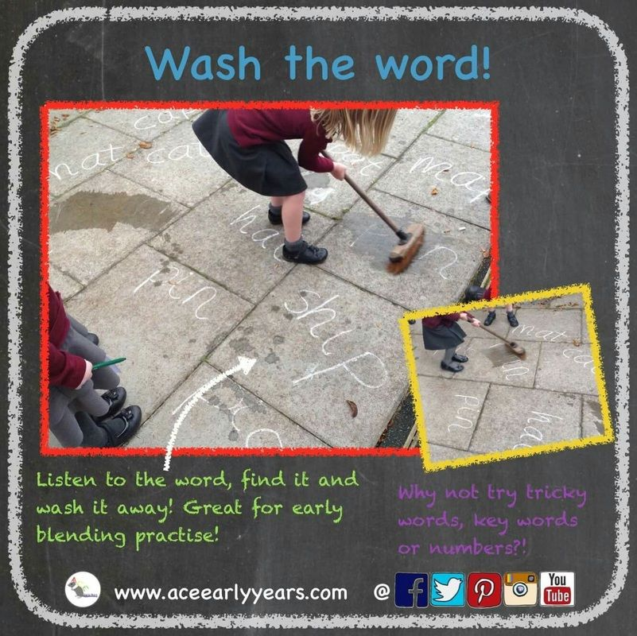
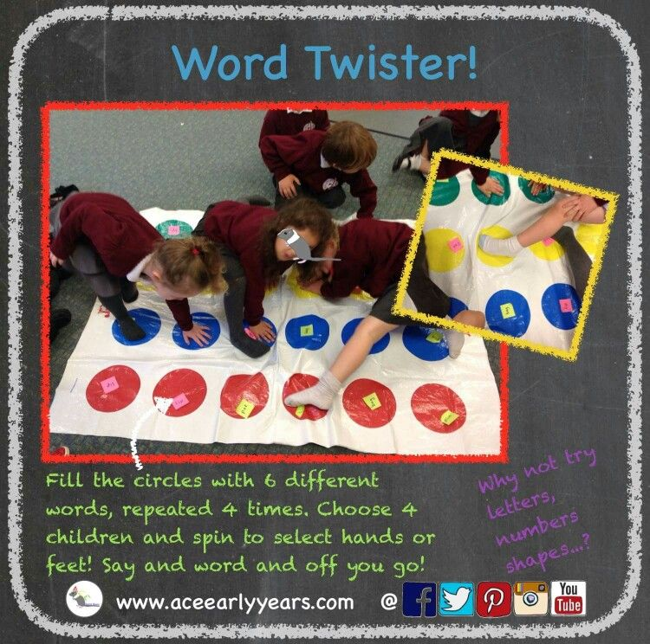
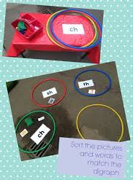
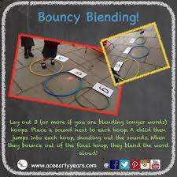
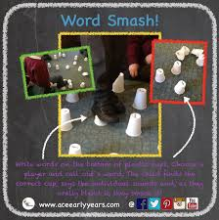
GAMES AND ACTIVITIES
http://www.aceearlyyears.com/

Slide 27

THANK YOU
Notes:
Peer observations
Videos online

