Slide 1

PHONICS
Parents Workshop

Slide 2
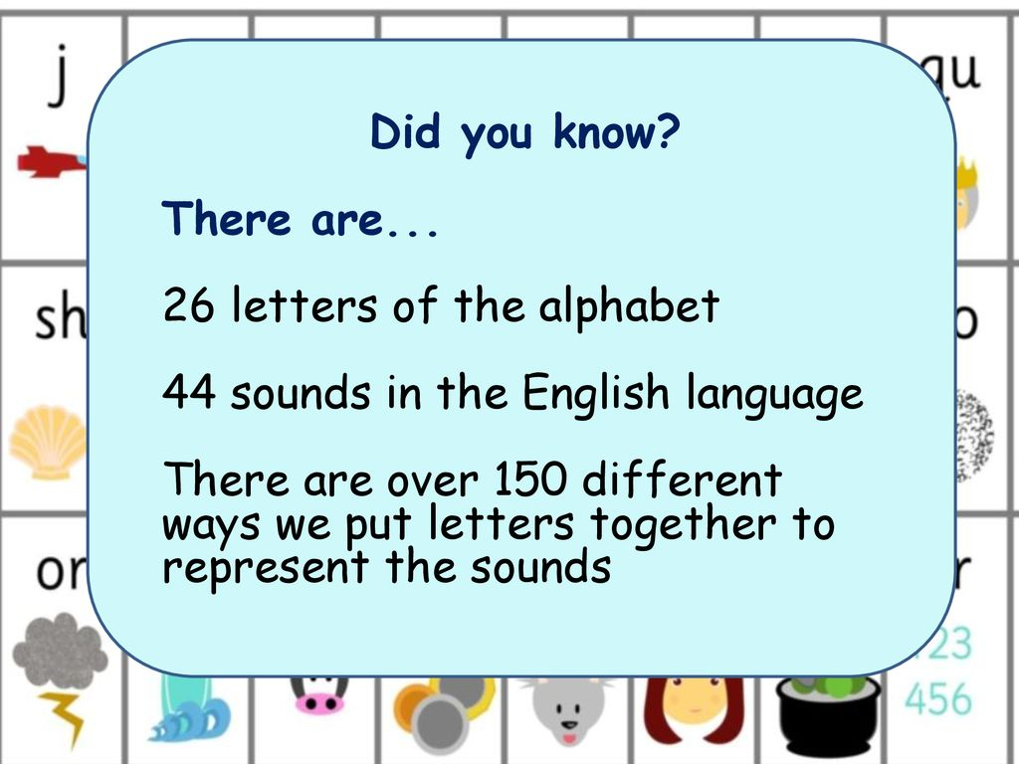
Why do we teach phonics?

Slide 3

Introduction of Phonics Homework
Notes:
Why have we introduced phonics homework?

Slide 4

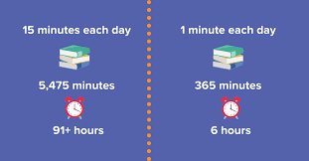
Reading
Notes:
How often should the children be reading?
Why read with your child? Research shows
Builds a stronger relationship with parents, concentration and discipline
Foundation of academic success
Improvement in speech languages
Understanding how to read the book – modelling questioning,

Slide 5
How can you support you child?
Listen to child read daily
Library visits (model an enjoyment reading)
Practise listening skills (phase 1 phonics)
Practising segmenting and blending
Encourage conversation.

Slide 6

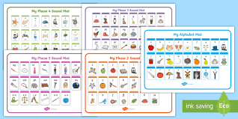
Letters and Sound Phases
At Holy Trinity we use the Letters and Sounds scheme.
It is split into 6 phases and provides a breakdown as to what to do in each stage.
Notes:
Some schools do not follow the ‘Letters and Sounds’ scheme or they supplement it using other phonics schemes.
Examples include ‘Letterland’, ‘Jolly Phonics’ and ‘Read Write Inc.’.
All these schemes have the same ultimate aim, which is to use a synthetic phonics approach to teach children to read quickly, fluently and with understanding.
Discuss the 6 phases, focus on phase 1

Slide 7
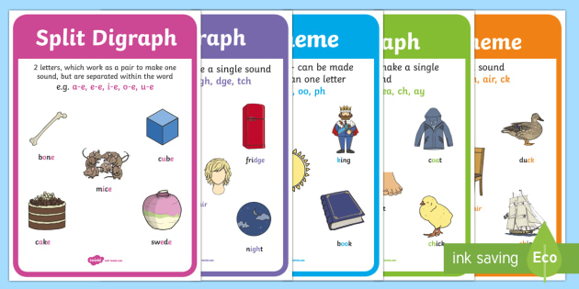
TERMINOLOGY
Letter and Sounds suggest the correct terminology should be used from Year 1 onwards. *
Notes:
Refer to handout

Slide 8

THANK YOU
Notes:
Peer observations
Videos online

