Slide 1
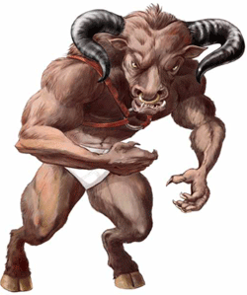
Greek Mythological Beasts

Slide 2
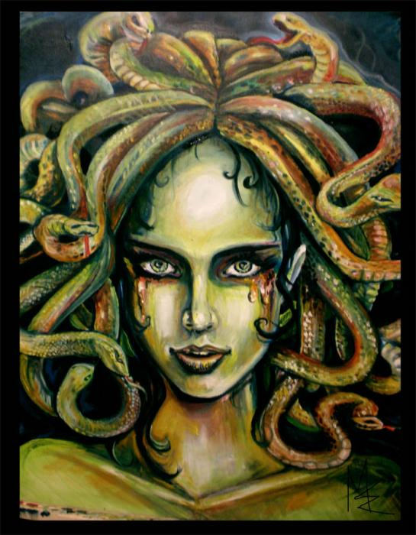
Medusa (med-yoos-uh)
Her hair was a nest of snakes.
Anyone who looked at her was turned to stone.
She was killed by Perseus.

Slide 3
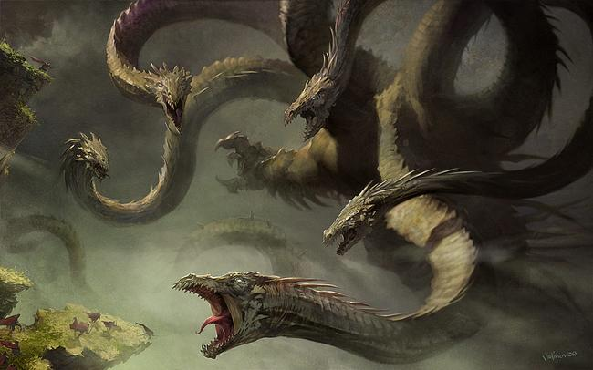
Hydra
It had nine heads.
Each time you cut a head off, two more would grow in its place.
It was killed by Heracles.

Slide 4
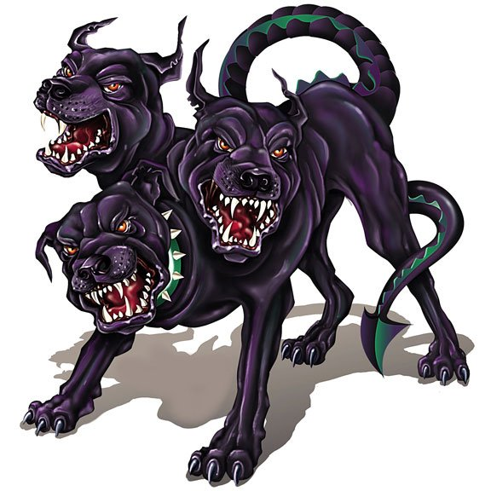
Cerberus (ser-ber-us)
Three-headed dog belonging to Hades.
It guarded the Underworld and stopped the dead from leaving.

Slide 5
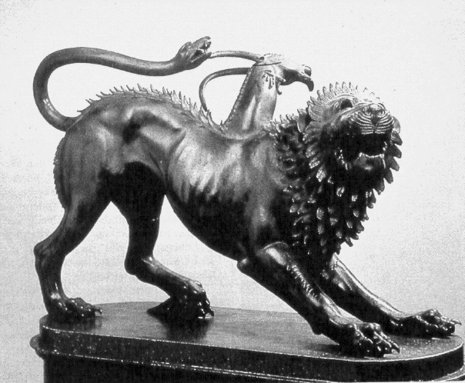
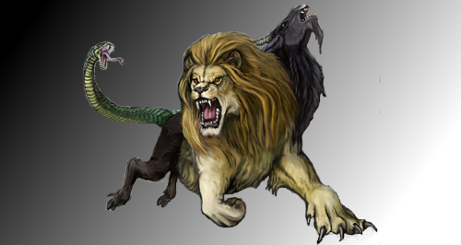
Chimera (ki-meer-uh)
It had the head of a lion, the body of a goat and the tail of a dragon.
It breathed deadly fire.
It was killed by a hero called Bellophron.

Slide 6
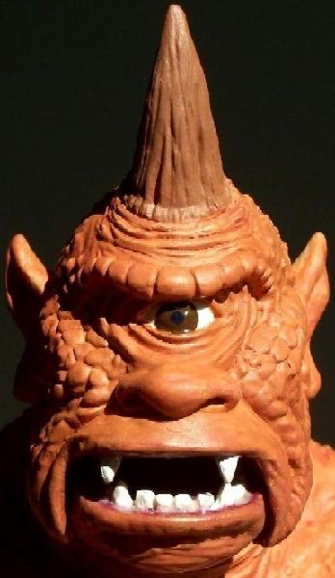
Cyclops
They lived on an island.
They had a single eye in the middle of their forehead.
They ate people who landed on the island.

Slide 7
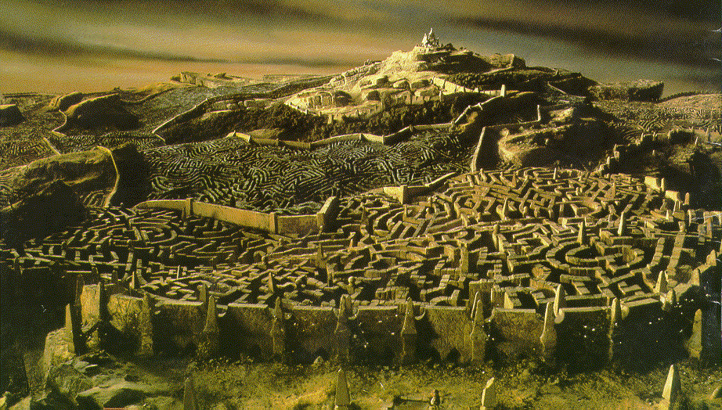
Minotaur
It had the body of a man and the head of a bull.
It lived in a giant labyrinth under King Minos’s palace.
It ate young men and women.

Slide 8
Which is which?
Chimera
Minotaur
Cyclops
Hydra
Medusa
Cerberus

