Slide 1
Maths
To use inverse operations (addition and subtraction).

Slide 2
Instructions
Watch the video on the following slide.
Try to complete the questions on the rest of the slides.
Do your working out on some paper and just add your answers to the slides.

Slide 3

Video link:
https://vimeo.com/461352921

Slide 4
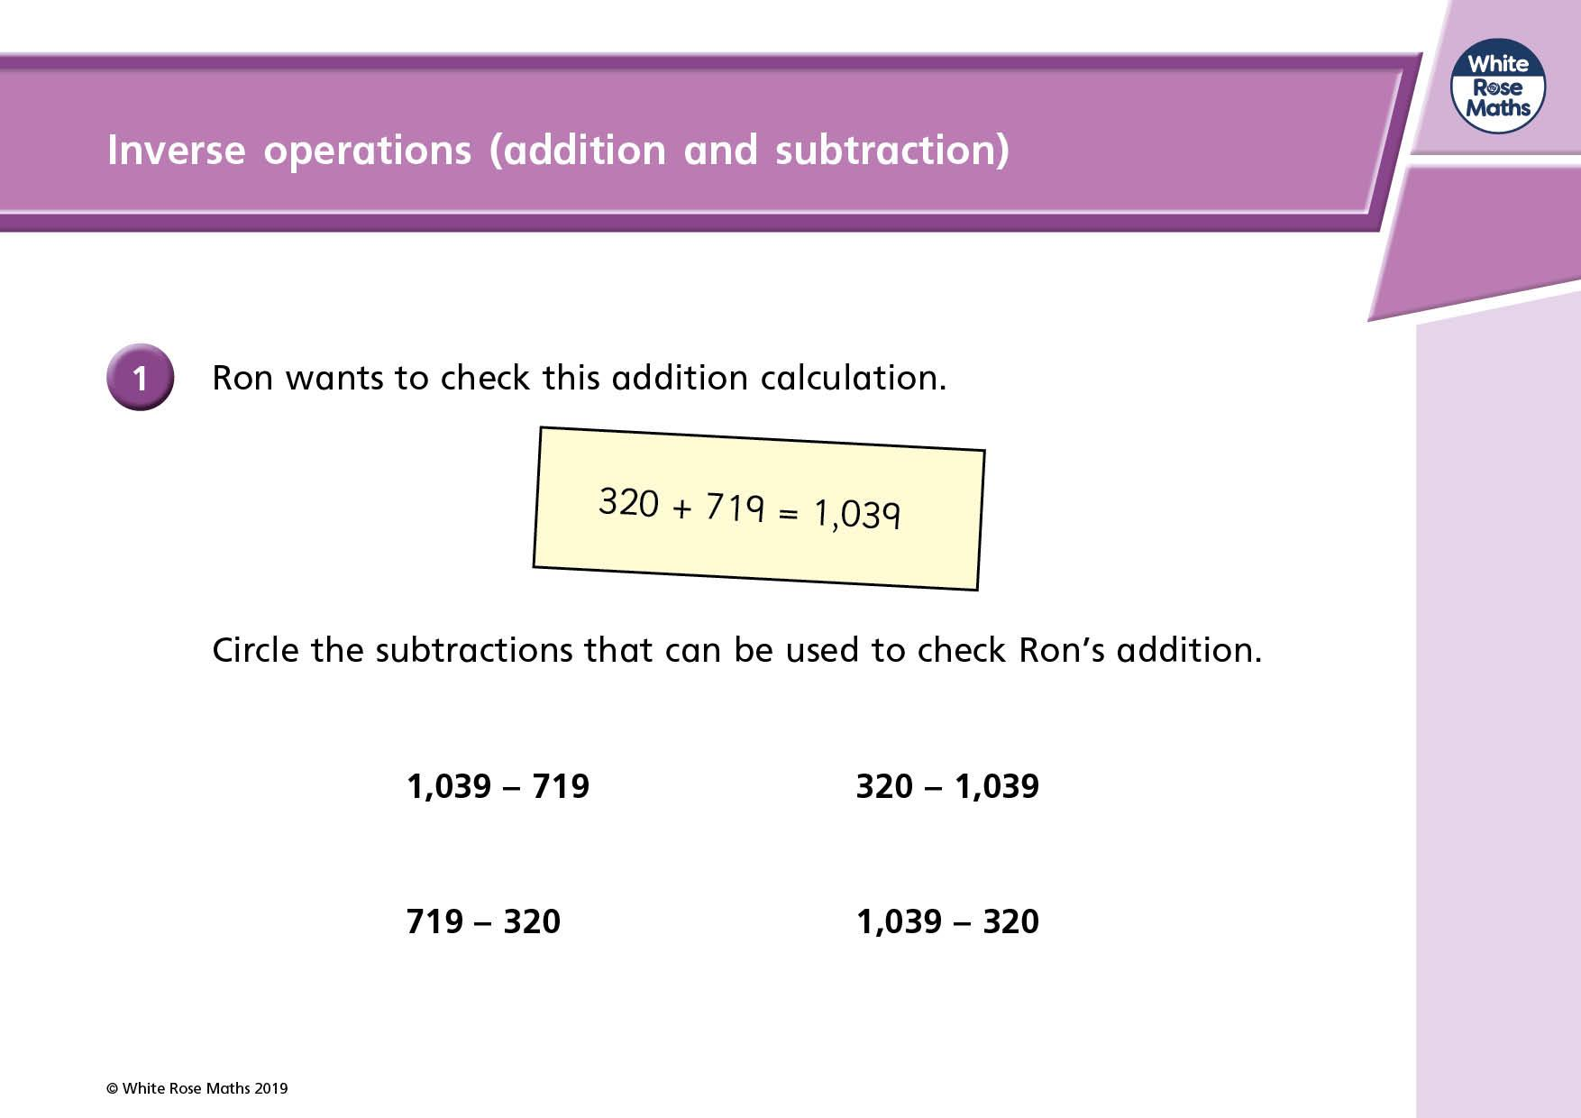

USE
ABOVE TO DRAW CIRCLES

Slide 5
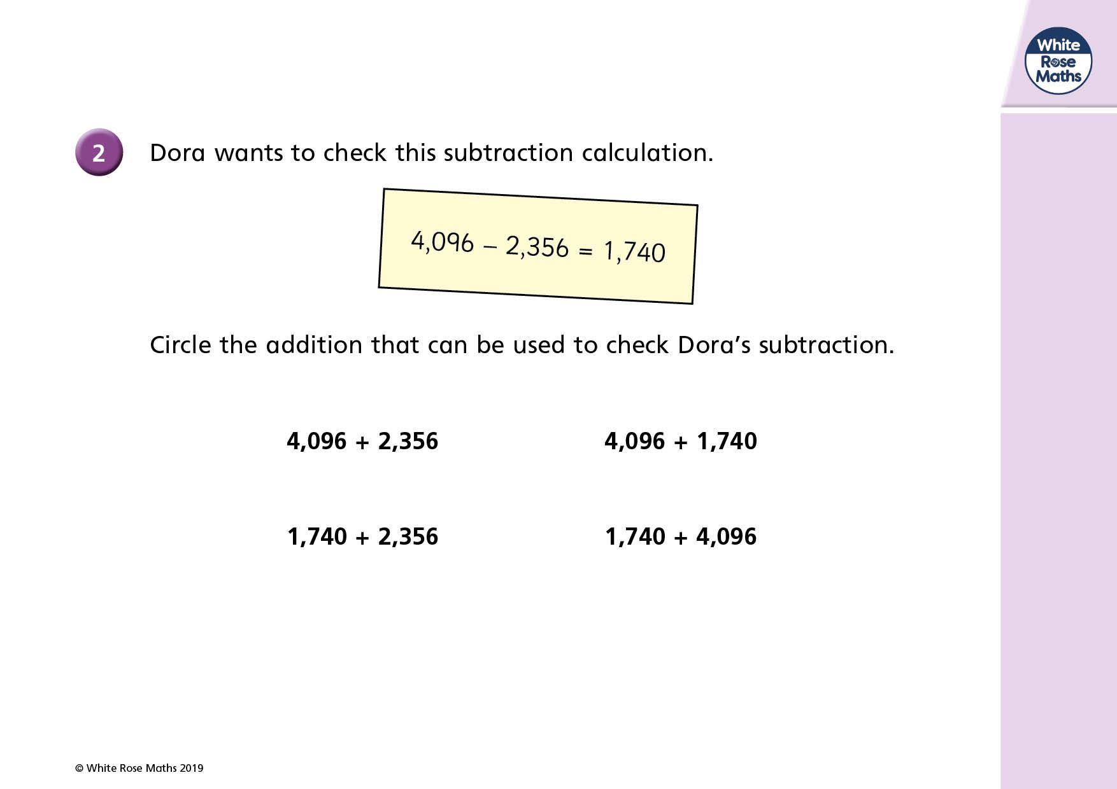
USE
ABOVE TO DRAW CIRCLES

Slide 6
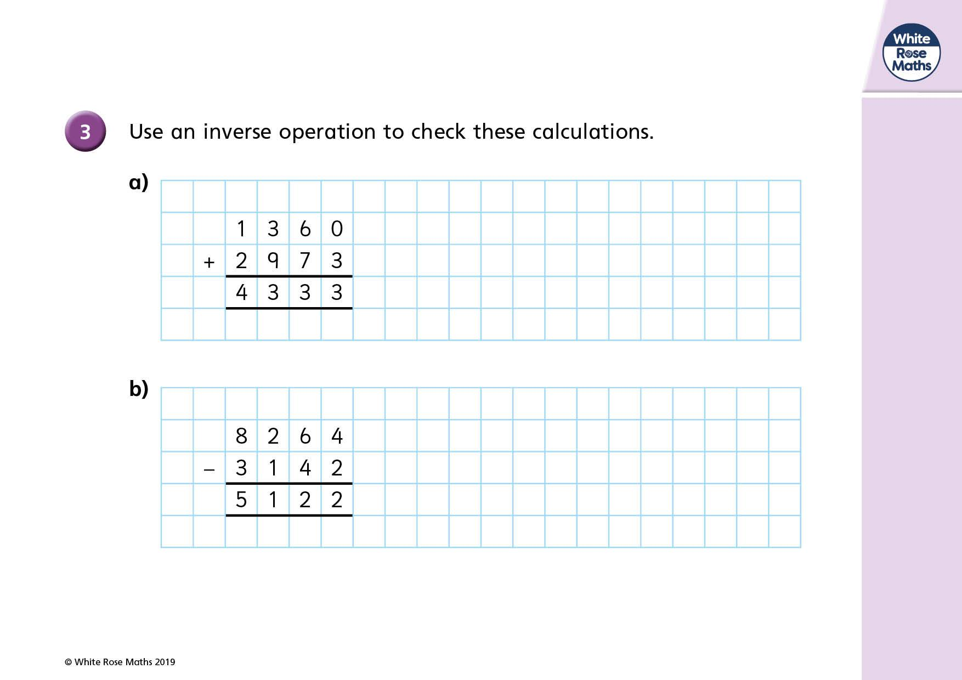
-
+

Slide 7
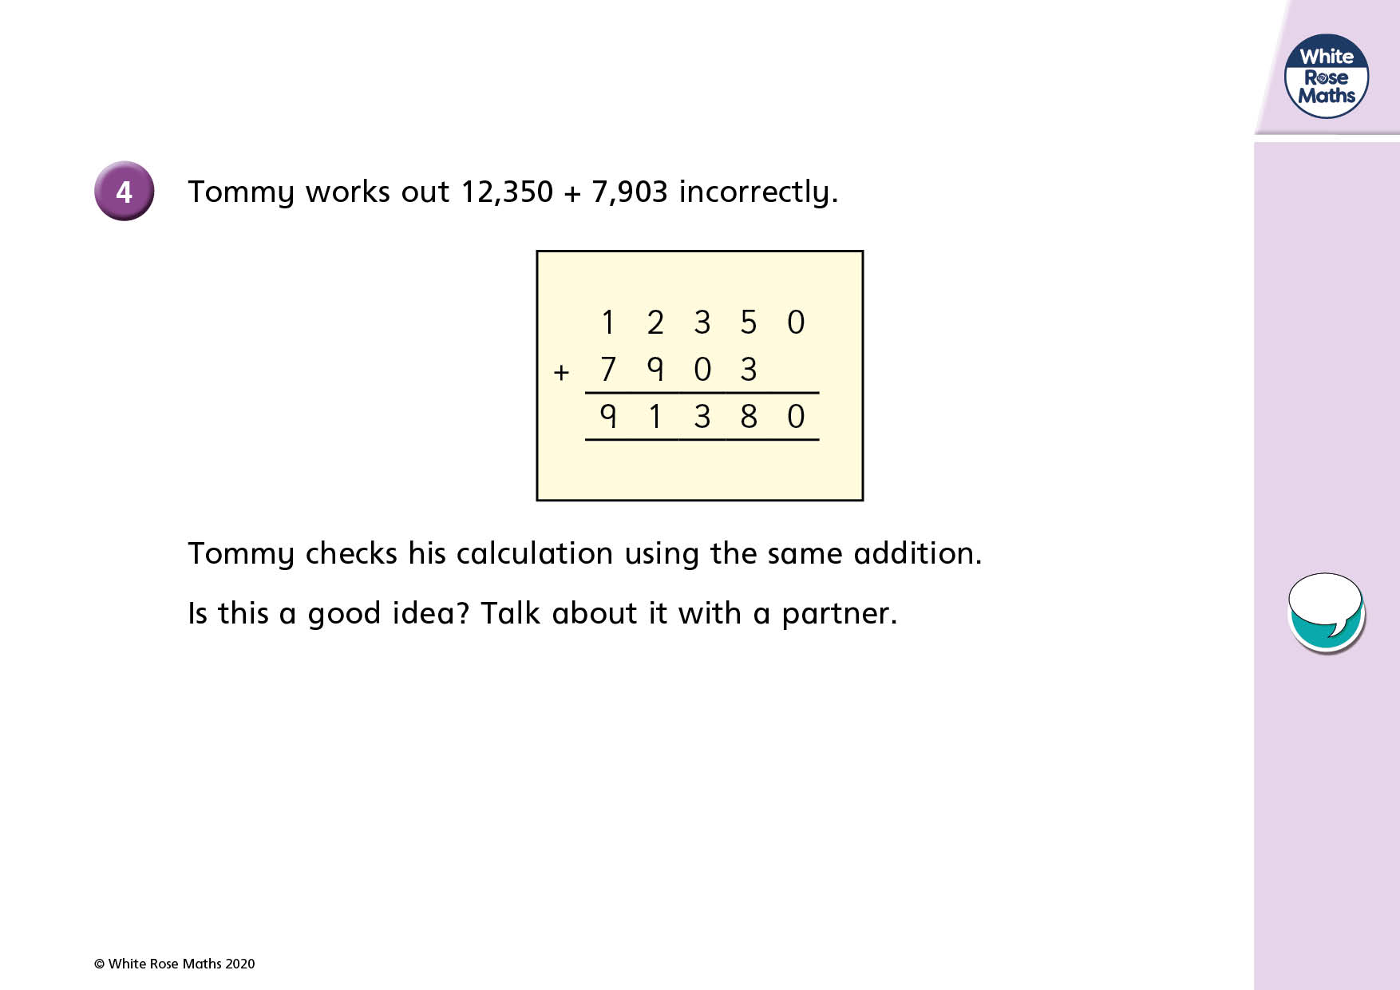

Slide 8
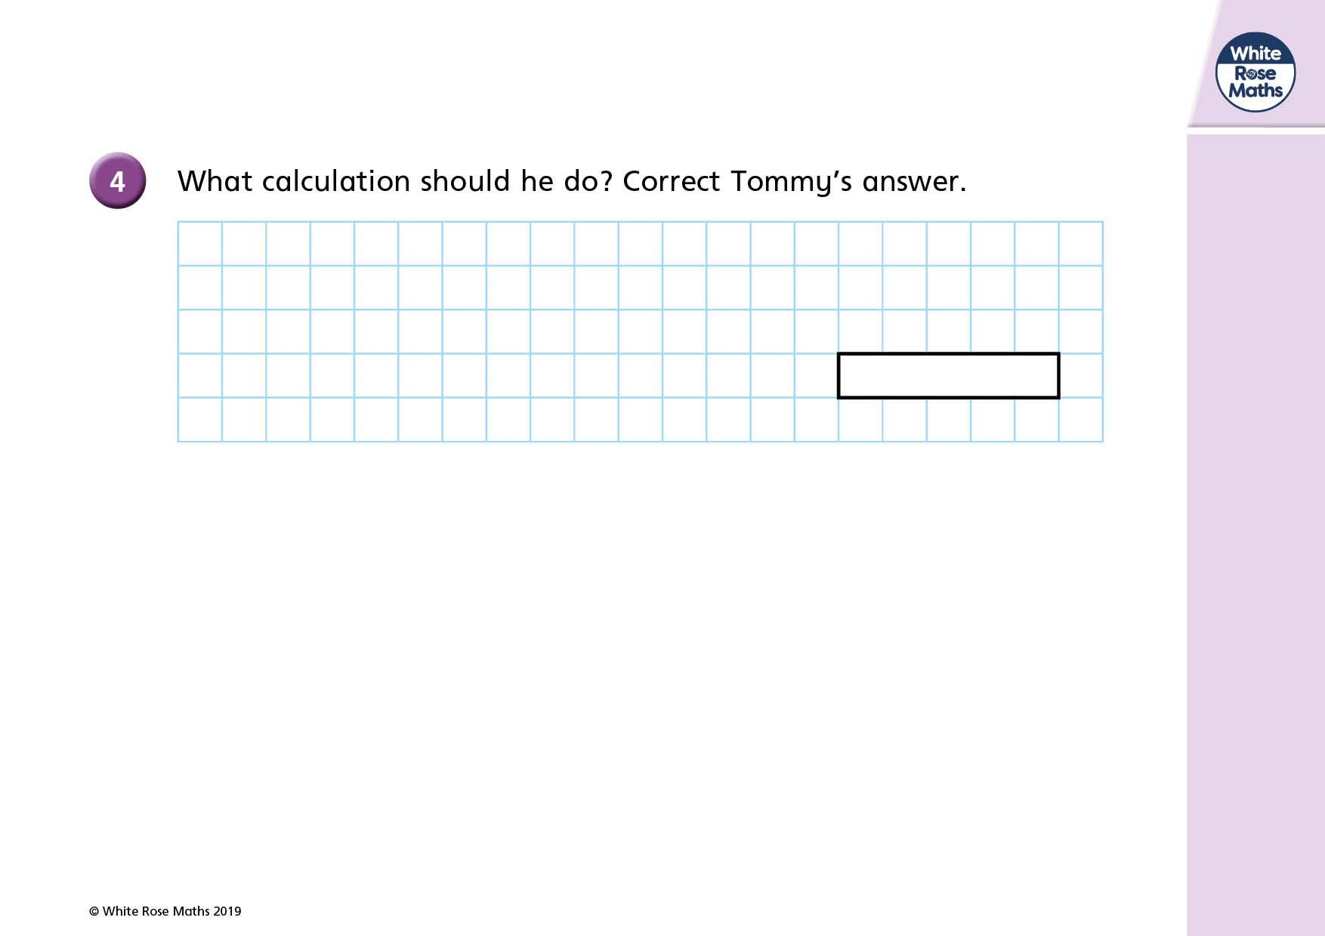
+
-

Slide 9
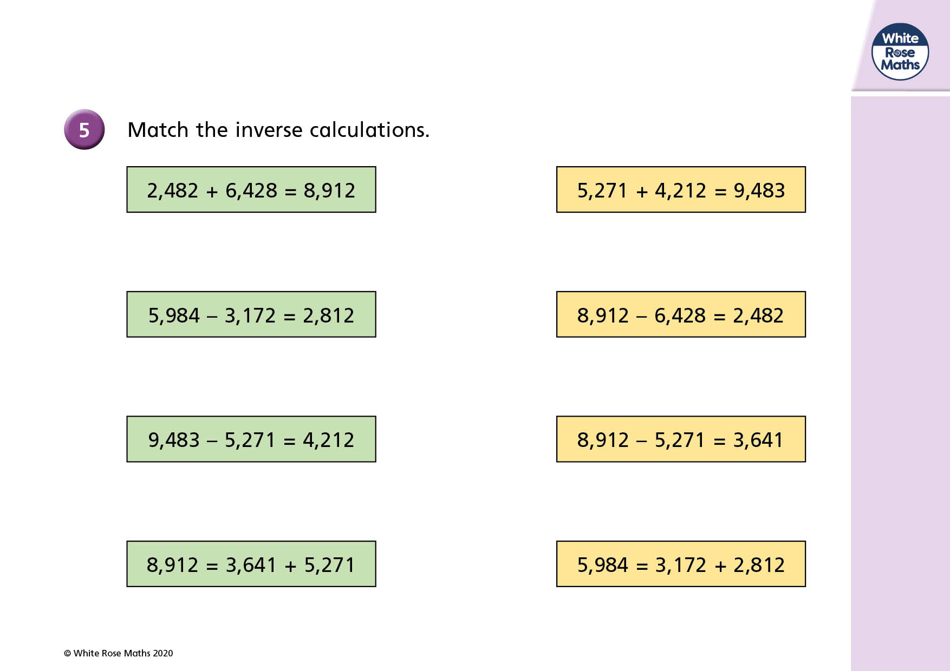

USE
ABOVE TO DRAW LINES

Slide 10
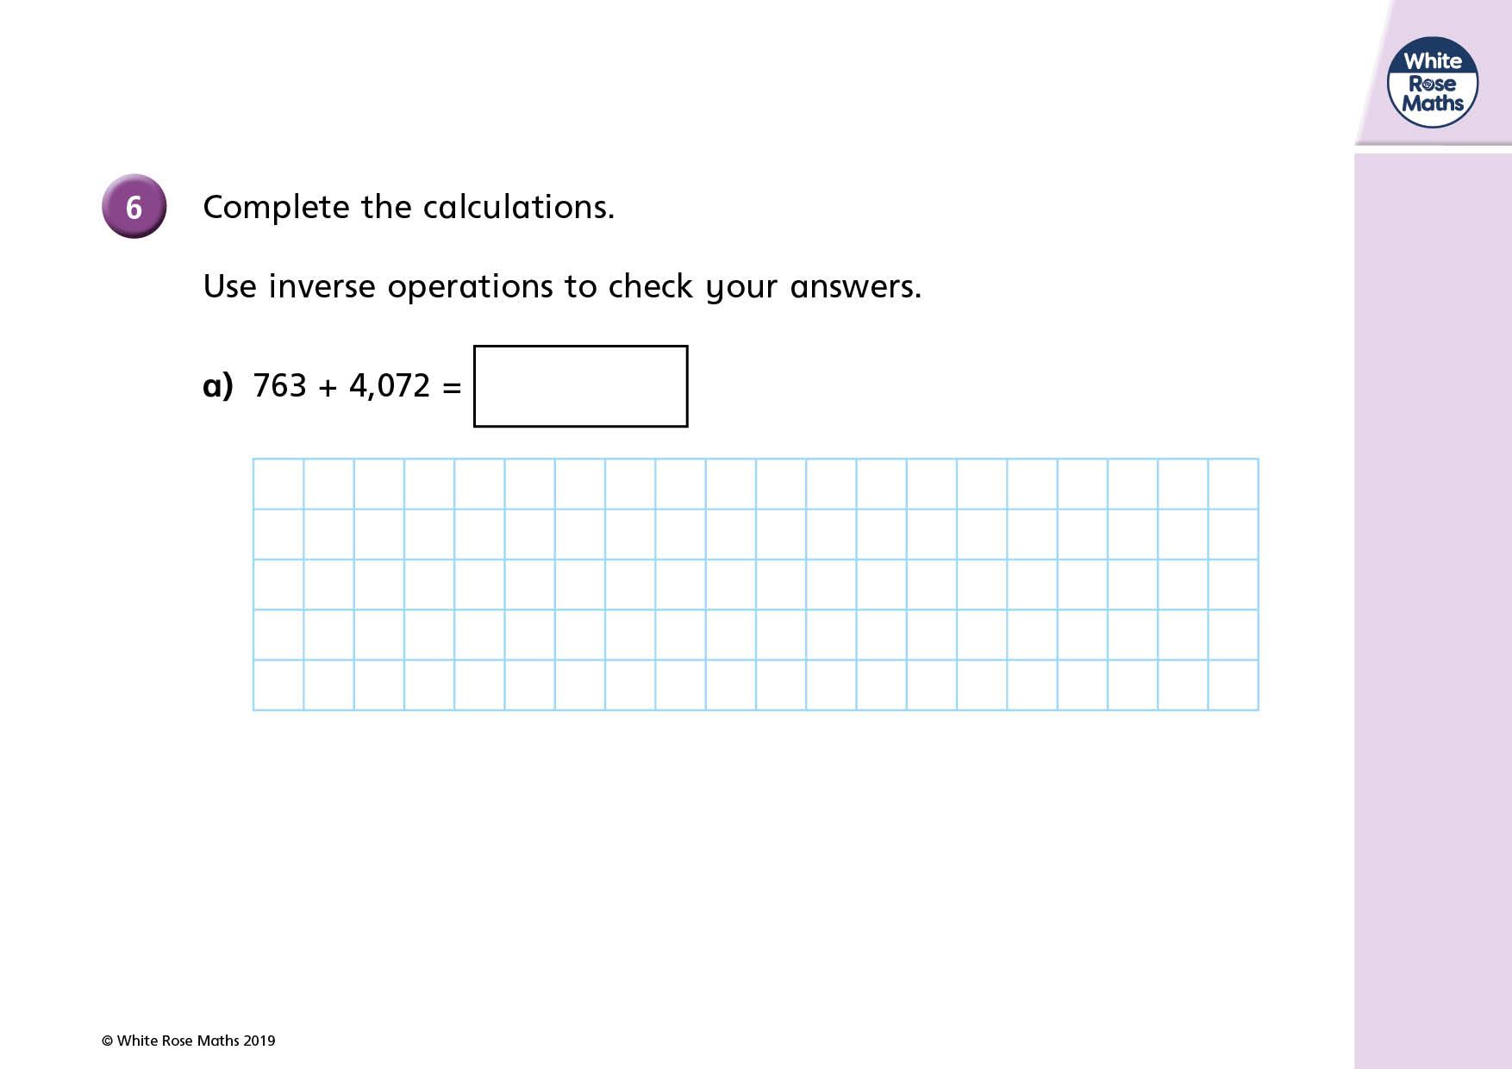
+
-

Slide 11
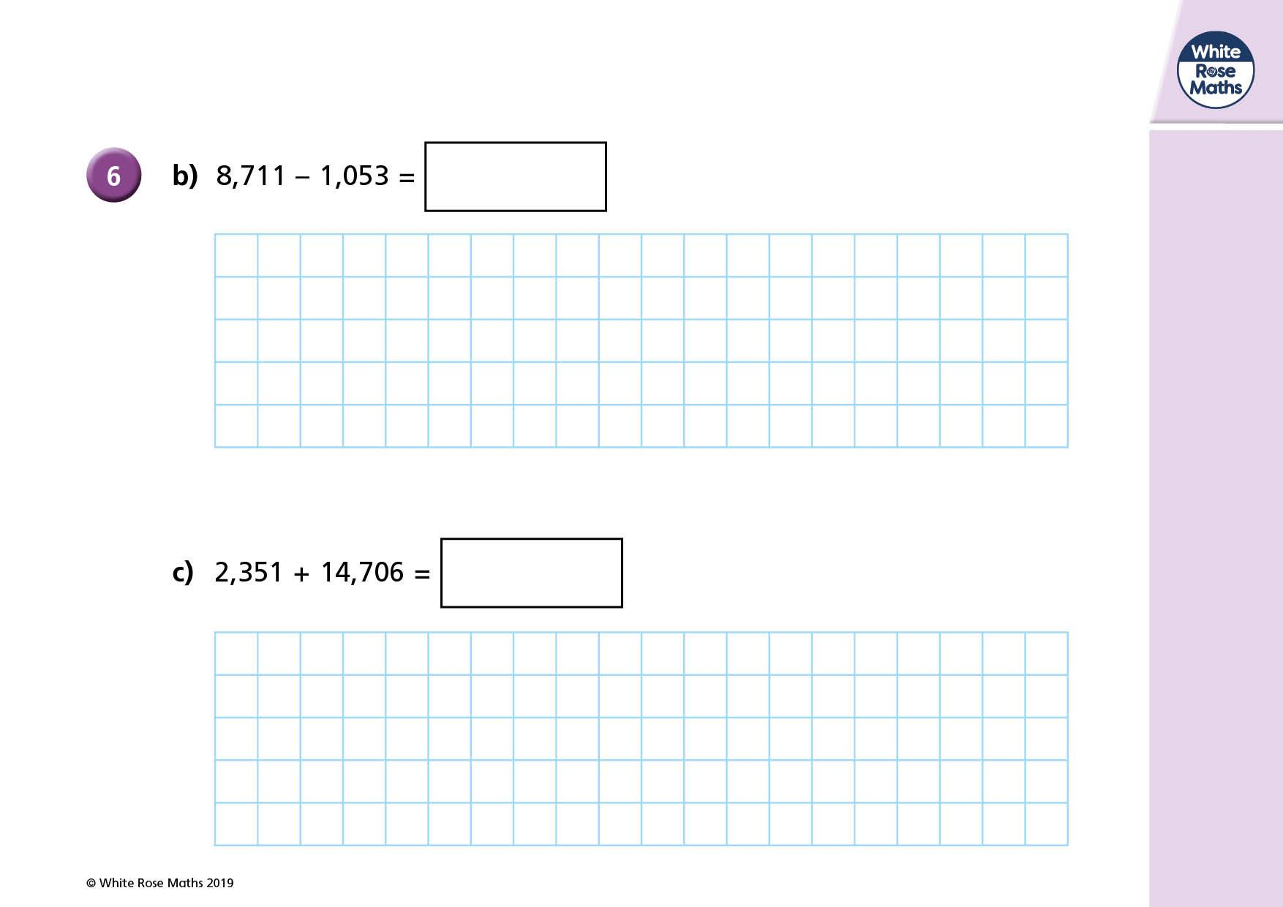
-
+
+
-

Slide 12
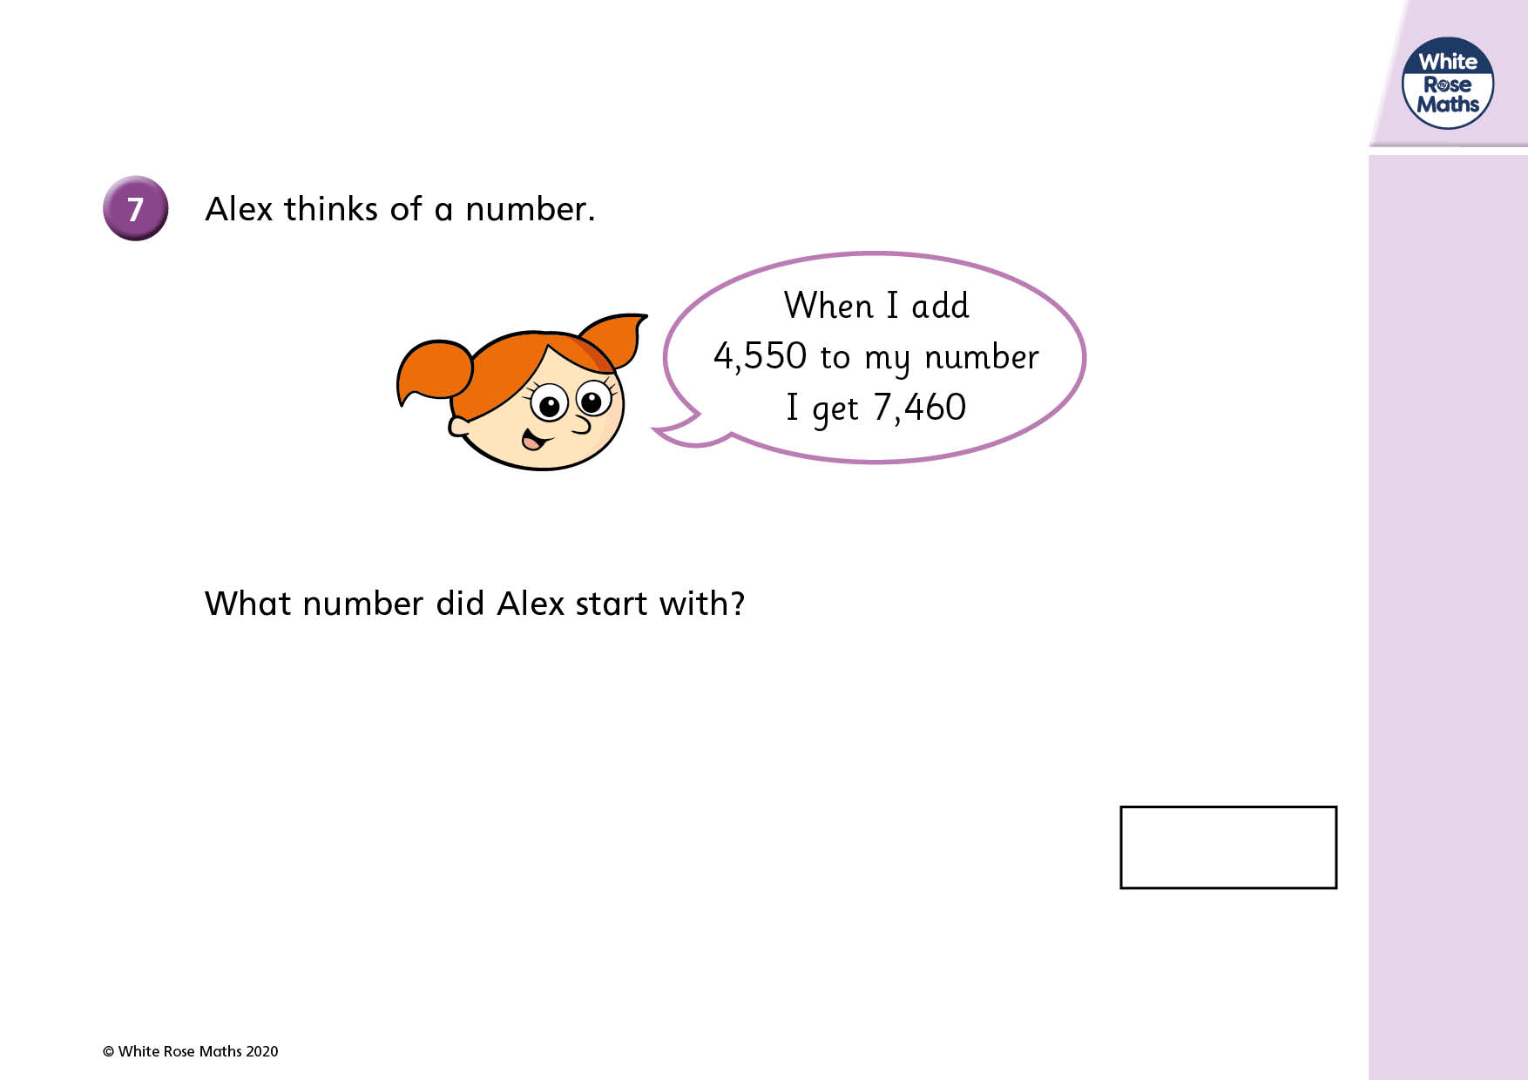

Slide 13
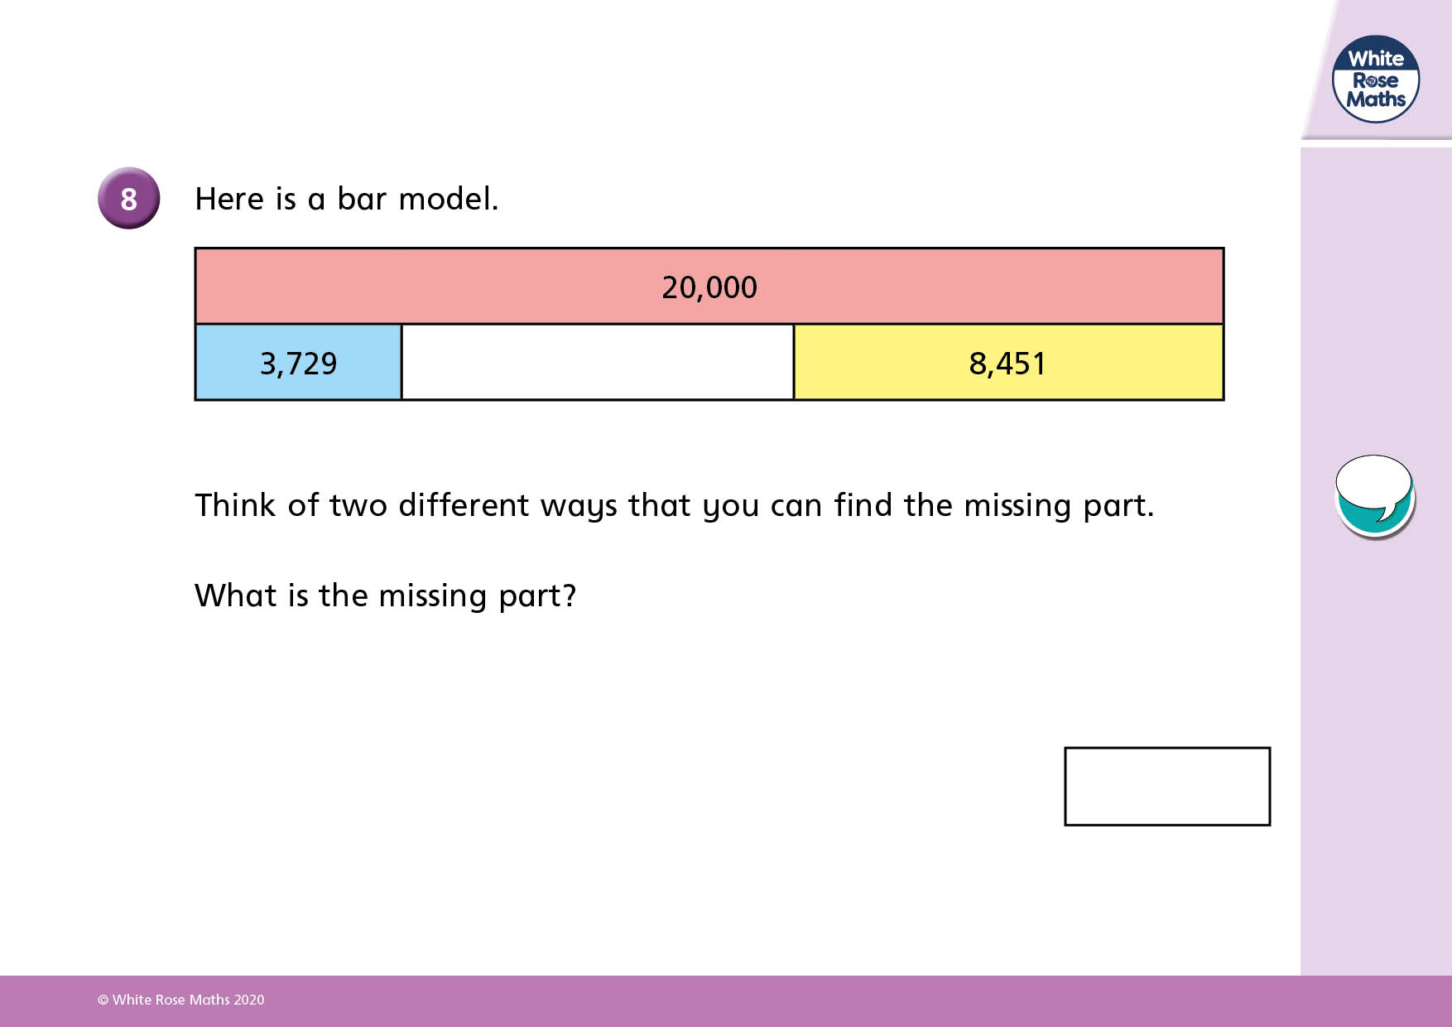

Slide 14
How to submit:
Once you have finished adding your answers they will automatically save.
1) Go back to google classroom and go to the classwork page.
2) Find this assignment and click 'view assignment'.
3) On the right hand side of the screen click 'Hand in'.

