Slide 1
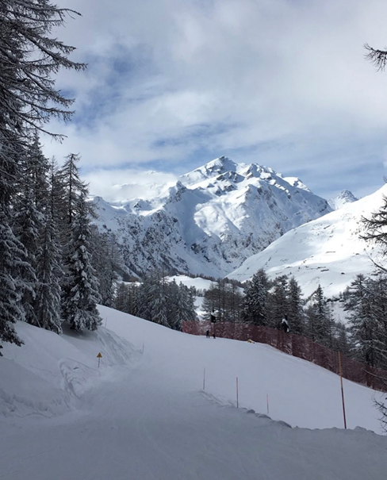
Geography- Mountains (Climates)
What is the climate of a mountain like?
What would it be like to live on a mountain?
What are avalanches?

Slide 2
To describe the climate of mountains and explore mountain life.
As you would expect, mountains have their own climate. The weather 8,000 metres (over 26,000 feet) high up in the sky is very different to the weather we experience on the ground. The higher up you go the colder it gets.

Slide 3
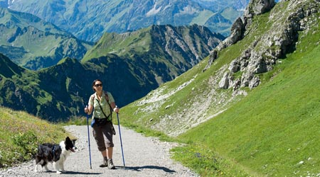
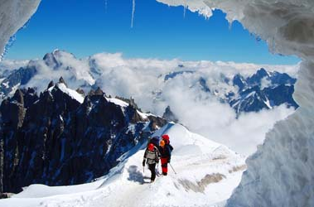
Mountain Climates
Mountain weather conditions can change in a split second! Well, maybe not quite that quickly but in just a few minutes clouds can gather and a thunderstorm begins. That’s why mountaineers have to be ready for anything; they pack their rucksacks really carefully and carry emergency kit like tents and extra food. Professional climbers always tell other people what their plans are so, if they go missing, search and rescue teams know where to look!
Lower down, the climate may be milder (temperate), suitable for lots of different plants and trees to grow, which in turn, provide food for a wide variety of animals. Higher up, plants and animals are fewer: they have to be highly adapted to survive, as the climate becomes much harsher. It’s windy and cold. Frozen ground means that there is not much water available and the soil is shallow. Humans also struggle to cope at high altitude (a fancy word for great height), because the air becomes much thinner, meaning that there is less oxygen available for your body to use.
Mountains also receive lots and lots of rainfall. This is because air travelling over land is forced up and over any mountains in its path – it can’t tunnel! This air cools as it rises causing the condensation of any water vapour it was carrying into huge clouds (made up of tiny droplets) ready to burst at any moment.
We often see snow at the top of mountains because the temperature is so cold – mountains allow us to see snow at the Equator. Who would have thought in the middle of Africa you could see snow? Visit Mount Kilimanjaro and you will see a whole lot of it!

Slide 4
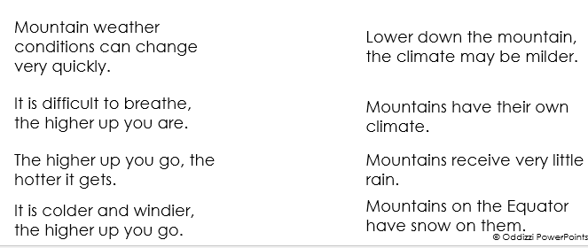
Activity 1 - true or false?
Drag and drop the statements under true or false heading using the information from the previous slide to help you.
true
false

Slide 5
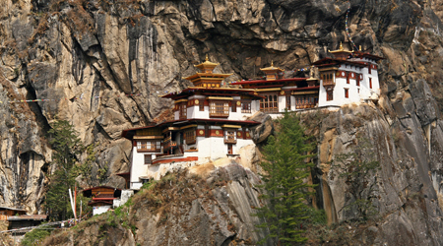
Mountain Life
Mountains can be very rocky and barren: you wouldn’t expect to find much up there. However, mountainous regions are home to approximately one-tenth of the world’s population!
Important metals and precious minerals can also be found beneath mountain ranges and so mining creates jobs in mountainous areas. In Bingham Canyon, in the state of Utah in the USA, you’ll find the world’s largest single pit, open cast (or open cut) mine. It’s almost a kilometre deep and 2.5 km wide – it’s so huge, you can see it from the moon! This mine has produced over 19 million tonnes of copper over a century, more than any other mine in history.
Higher up, the air is thinner, making it more difficult to get enough oxygen to allow your body to work hard. Steep slopes mean that growing food and building houses is also much more difficult.
The extreme climate (tonnes of snow!) means that some mountain communities can be cut off from the rest of the country for months. However, the construction of new tunnels in the last fifty years has boosted business in the European Alps. Villages like Livigno in Italy that were previously only accessible on cross country skis, are now easy to reach for most of year. Avalanches are still a natural hazard though.
Travel is tough in the mountains. Roads have to wind, switching back and forth to allow vehicles to climb.
Millions of holiday-makers flock to the mountains, in summer to climb and in winter to ski.
Think of all of the hotel rooms, ski chalets, ski schools, chair lifts, shops and restaurants needed in an Alpine holiday resort, and all of the people needed to work there. Clearly, there’s money to be made in the mountains!
Mountains can actually be very good places to live; the soils on the slopes of volcanoes are often very fertile. For example, in Italy the lower slopes of Mount Etna are home to many vineyards producing fine wine.

Slide 6
Activity 2 - What might it be like to live on a mountain?
Use the subheadings to help you add information to answer this question.
Day-to-day life
Food
Weather and climate
Jobs

Slide 7
Activity 3 - the word ‘avalanche’ has been used in this lesson.
on the next slide create a poster all about avalanches similar to the posters on Mountain Climate and Mountain Life.
You will need to use google to help you find out important information and maybe even to find some images to add.

Slide 8
AVALANCHES

Slide 9
How to submit:
Once you have finished adding your answers they will automatically save.
1) Go back to google classroom and go to the classwork page.
2) Find this assignment and click 'view assignment'.
3) On the right hand side of the screen click 'Hand in'.

