Slide 1
Maths
To subtract two 4-digit numbers with one exchange.

Slide 2
Instructions
Watch the video on the following slide.
Try to complete the questions on the rest of the slides.
Do your working out on some paper and just add your answers to the slides.

Slide 3

Here is the link to the video just in case it didn’t work on the previous slide:
https://vimeo.com/459399023

Slide 4
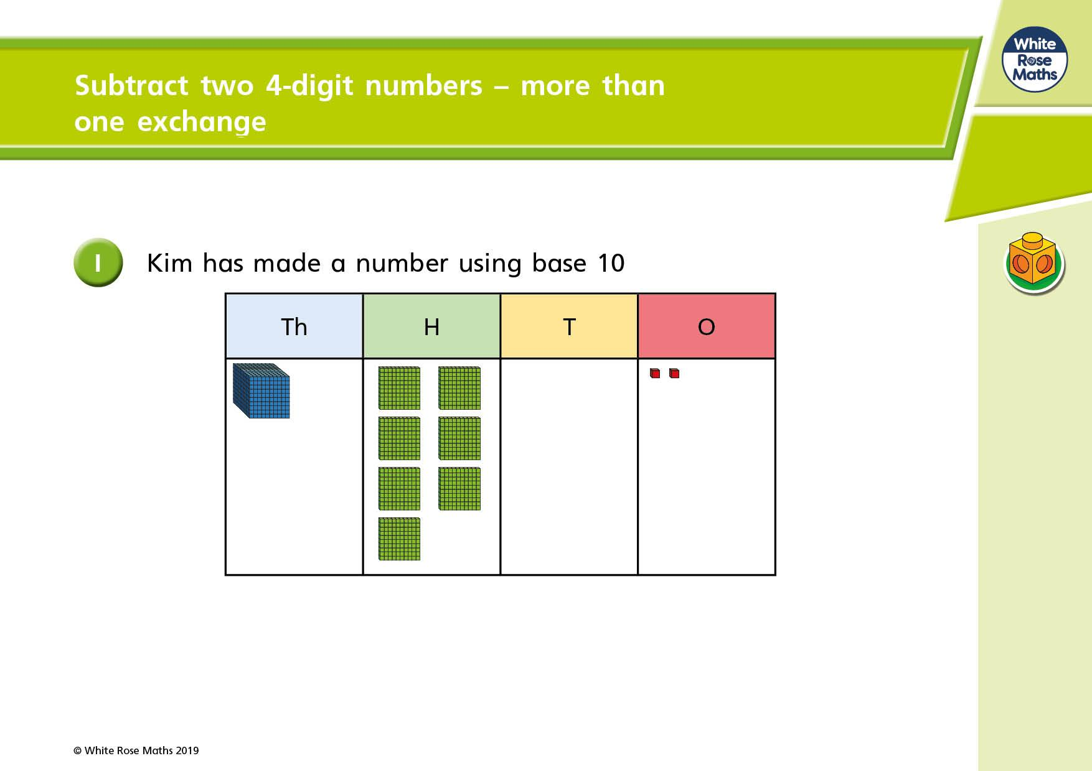

Slide 5
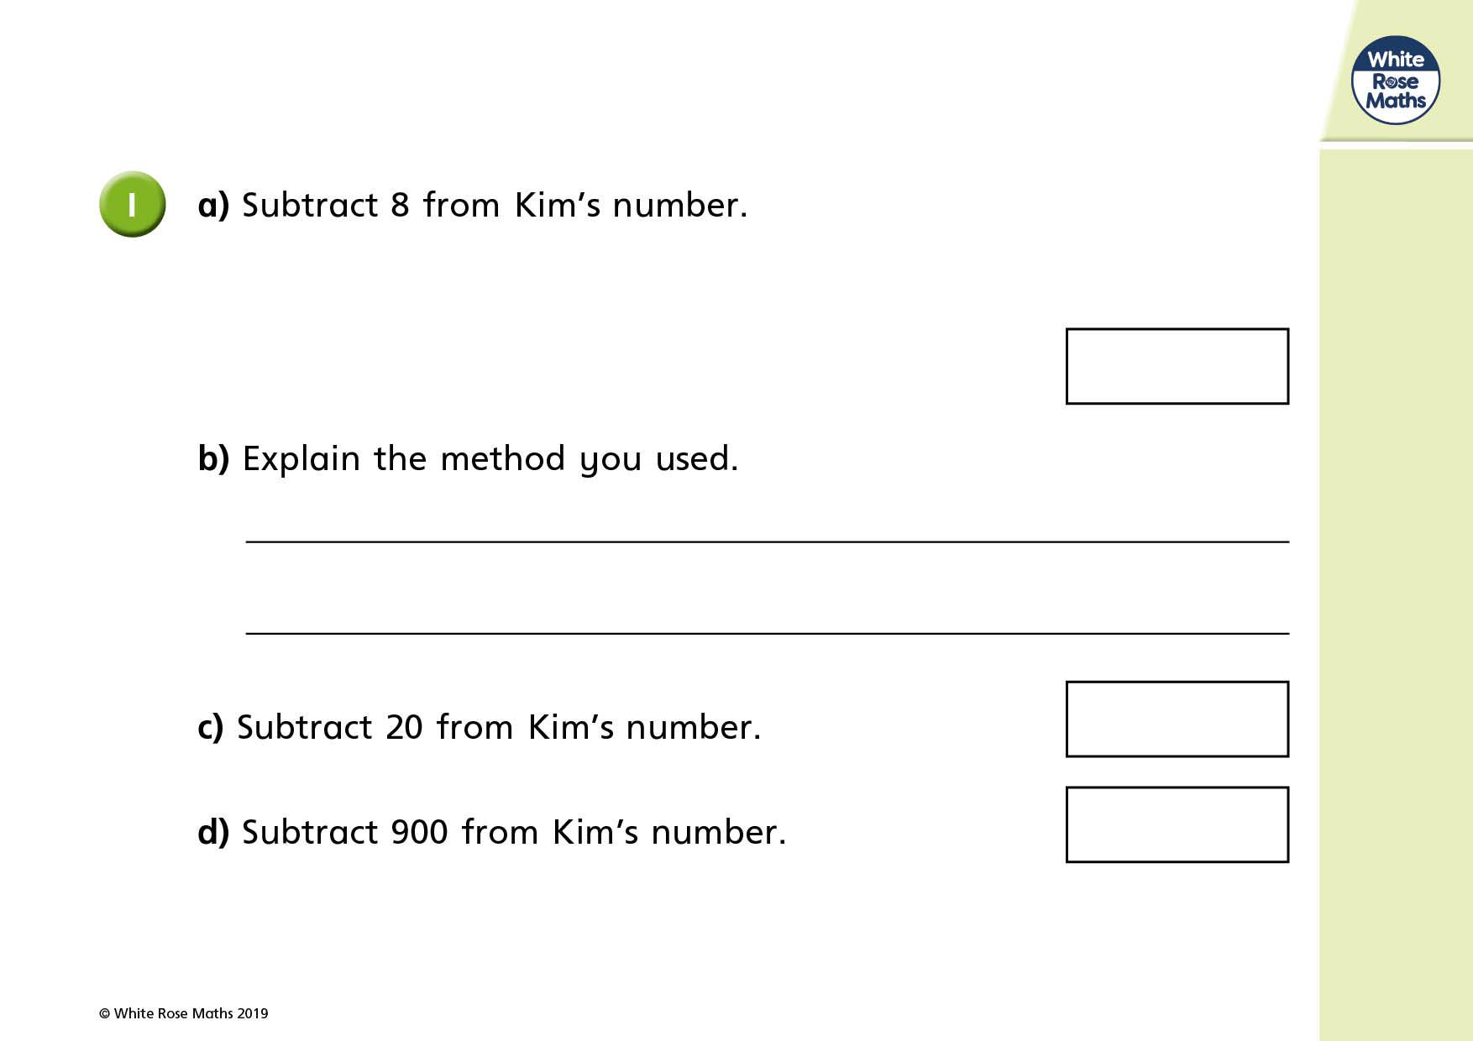

Slide 6
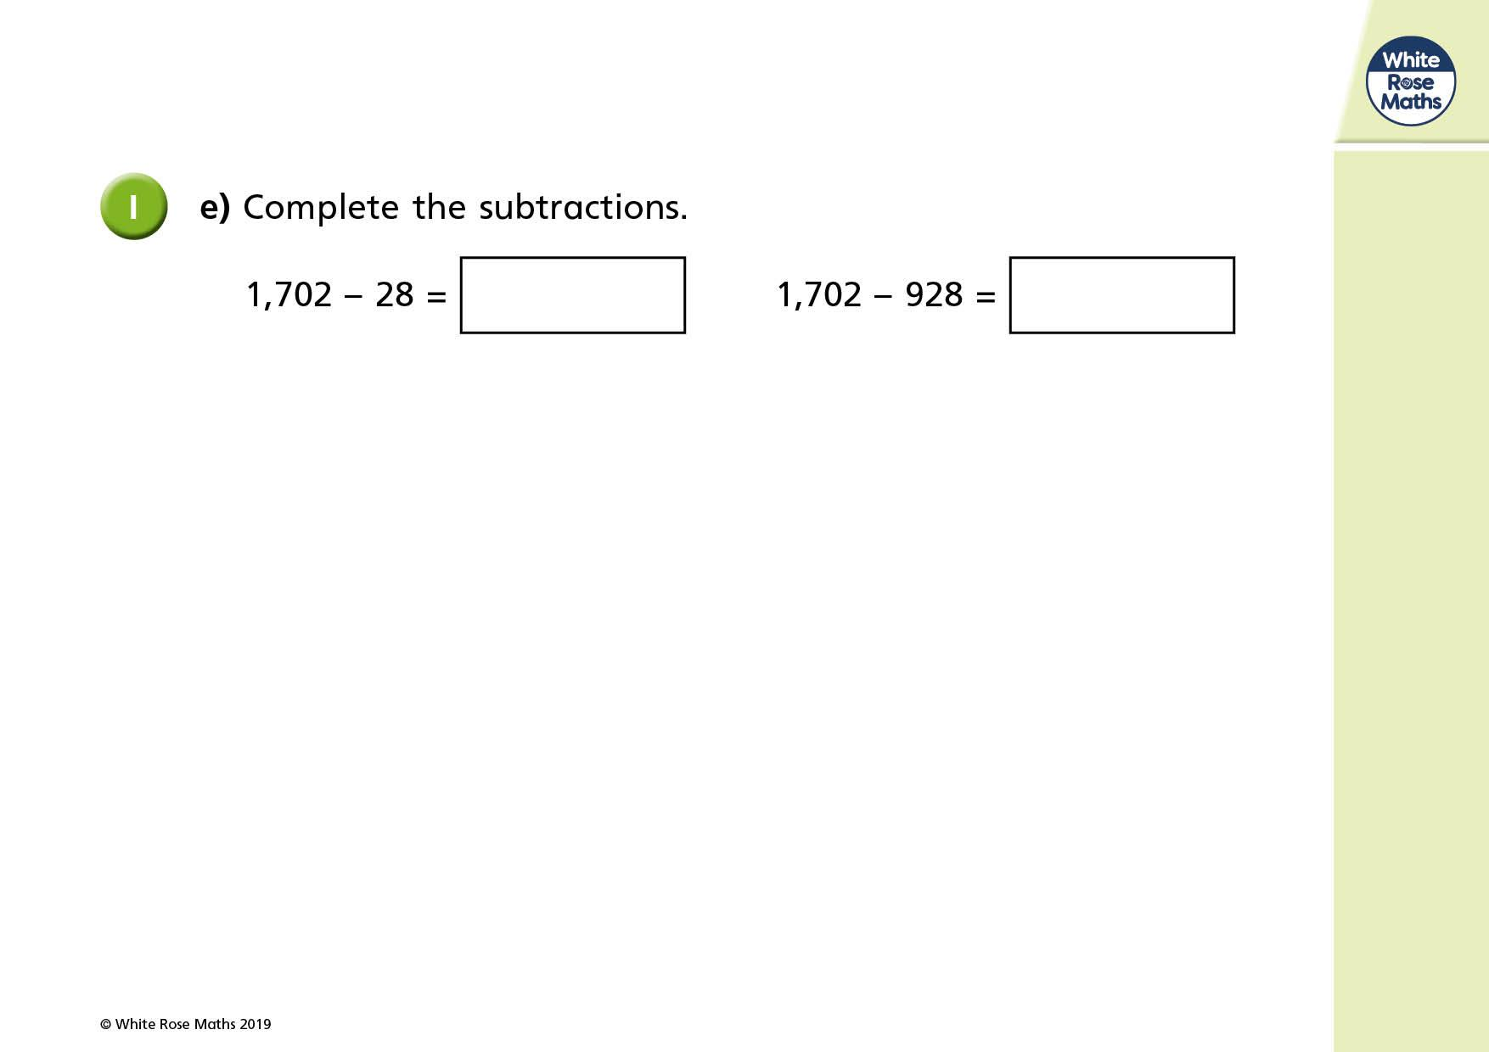

Slide 7
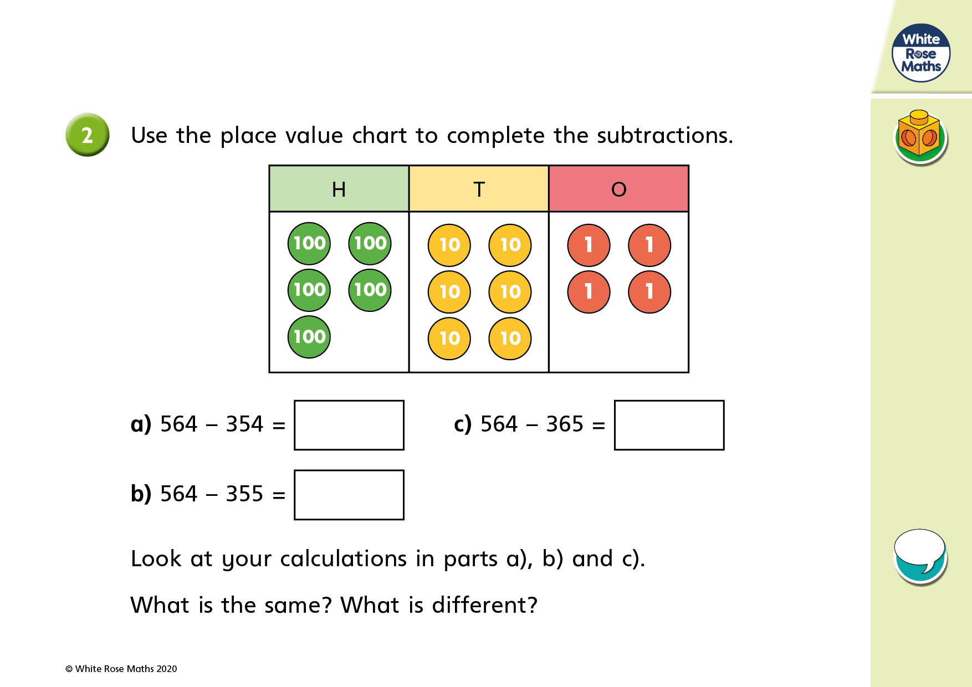
Same:
Different:

Slide 8
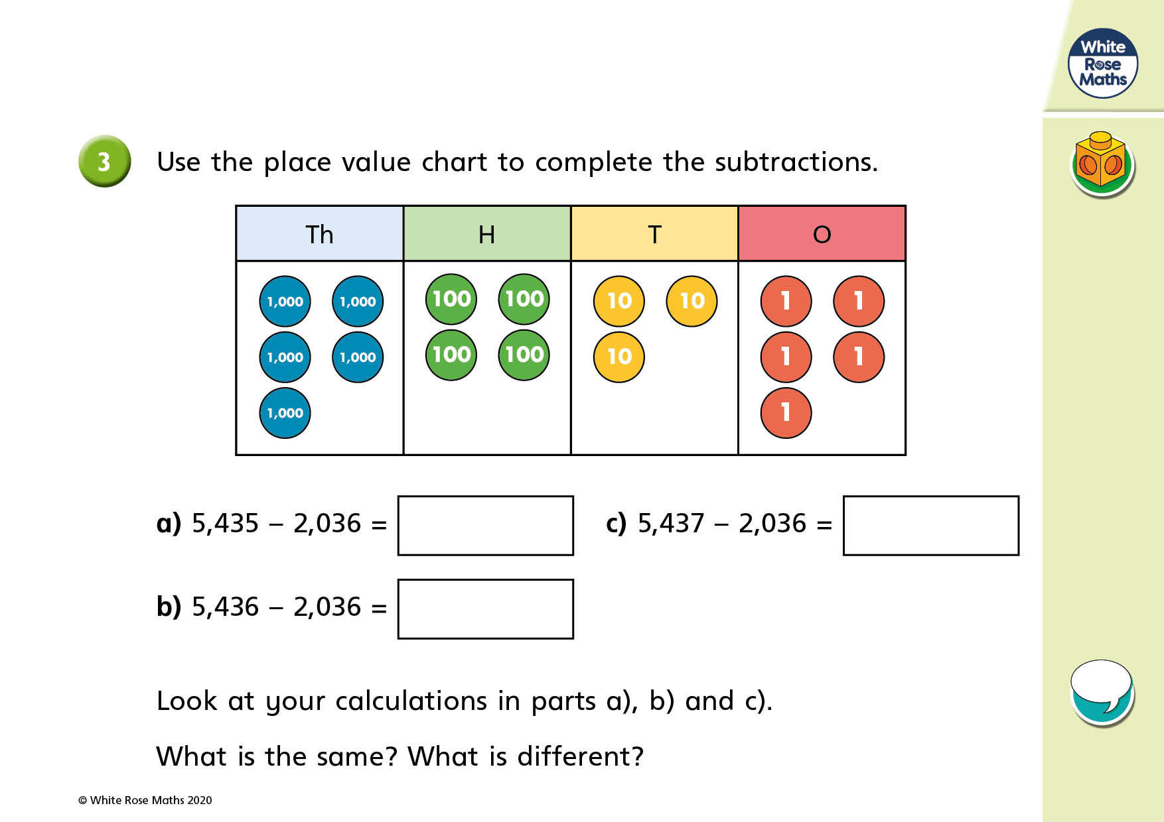
Same:
Different:

Slide 9
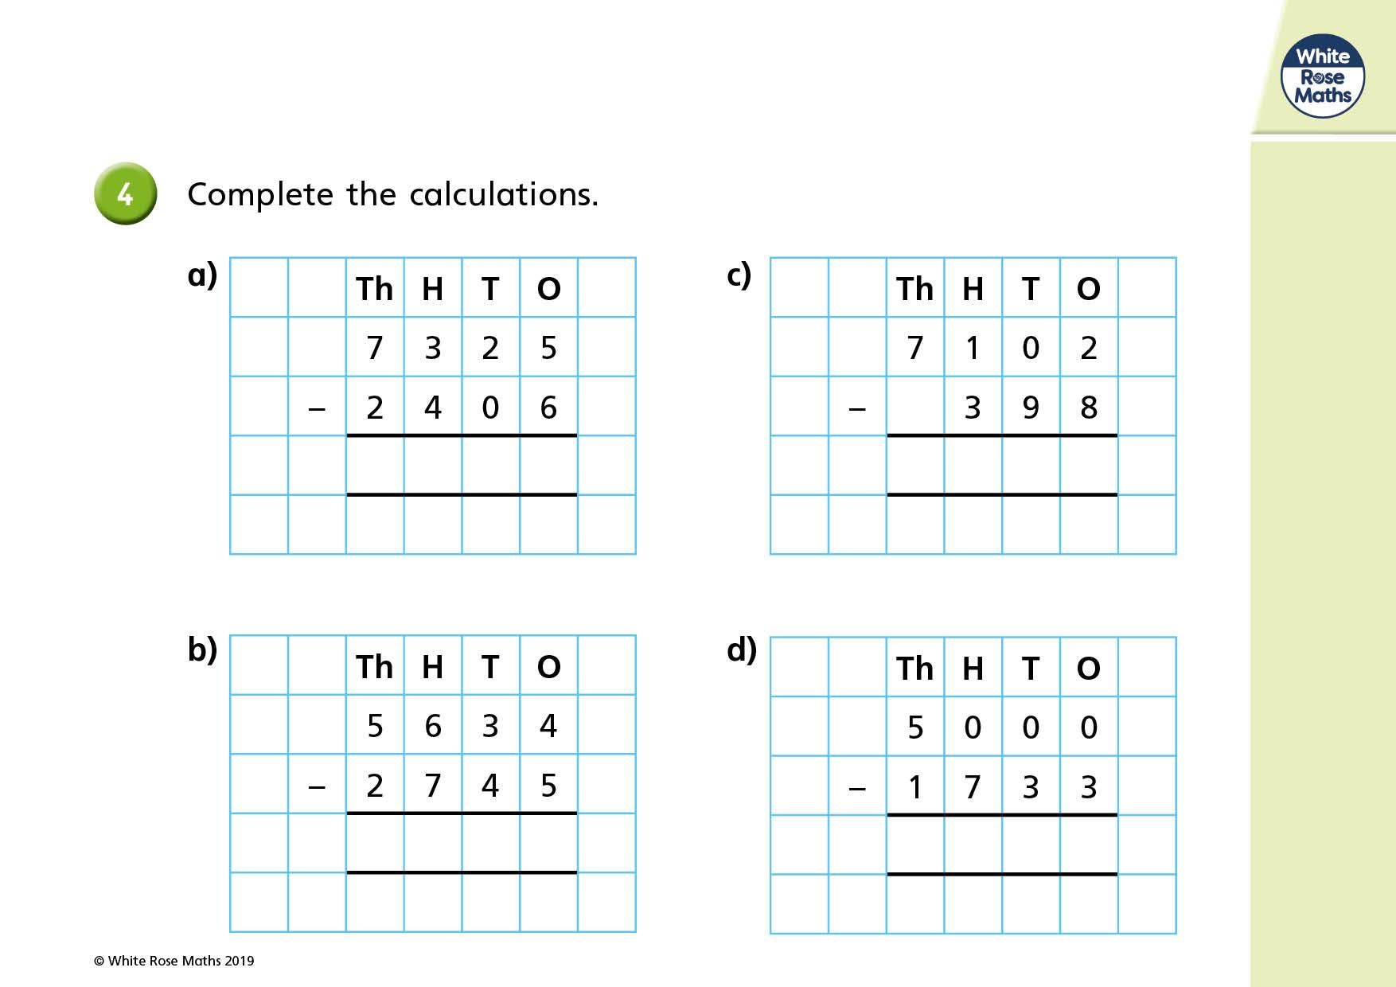

Slide 10
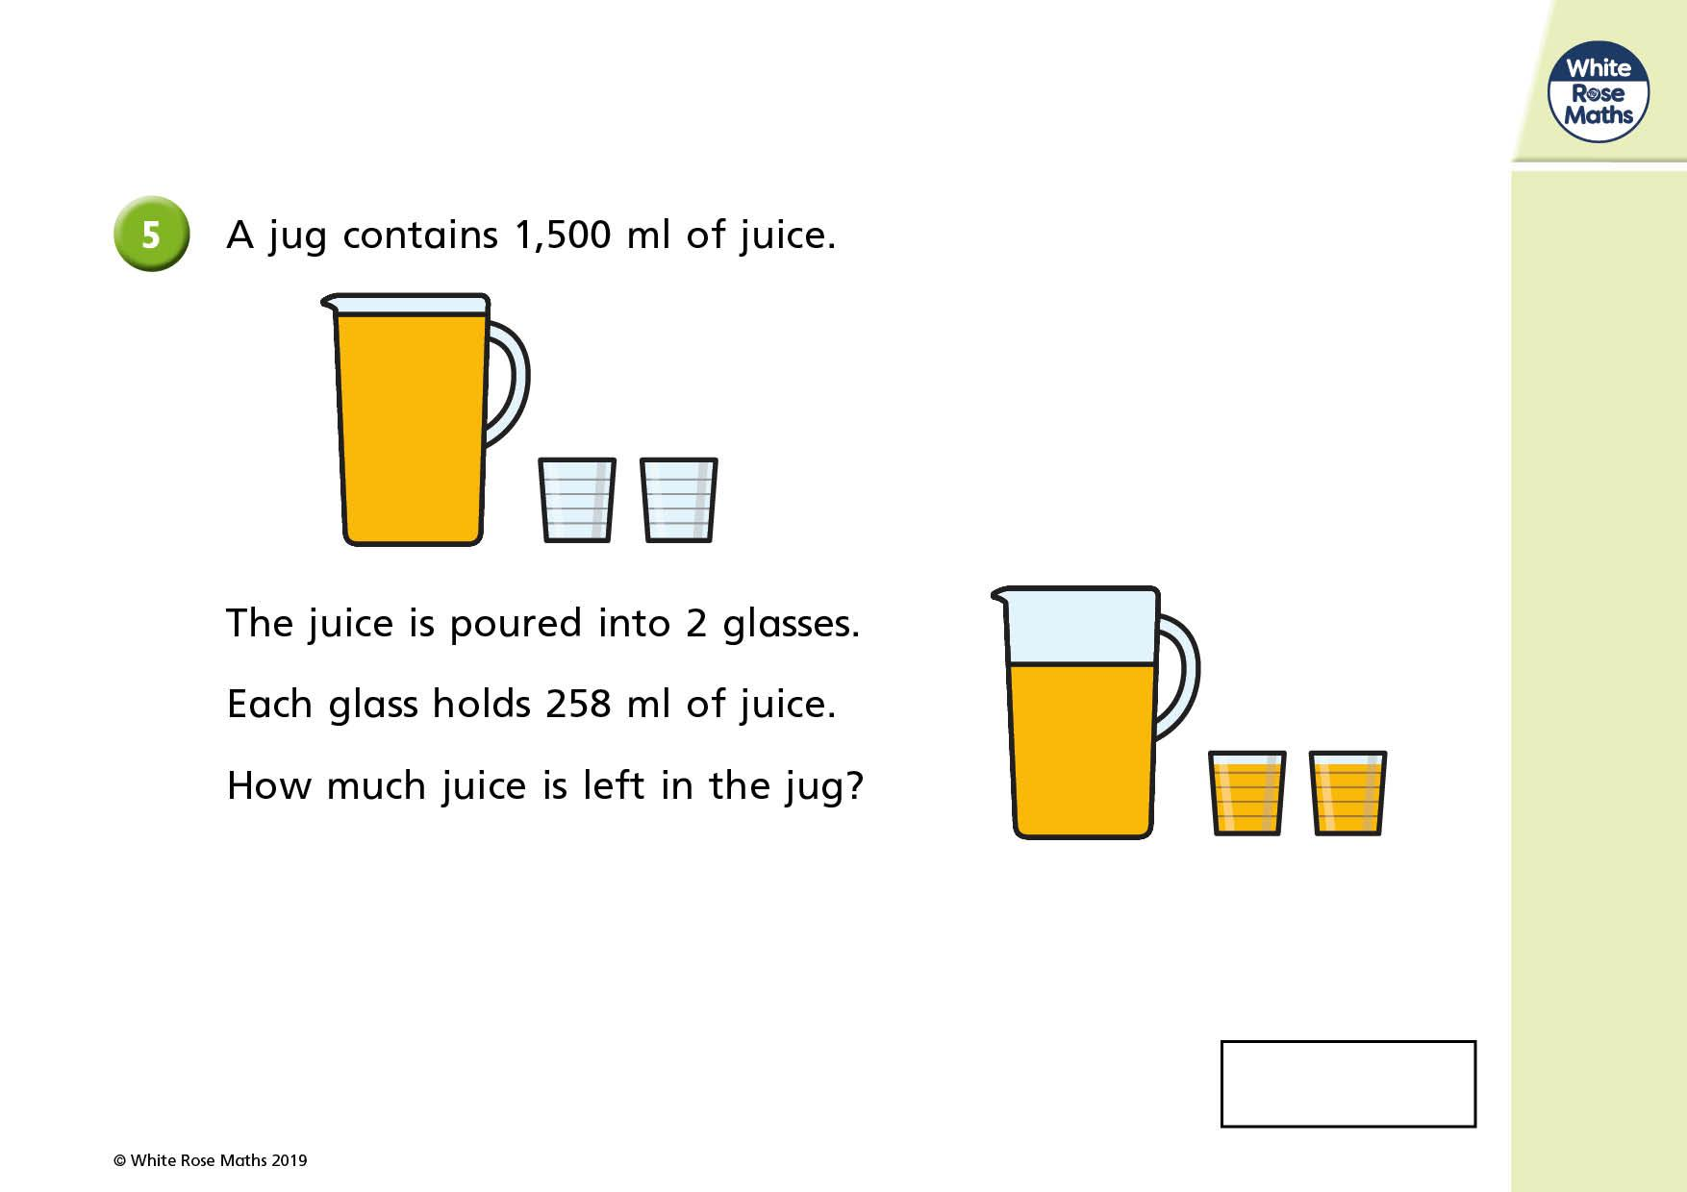

Slide 11
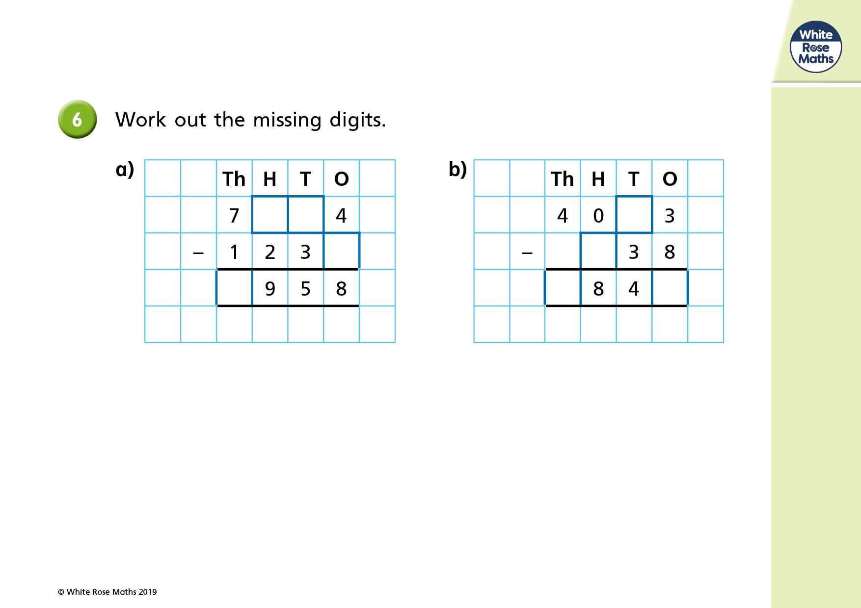

Slide 12
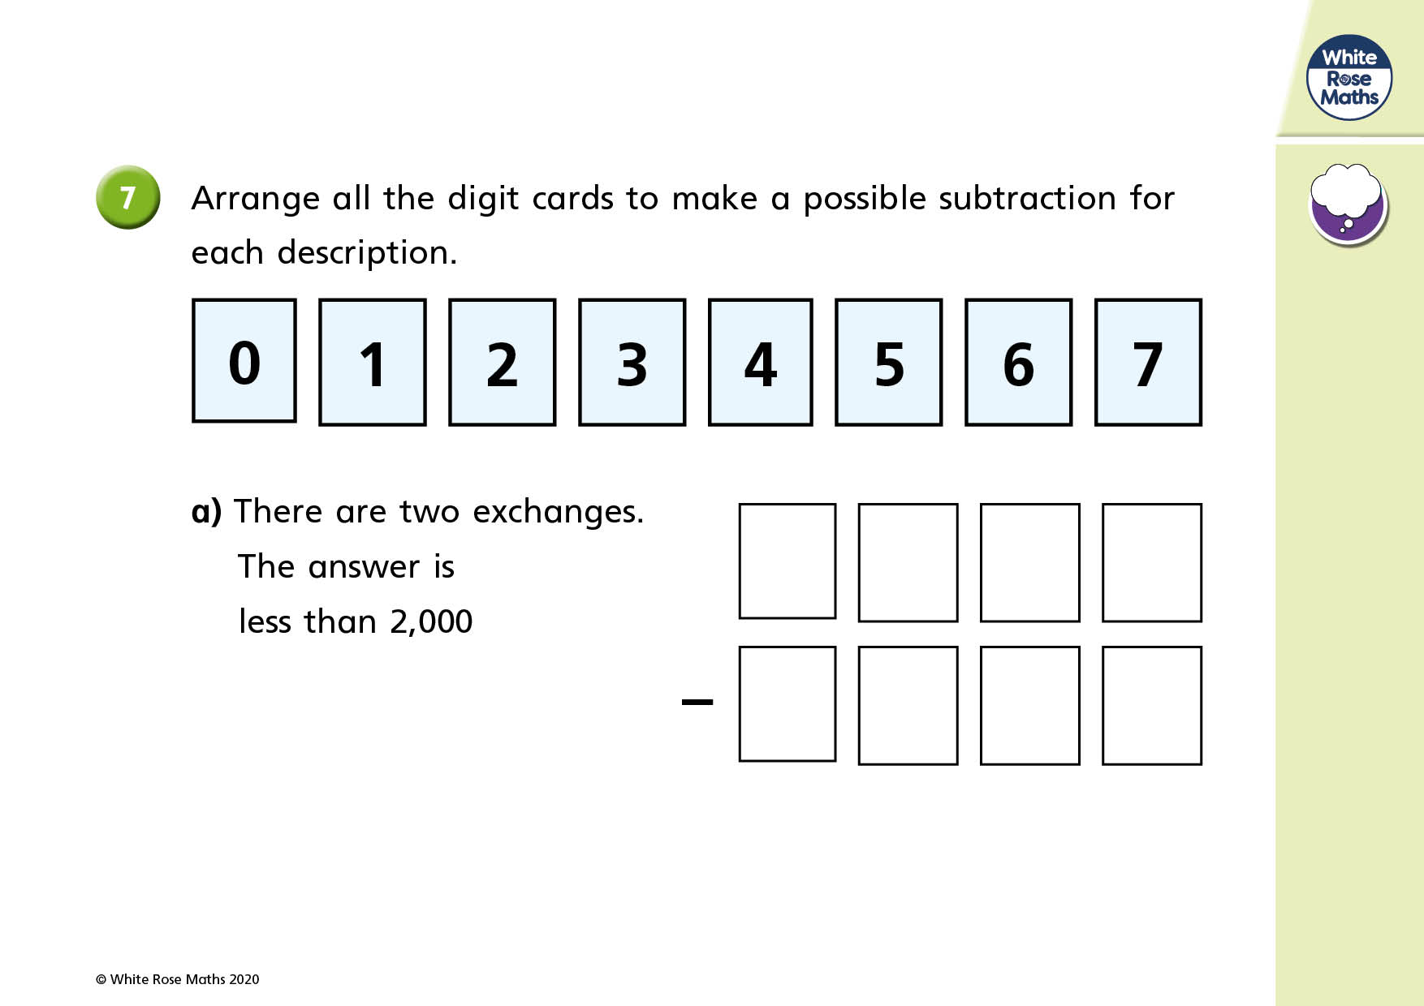

Slide 13
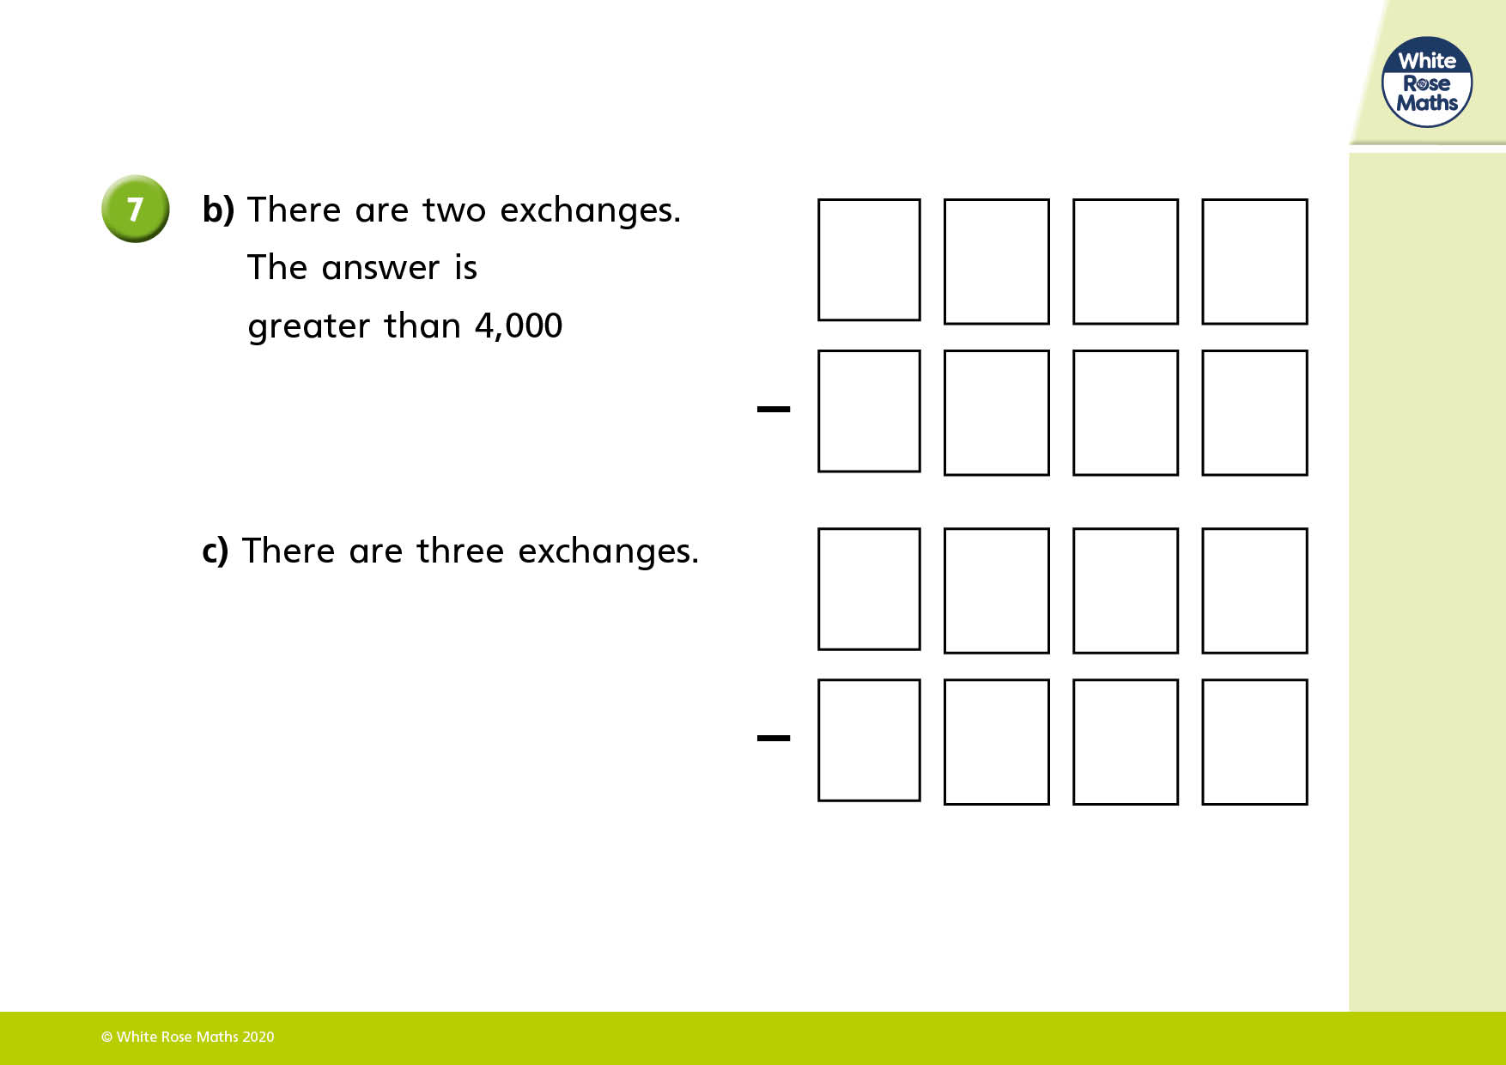

Slide 14
How to submit:
Once you have finished adding your answers they will automatically save.
1) Go back to google classroom and go to the classwork page.
2) Find this assignment and click 'view assignment'.
3) On the right hand side of the screen click 'Hand in'.

