Slide 1
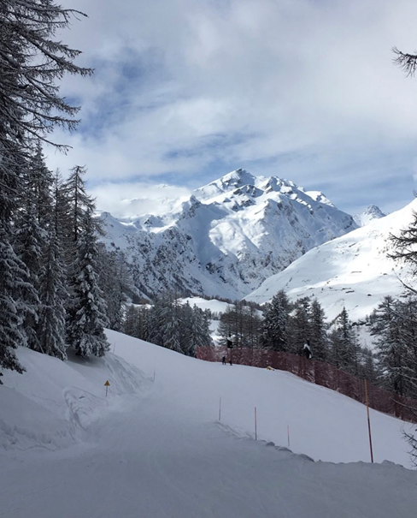
Geography- Mountains
The four different types of mountain;
How the different types of mountains are formed.
The features of a mountain;

Slide 2
To describe the key features of a mountain and how they are formed.
Use the following slides to find information on the four types of mountains and how each of them is formed.
Add this information into the data sheet.
Draw and label a diagram of a mountain with the three key features and write a sentence about each feature. upload a picture of your diagram to google classroom or to the Year 5 email.

Slide 3
Types of mountain
You’ll remember that the Earth’s crust is made up of plates that are on the move. The circulation of heat energy within the Earth’s mantle drives this gradual movement. Many of the world’s greatest mountain ranges were created during the collision of giant plates.

Slide 4
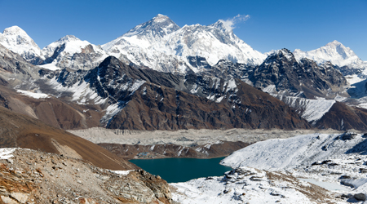
Fold Mountains
When two of these massive plates collide, land (or even the sea bed) may be pushed upwards and folded. What you’d imagine to be solid and immovable simply crumples and folds like a cloth pushed across a table – although it does take many millions of years to create a mountain range as impressive as the Himalayas.

Slide 5
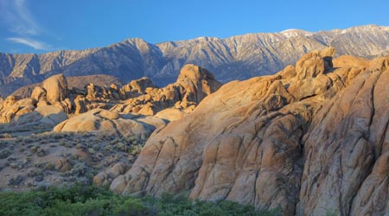
Fault-block Mountains
Plates of the Earth’s crust that float on the mantle may buckle and crack as they move. Fault-block mountains are formed when parts of a fractured plate are forced to move up (while other parts are pushed down), as the whole plate travels forward. The land forced up is a new mountain range. A good example of this type of physical feature is the Sierra Nevada in the USA.

Slide 6
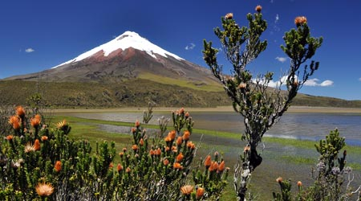
Volcanoes (or Fire Mountains)
These peaks are formed by a series of eruptions in which red hot lava gushes out of the volcano’s mouth or crater. When this molten rock cools it solidifies adding another layer to the ground and so over time the volcano grows, with lava from numerous eruptions piling up. Whether a volcano has a gently sloping shape or a steep cone shape depends on how sticky (scientists say viscous) the lava is. Examples of volcanic mountains are Mount Etna, Mauna Loa and Vesuvius.

Slide 7
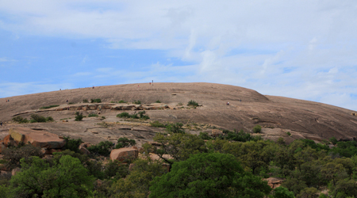
Dome Mountains
These mountains form when a huge swelling of magma pushes up under the earth’s crust. Rather like a spot or pimple on the earth’s surface (yuk!) that never erupts. The magma cools to form new rock but may not be revealed as a new mountain until millions of years later, after the weather, glaciers and rivers have worked on the rocks on top that are more easily broken down and carried away. A good example of a dome mountain is Enchanted Rock found in the USA, in Texas.

Slide 8
Add the information you have found to this table then share the slides so your teacher can check your work
Type of mountain | How they are formed

Slide 9
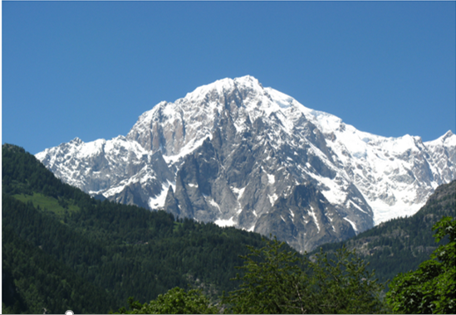
Features of a mountain
Mountains don’t all look the same, but there are three key features of any mountain …

Slide 10
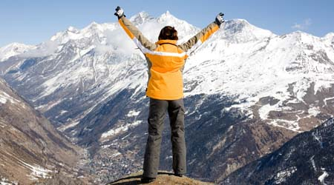
The Summit
This is the top of the mountain and a climber’s ultimate goal. From here, if you are above the clouds, you can often see for miles. Be careful though, the harshest conditions are found here. It’s often snow-covered and freezing. Surprisingly, some mountains have a wide flat top or plateau. But if the summit is a peak or a ridge of land, it can be very narrow – there’s not much room to stand.

Slide 11
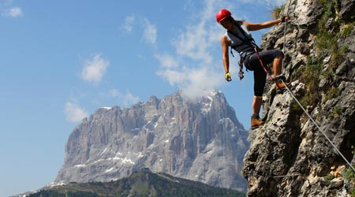
The Slope
This is the side of the mountain; you’d have to climb this to reach the summit. Some mountains have gentle (shallow) slopes on all sides, which aren’t too hard to clamber up. However some mountains are very steep. There’ll be rocks to scramble up and you might need special equipment, including ropes and harnesses, to help you complete your ascent. A cliff-like slope of a mountain is called a face and is named after the direction in which it ‘looks’: for example, ‘north face’ or ‘south face’. The north face of Mount Eiger, in Switzerland, is said to be the hardest to climb. Tragically, many climbers have died attempting to scale it, earning it the nickname ‘Murderous Wall’ or Mordwand in German.

Slide 12
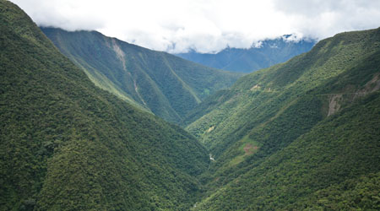
The Valley
The whole trough or dip between two mountains is called a valley. It can be v-shaped with a river running at its base or steep-sided with a flat bottom, the shape of the letter U. Glaciers have been at work bulldozing the rocks where you find a U-shaped valley.
Dramatic peaks and troughs are only really seen on young mountains (that’s young as in only a few million years old) because as mountains age, bits of their main bodies fall off due to the work of the weather and these bit fall into the gorges around them, filling them up. Thank goodness that doesn’t happen to us as we grow old!

Slide 13
Using the information you have learned on these slides, draw and label a diagram of a mountain on paper or in your home learning book and upload a picture of it either to the next slide or to the Year 5 email.

Slide 14
Upload diagram picture to this slide

