Slide 1

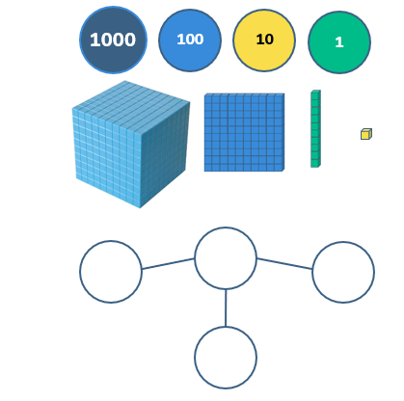
Year 5 Place Value Lesson 1
To be able to recognise and represent numbers up to 10,000
Starter:
Success Criteria: Must: I can use concrete resources to represent up to 9,999; Should: I can use pictorial representations to represent numbers up to 10,000; Could: I can represent numbers up to 10,000 using numeral or worded number forms.
Show me 7,043 in three different ways.
Extension Can you write 7,043 in its worded form?
http://bit.ly/Yr5PV To download lessons 1-5 click the link!
Notes:
Children could work through this using concrete resources, rather than responding in written form as a means of differentiation.

Slide 2
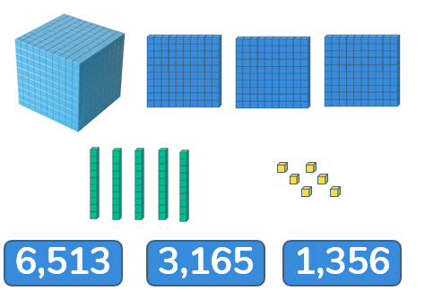
Year 5 Place Value Lesson 1
To be able to recognise and represent numbers up to 10,000
Talking time
Success Criteria: Must: I can use concrete resources to represent up to 9,999; Should: I can use pictorial representations to represent numbers up to 10,000; Could: I can represent numbers up to 10,000 using numeral or worded number forms.
Match the diagram to the number
http://bit.ly/Yr5PV To download lessons 1-5 click the link!

Slide 3
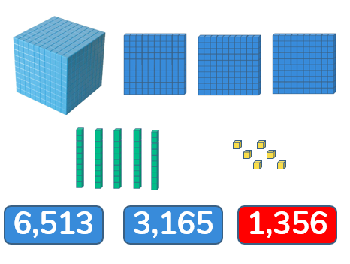
Year 5 Place Value Lesson 1
To be able to recognise and represent numbers up to 10,000
Talking time
Success Criteria: Must: I can use concrete resources to represent up to 9,999; Should: I can use pictorial representations to represent numbers up to 10,000; Could: I can represent numbers up to 10,000 using numeral or worded number forms.
Match the diagram to the number
http://bit.ly/Yr5PV To download lessons 1-5 click the link!

Slide 4
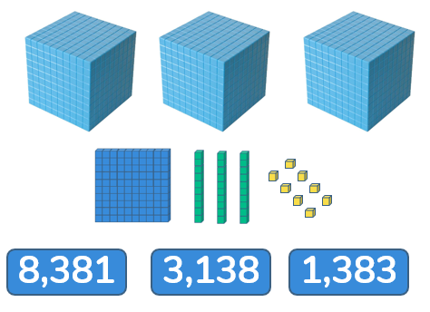
Year 5 Place Value Lesson 1
To be able to recognise and represent numbers up to 10,000
Talking time
Success Criteria: Must: I can use concrete resources to represent up to 9,999; Should: I can use pictorial representations to represent numbers up to 10,000; Could: I can represent numbers up to 10,000 using numeral or worded number forms.
Match the diagram to the number
http://bit.ly/Yr5PV To download lessons 1-5 click the link!

Slide 5
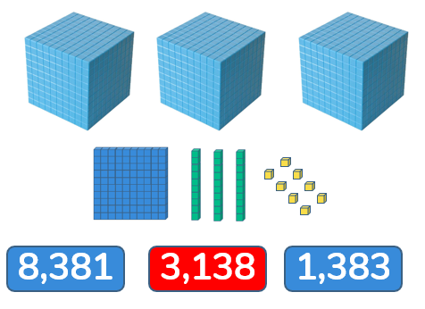
Year 5 Place Value Lesson 1
To be able to recognise and represent numbers up to 10,000
Talking time
Success Criteria: Must: I can use concrete resources to represent up to 9,999; Should: I can use pictorial representations to represent numbers up to 10,000; Could: I can represent numbers up to 10,000 using numeral or worded number forms.
Match the diagram to the number
http://bit.ly/Yr5PV To download lessons 1-5 click the link!

Slide 6
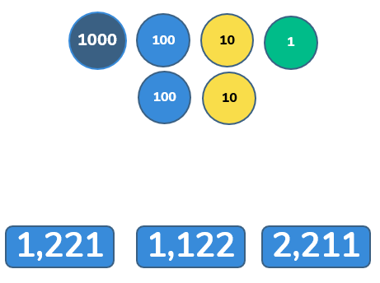
Year 5 Place Value Lesson 1
To be able to recognise and represent numbers up to 10,000
Talking time
Success Criteria: Must: I can use concrete resources to represent up to 9,999; Should: I can use pictorial representations to represent numbers up to 10,000; Could: I can represent numbers up to 10,000 using numeral or worded number forms.
Match the diagram to the number
http://bit.ly/Yr5PV To download lessons 1-5 click the link!

Slide 7
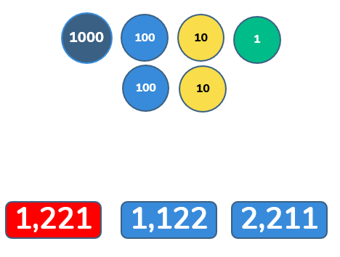
Year 5 Place Value Lesson 1
To be able to recognise and represent numbers up to 10,000
Talking time
Success Criteria: Must: I can use concrete resources to represent up to 9,999; Should: I can use pictorial representations to represent numbers up to 10,000; Could: I can represent numbers up to 10,000 using numeral or worded number forms.
Match the diagram to the number
http://bit.ly/Yr5PV To download lessons 1-5 click the link!

Slide 8
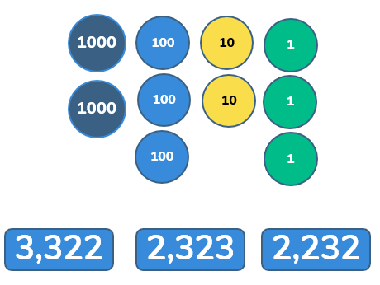
Year 5 Place Value Lesson 1
To be able to recognise and represent numbers up to 10,000
Talking time
Success Criteria: Must: I can use concrete resources to represent up to 9,999; Should: I can use pictorial representations to represent numbers up to 10,000; Could: I can represent numbers up to 10,000 using numeral or worded number forms.
Match the diagram to the number
http://bit.ly/Yr5PV To download lessons 1-5 click the link!

Slide 9
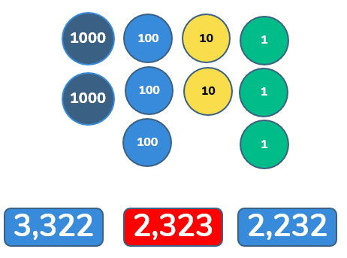
Year 5 Place Value Lesson 1
To be able to recognise and represent numbers up to 10,000
Talking time
Success Criteria: Must: I can use concrete resources to represent up to 9,999; Should: I can use pictorial representations to represent numbers up to 10,000; Could: I can represent numbers up to 10,000 using numeral or worded number forms.
Match the diagram to the number
http://bit.ly/Yr5PV To download lessons 1-5 click the link!

Slide 10
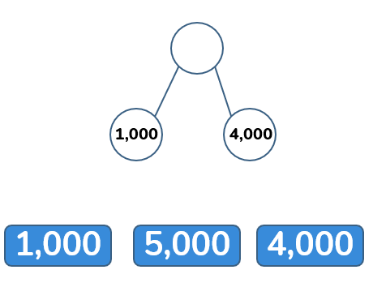
Year 5 Place Value Lesson 1
To be able to recognise and represent numbers up to 10,000
Talking time
Success Criteria: Must: I can use concrete resources to represent up to 9,999; Should: I can use pictorial representations to represent numbers up to 10,000; Could: I can represent numbers up to 10,000 using numeral or worded number forms.
Match the diagram to the number
http://bit.ly/Yr5PV To download lessons 1-5 click the link!

Slide 11
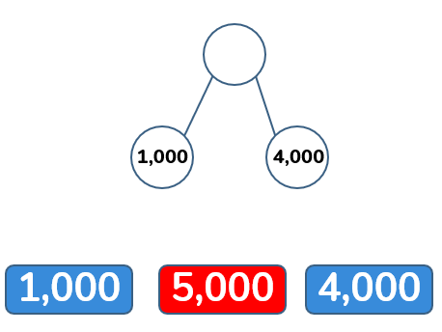
Year 5 Place Value Lesson 1
To be able to recognise and represent numbers up to 10,000
Talking time
Success Criteria: Must: I can use concrete resources to represent up to 9,999; Should: I can use pictorial representations to represent numbers up to 10,000; Could: I can represent numbers up to 10,000 using numeral or worded number forms.
Match the diagram to the number
http://bit.ly/Yr5PV To download lessons 1-5 click the link!

Slide 12
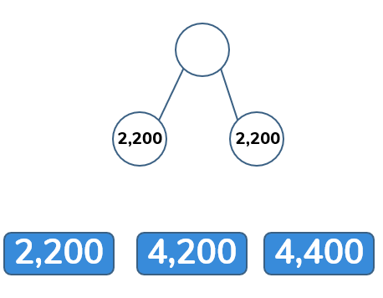
Year 5 Place Value Lesson 1
To be able to recognise and represent numbers up to 10,000
Talking time
Success Criteria: Must: I can use concrete resources to represent up to 9,999; Should: I can use pictorial representations to represent numbers up to 10,000; Could: I can represent numbers up to 10,000 using numeral or worded number forms.
Match the diagram to the number
http://bit.ly/Yr5PV To download lessons 1-5 click the link!

Slide 13
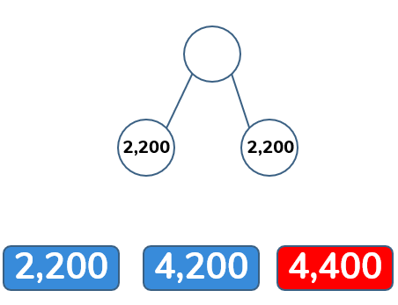
Year 5 Place Value Lesson 1
To be able to recognise and represent numbers up to 10,000
Talking time
Success Criteria: Must: I can use concrete resources to represent up to 9,999; Should: I can use pictorial representations to represent numbers up to 10,000; Could: I can represent numbers up to 10,000 using numeral or worded number forms.
Match the diagram to the number
http://bit.ly/Yr5PV To download lessons 1-5 click the link!

Slide 14
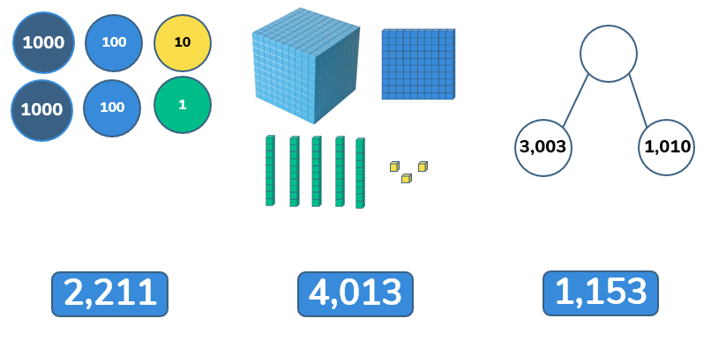
Year 5 Place Value Lesson 1
To be able to recognise and represent numbers up to 10,000
Activity 1:
Success Criteria: Must: I can use concrete resources to represent up to 9,999; Should: I can use pictorial representations to represent numbers up to 10,000; Could: I can represent numbers up to 10,000 using numeral or worded number forms.
Match each diagram to the correct number.
http://bit.ly/Yr5PV To download lessons 1-5 click the link!

Slide 15
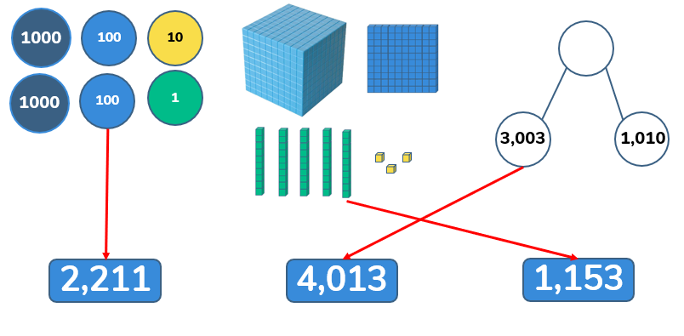
Year 5 Place Value Lesson 1
To be able to recognise and represent numbers up to 10,000
Activity 1:
Success Criteria: Must: I can use concrete resources to represent up to 9,999; Should: I can use pictorial representations to represent numbers up to 10,000; Could: I can represent numbers up to 10,000 using numeral or worded number forms.
Match each diagram to the correct number.
http://bit.ly/Yr5PV To download lessons 1-5 click the link!

Slide 16
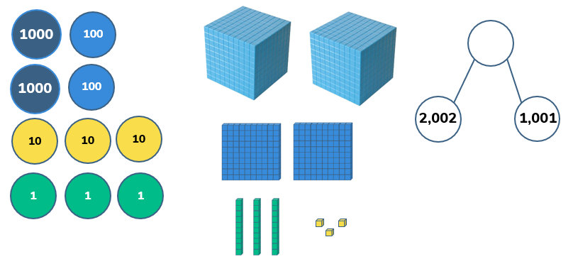
Year 5 Place Value Lesson 1
To be able to recognise and represent numbers up to 10,000
Talking time:
Success Criteria: Must: I can use concrete resources to represent up to 9,999; Should: I can use pictorial representations to represent numbers up to 10,000; Could: I can represent numbers up to 10,000 using numeral or worded number forms.
Which one doesn’t belong?
http://bit.ly/Yr5PV To download lessons 1-5 click the link!

Slide 17
Year 5 Place Value Lesson 1
To be able to recognise and represent numbers up to 10,000
Talking time:
Success Criteria: Must: I can use concrete resources to represent up to 9,999; Should: I can use pictorial representations to represent numbers up to 10,000; Could: I can represent numbers up to 10,000 using numeral or worded number forms.
Which one doesn’t belong?
http://bit.ly/Yr5PV To download lessons 1-5 click the link!

Slide 18
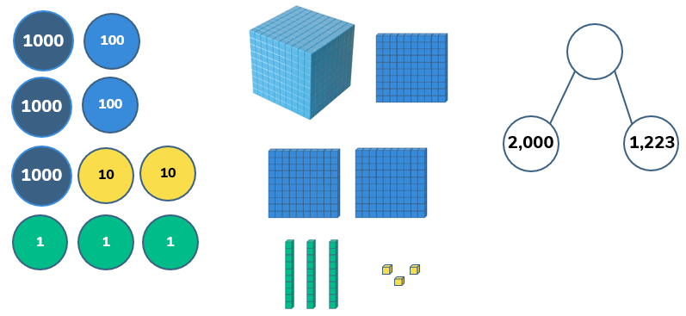
Year 5 Place Value Lesson 1
To be able to recognise and represent numbers up to 10,000
Talking time:
Success Criteria: Must: I can use concrete resources to represent up to 9,999; Should: I can use pictorial representations to represent numbers up to 10,000; Could: I can represent numbers up to 10,000 using numeral or worded number forms.
Which one doesn’t belong?
http://bit.ly/Yr5PV To download lessons 1-5 click the link!

Slide 19

Year 5 Place Value Lesson 1
To be able to recognise and represent numbers up to 10,000
Talking time:
Success Criteria: Must: I can use concrete resources to represent up to 9,999; Should: I can use pictorial representations to represent numbers up to 10,000; Could: I can represent numbers up to 10,000 using numeral or worded number forms.
Which one doesn’t belong?
http://bit.ly/Yr5PV To download lessons 1-5 click the link!

Slide 20
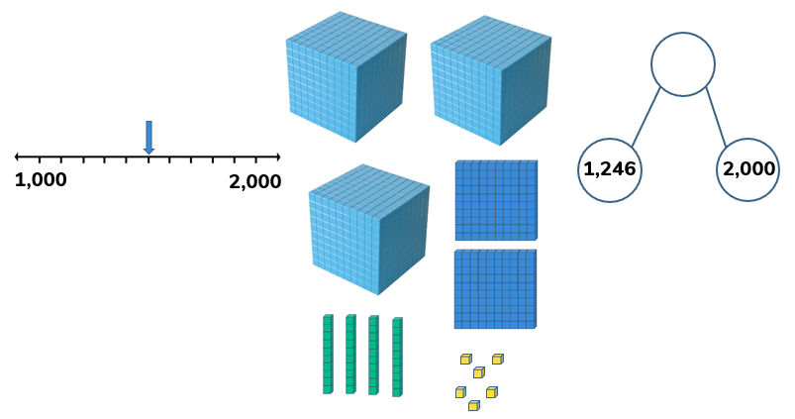
Year 5 Place Value Lesson 1
To be able to recognise and represent numbers up to 10,000
Talking time:
Success Criteria: Must: I can use concrete resources to represent up to 9,999; Should: I can use pictorial representations to represent numbers up to 10,000; Could: I can represent numbers up to 10,000 using numeral or worded number forms.
Which one doesn’t belong?
http://bit.ly/Yr5PV To download lessons 1-5 click the link!

Slide 21
Year 5 Place Value Lesson 1
To be able to recognise and represent numbers up to 10,000
Talking time:
Success Criteria: Must: I can use concrete resources to represent up to 9,999; Should: I can use pictorial representations to represent numbers up to 10,000; Could: I can represent numbers up to 10,000 using numeral or worded number forms.
Which one doesn’t belong?
http://bit.ly/Yr5PV To download lessons 1-5 click the link!

Slide 22
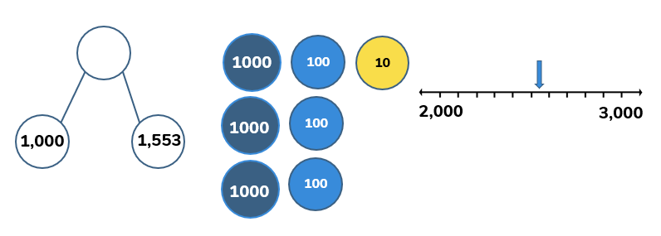
Year 5 Place Value Lesson 1
To be able to recognise and represent numbers up to 10,000
Activity 2:
Success Criteria: Must: I can use concrete resources to represent up to 9,999; Should: I can use pictorial representations to represent numbers up to 10,000; Could: I can represent numbers up to 10,000 using numeral or worded number forms.
Which one doesn’t belong?
Answer. Prove. Explain.
http://bit.ly/Yr5PV To download lessons 1-5 click the link!

Slide 23
Year 5 Place Value Lesson 1
To be able to recognise and represent numbers up to 10,000
Activity 2:
Success Criteria: Must: I can use concrete resources to represent up to 9,999; Should: I can use pictorial representations to represent numbers up to 10,000; Could: I can represent numbers up to 10,000 using numeral or worded number forms.
Which one doesn’t belong?
The place value counter representation doesn’t belong, as the part-whole model shows 2,553 and the number line has an arrow pointing approximately halfway between 2,500 and 2,600 meaning it is likely to be 2,553. Therefore, the place value counter representation doesn’t belong.
http://bit.ly/Yr5PV To download lessons 1-5 click the link!

Slide 24
Year 5 Place Value Lesson 1
To be able to recognise and represent numbers up to 10,000
Talking time:
Success Criteria: Must: I can use concrete resources to represent up to 9,999; Should: I can use pictorial representations to represent numbers up to 10,000; Could: I can represent numbers up to 10,000 using numeral or worded number forms.
Complete the table below:
 | Add 10 | Add 100 | Add 1,000
1,203
2,405
 |  | 7,107
http://bit.ly/Yr5PV To download lessons 1-5 click the link!
Notes:
Children can use place value counters or Base 10 (Dienes blocks) as a means of differentiation. You could also provide place value tables or encourage pupils to use them on their mini-whiteboards.

Slide 25
Year 5 Place Value Lesson 1
To be able to recognise and represent numbers up to 10,000
Talking time:
Success Criteria: Must: I can use concrete resources to represent up to 9,999; Should: I can use pictorial representations to represent numbers up to 10,000; Could: I can represent numbers up to 10,000 using numeral or worded number forms.
Complete the table below:
 | Add 10 | Add 100 | Add 1,000
1,203 | 1,213 | 1,303 | 2,203
2,405 | 2,415 | 2,505 | 3,405
7,007 | 7, 017 | 7,107 | 8,007
http://bit.ly/Yr5PV To download lessons 1-5 click the link!

Slide 26
Year 5 Place Value Lesson 1
To be able to recognise and represent numbers up to 10,000
Activity 3:
Success Criteria: Must: I can use concrete resources to represent up to 9,999; Should: I can use pictorial representations to represent numbers up to 10,000; Could: I can represent numbers up to 10,000 using numeral or worded number forms.
Complete the table below:
 | Add 10 | Add 100 | Add 1,000
2,406
5,823
 |  |  | 8,888
http://bit.ly/Yr5PV To download lessons 1-5 click the link!
Notes:
Children can use place value counters or Base 10 (Dienes blocks) as a means of differentiation. You could also provide place value tables or encourage pupils to use them on their mini-whiteboards.

Slide 27
Year 5 Place Value Lesson 1
To be able to recognise and represent numbers up to 10,000
Activity 3:
Success Criteria: Must: I can use concrete resources to represent up to 9,999; Should: I can use pictorial representations to represent numbers up to 10,000; Could: I can represent numbers up to 10,000 using numeral or worded number forms.
Complete the table below:
 | Add 10 | Add 100 | Add 1,000
2,406 | 2,416 | 2,506 | 3,406
5,823 | 5,833 | 5,923 | 6,823
7,088 | 7,098 | 7,188 | 8,088
http://bit.ly/Yr5PV To download lessons 1-5 click the link!

Slide 28
Year 5 Place Value Lesson 1
To be able to recognise and represent numbers up to 10,000
Activity 4:
Success Criteria: Must: I can use concrete resources to represent up to 9,999; Should: I can use pictorial representations to represent numbers up to 10,000; Could: I can represent numbers up to 10,000 using numeral or worded number forms.
James has made four 5-digit numbers using the digits 9, 7, 5, 3 and 1.
He has changed each number into a letter.
His numbers are:
1) zz,zzz
2) yy,yyy
3) xy,vwx
4) xy,wvx
Here are some clues:
Number 2 is the smallest possible number;
z is the greatest value digit;
w is greater than v, and v is greater than x.
http://bit.ly/Yr5PV To download lessons 1-5 click the link!

Slide 29
Year 5 Place Value Lesson 1
To be able to recognise and represent numbers up to 10,000
Activity 4:
Success Criteria: Must: I can use concrete resources to represent up to 9,999; Should: I can use pictorial representations to represent numbers up to 10,000; Could: I can represent numbers up to 10,000 using numeral or worded number forms.
James has made four 5-digit numbers using the digits 9, 7, 5, 3 and 1.
He has changed each number into a letter.
His numbers are arranged from largest to smallest:
1) zz,zzz
2) xy,wvx
3) xy,vwx
4) yy,yyy
It is first important to figure out the value of each letter. We should know that Number 1 is 99,999 so z is worth 9. We can then work out that y is 1, because Number 4 is the lowest possible value number. From there we can figure out that w is 7, v is 5 and x is 3 based on the third clue. Number 1 is 99,999; Number 4 is 11,111; Number 3 is 31,573; Number 2 is 31,753.
http://bit.ly/Yr5PV To download lessons 1-5 click the link!

Slide 30
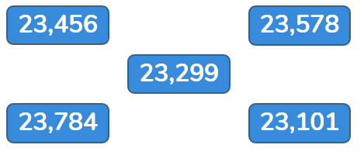

Year 5 Place Value Lesson 1
To be able to recognise and represent numbers up to 10,000
Evaluation:
Success Criteria: Must: I can use concrete resources to represent up to 9,999; Should: I can use pictorial representations to represent numbers up to 10,000; Could: I can represent numbers up to 10,000 using numeral or worded number forms.
Chen says, “I can order the following numbers by only looking at the first three digits.”
Chen is correct.
Explain why Chen is correct.
http://bit.ly/Yr5PV To download lessons 1-5 click the link!

Slide 31
Year 5 Place Value Lesson 1
To be able to recognise and represent numbers up to 10,000
Evaluation:
Success Criteria: Must: I can use concrete resources to represent up to 9,999; Should: I can use pictorial representations to represent numbers up to 10,000; Could: I can represent numbers up to 10,000 using numeral or worded number forms.
Chen says, “I can order the following numbers by only looking at the first three digits.”
Chen is correct.
Explain why Chen is correct.
Chen is correct because the first two digits are the same in the ten thousands and thousands columns, but each of the five numbers has a different value digit in the hundreds column, so he only needs to look at that third largest value column. Therefore, Chen is correct when he says that he can order the following numbers by only looking at the first three digits.
The ascending order would be:
23,101; 23,299; 23,456; 23,578; 23,784
http://bit.ly/Yr5PV To download lessons 1-5 click the link!

