Slide 1

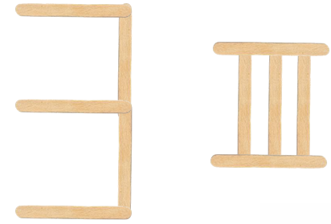
Year 5 Place Value Lesson 2
To be able to recognise and use Roman Numerals up to M (1,000)
Starter:
Success Criteria: Must: I can use concrete resources to represent Roman Numerals up to C (100); Should: I can represent numbers up to C (100) using Roman Numerals; Could: I can represent numbers up to M (1,000) using Roman Numerals.
I am going to shout out some numbers, you need to make them in their numeral and Roman Numeral form using the lollipop sticks on your table.
For example, three would be:
thirdspacelearning.com Specialist 1-to-1 maths interventions and curriculum resources

Slide 2
Year 5 Place Value Lesson 2
To be able to recognise and use Roman Numerals up to M (1,000)
Activity 1:
Success Criteria: Must: I can use concrete resources to represent Roman Numerals up to C (100); Should: I can represent numbers up to C (100) using Roman Numerals; Could: I can represent numbers up to M (1,000) using Roman Numerals.
The Roman numerals in order are:
I which is 1, V which is 5, X which is 10, L which is 50, C which is 100, D which is 500, and M which is 1,000.
A way to remember the order is using the following sentence:
I Value Xylophones Like Cows Dig Milk
Working with your table partner, write your own sentence to help you remember!
thirdspacelearning.com Specialist 1-to-1 maths interventions and curriculum resources

Slide 3
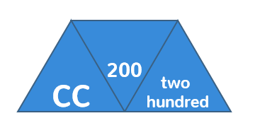
Year 5 Place Value Lesson 2
To be able to recognise and use Roman Numerals up to M (1,000)
Talking time:
Success Criteria: Must: I can use concrete resources to represent Roman Numerals up to C (100); Should: I can represent numbers up to C (100) using Roman Numerals; Could: I can represent numbers up to M (1,000) using Roman Numerals.
Each diagram shows a number in numerals, words and Roman Numerals.
For example:
thirdspacelearning.com Specialist 1-to-1 maths interventions and curriculum resources

Slide 4
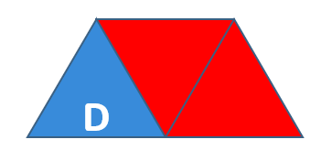
Year 5 Place Value Lesson 2
To be able to recognise and use Roman Numerals up to M (1,000)
Talking time:
Success Criteria: Must: I can use concrete resources to represent Roman Numerals up to C (100); Should: I can represent numbers up to C (100) using Roman Numerals; Could: I can represent numbers up to M (1,000) using Roman Numerals.
Each diagram shows a number in numerals, words and Roman Numerals.
Complete the diagram:
thirdspacelearning.com Specialist 1-to-1 maths interventions and curriculum resources

Slide 5
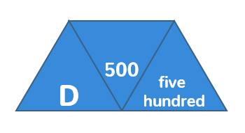
Year 5 Place Value Lesson 2
To be able to recognise and use Roman Numerals up to M (1,000)
Talking time:
Success Criteria: Must: I can use concrete resources to represent Roman Numerals up to C (100); Should: I can represent numbers up to C (100) using Roman Numerals; Could: I can represent numbers up to M (1,000) using Roman Numerals.
Each diagram shows a number in numerals, words and Roman Numerals.
Complete the diagram:
thirdspacelearning.com Specialist 1-to-1 maths interventions and curriculum resources

Slide 6
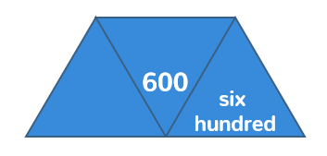
Year 5 Place Value Lesson 2
To be able to recognise and use Roman Numerals up to M (1,000)
Talking time:
Success Criteria: Must: I can use concrete resources to represent Roman Numerals up to C (100); Should: I can represent numbers up to C (100) using Roman Numerals; Could: I can represent numbers up to M (1,000) using Roman Numerals.
Each diagram shows a number in numerals, words and Roman Numerals.
Complete the diagram:
thirdspacelearning.com Specialist 1-to-1 maths interventions and curriculum resources

Slide 7
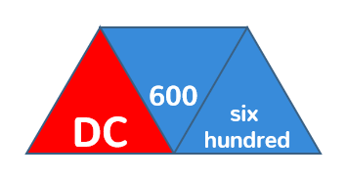
Year 5 Place Value Lesson 2
To be able to recognise and use Roman Numerals up to M (1,000)
Talking time:
Success Criteria: Must: I can use concrete resources to represent Roman Numerals up to C (100); Should: I can represent numbers up to C (100) using Roman Numerals; Could: I can represent numbers up to M (1,000) using Roman Numerals.
Each diagram shows a number in numerals, words and Roman Numerals.
Complete the diagram:
thirdspacelearning.com Specialist 1-to-1 maths interventions and curriculum resources

Slide 8
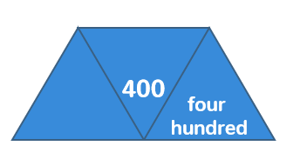
Year 5 Place Value Lesson 2
To be able to recognise and use Roman Numerals up to M (1,000)
Talking time:
Success Criteria: Must: I can use concrete resources to represent Roman Numerals up to C (100); Should: I can represent numbers up to C (100) using Roman Numerals; Could: I can represent numbers up to M (1,000) using Roman Numerals.
Each diagram shows a number in numerals, words and Roman Numerals.
Complete the diagram:
thirdspacelearning.com Specialist 1-to-1 maths interventions and curriculum resources

Slide 9
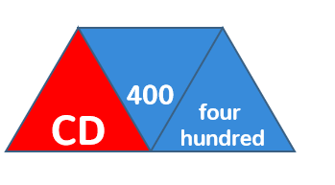
Year 5 Place Value Lesson 2
To be able to recognise and use Roman Numerals up to M (1,000)
Talking time:
Success Criteria: Must: I can use concrete resources to represent Roman Numerals up to C (100); Should: I can represent numbers up to C (100) using Roman Numerals; Could: I can represent numbers up to M (1,000) using Roman Numerals.
Each diagram shows a number in numerals, words and Roman Numerals.
Complete the diagram:
thirdspacelearning.com Specialist 1-to-1 maths interventions and curriculum resources

Slide 10
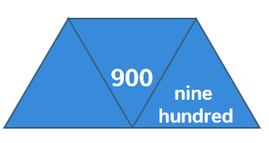
Year 5 Place Value Lesson 2
To be able to recognise and use Roman Numerals up to M (1,000)
Talking time:
Success Criteria: Must: I can use concrete resources to represent Roman Numerals up to C (100); Should: I can represent numbers up to C (100) using Roman Numerals; Could: I can represent numbers up to M (1,000) using Roman Numerals.
Each diagram shows a number in numerals, words and Roman Numerals.
Complete the diagram:
thirdspacelearning.com Specialist 1-to-1 maths interventions and curriculum resources

Slide 11
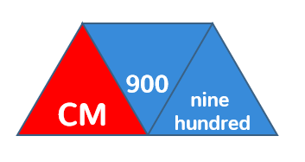
Year 5 Place Value Lesson 2
To be able to recognise and use Roman Numerals up to M (1,000)
Talking time:
Success Criteria: Must: I can use concrete resources to represent Roman Numerals up to C (100); Should: I can represent numbers up to C (100) using Roman Numerals; Could: I can represent numbers up to M (1,000) using Roman Numerals.
Each diagram shows a number in numerals, words and Roman Numerals.
Complete the diagram:
thirdspacelearning.com Specialist 1-to-1 maths interventions and curriculum resources

Slide 12
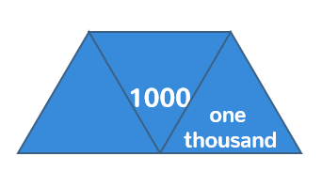
Year 5 Place Value Lesson 2
To be able to recognise and use Roman Numerals up to M (1,000)
Talking time:
Success Criteria: Must: I can use concrete resources to represent Roman Numerals up to C (100); Should: I can represent numbers up to C (100) using Roman Numerals; Could: I can represent numbers up to M (1,000) using Roman Numerals.
Each diagram shows a number in numerals, words and Roman Numerals.
Complete the diagram:
thirdspacelearning.com Specialist 1-to-1 maths interventions and curriculum resources

Slide 13
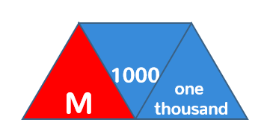
Year 5 Place Value Lesson 2
To be able to recognise and use Roman Numerals up to M (1,000)
Talking time:
Success Criteria: Must: I can use concrete resources to represent Roman Numerals up to C (100); Should: I can represent numbers up to C (100) using Roman Numerals; Could: I can represent numbers up to M (1,000) using Roman Numerals.
Each diagram shows a number in numerals, words and Roman Numerals.
Complete the diagram:
thirdspacelearning.com Specialist 1-to-1 maths interventions and curriculum resources

Slide 14
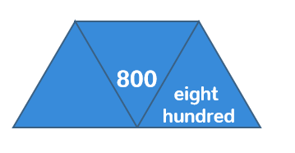
Year 5 Place Value Lesson 2
To be able to recognise and use Roman Numerals up to M (1,000)
Talking time:
Success Criteria: Must: I can use concrete resources to represent Roman Numerals up to C (100); Should: I can represent numbers up to C (100) using Roman Numerals; Could: I can represent numbers up to M (1,000) using Roman Numerals.
Each diagram shows a number in numerals, words and Roman Numerals.
Complete the diagram:
thirdspacelearning.com Specialist 1-to-1 maths interventions and curriculum resources

Slide 15
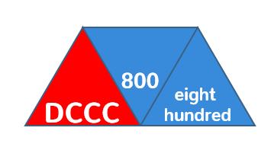
Year 5 Place Value Lesson 2
To be able to recognise and use Roman Numerals up to M (1,000)
Talking time:
Success Criteria: Must: I can use concrete resources to represent Roman Numerals up to C (100); Should: I can represent numbers up to C (100) using Roman Numerals; Could: I can represent numbers up to M (1,000) using Roman Numerals.
Each diagram shows a number in numerals, words and Roman Numerals.
Complete the diagram:
thirdspacelearning.com Specialist 1-to-1 maths interventions and curriculum resources

Slide 16
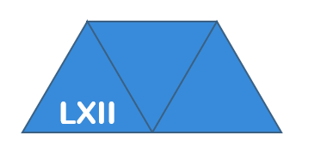
Year 5 Place Value Lesson 2
To be able to recognise and use Roman Numerals up to M (1,000)
Talking time:
Success Criteria: Must: I can use concrete resources to represent Roman Numerals up to C (100); Should: I can represent represent numbers up to C (100) using Roman Numerals; Could: I can represent numbers up to M (1,000) using Roman Numerals.
Each diagram shows a number in numerals, words and Roman Numerals.
Complete the diagram:
thirdspacelearning.com Specialist 1-to-1 maths interventions and curriculum resources

Slide 17
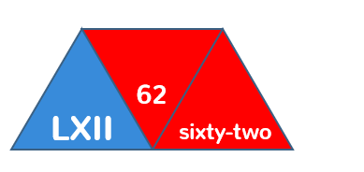
Year 5 Place Value Lesson 2
To be able to recognise and use Roman Numerals up to M (1,000)
Talking time:
Success Criteria: Must: I can use concrete resources to represent Roman Numerals up to C (100); Should: I can represent numbers up to C (100) using Roman Numerals; Could: I can represent numbers up to M (1,000) using Roman Numerals.
Each diagram shows a number in numerals, words and Roman Numerals.
Complete the diagram:
thirdspacelearning.com Specialist 1-to-1 maths interventions and curriculum resources

Slide 18
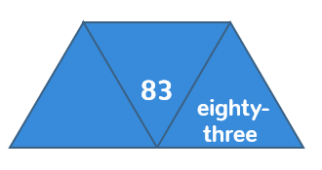
Year 5 Place Value Lesson 2
To be able to recognise and use Roman Numerals up to M (1,000)
Talking time:
Success Criteria: Must: I can use concrete resources to represent Roman Numerals up to C (100); Should: I can represent numbers up to C (100) using Roman Numerals; Could: I can represent numbers up to M (1,000) using Roman Numerals.
Each diagram shows a number in numerals, words and Roman Numerals.
Complete the diagram:
thirdspacelearning.com Specialist 1-to-1 maths interventions and curriculum resources

Slide 19
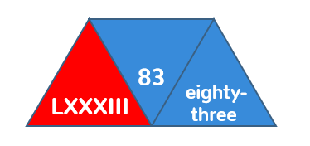
Year 5 Place Value Lesson 2
To be able to recognise and use Roman Numerals up to M (1,000)
Talking time:
Success Criteria: Must: I can use concrete resources to represent Roman Numerals up to C (100); Should: I can represent numbers up to C (100) using Roman Numerals; Could: I can represent numbers up to M (1,000) using Roman Numerals.
Each diagram shows a number in numerals, words and Roman Numerals.
Complete the diagram:
thirdspacelearning.com Specialist 1-to-1 maths interventions and curriculum resources

Slide 20
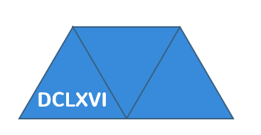
Year 5 Place Value Lesson 2
To be able to recognise and use Roman Numerals up to M (1,000)
Talking time:
Success Criteria: Must: I can use concrete resources to represent Roman Numerals up to C (100); Should: I can represent numbers up to C (100) using Roman Numerals; Could: I can represent numbers up to M (1,000) using Roman Numerals.
Each diagram shows a number in numerals, words and Roman Numerals.
Complete the diagram:
thirdspacelearning.com Specialist 1-to-1 maths interventions and curriculum resources

Slide 21
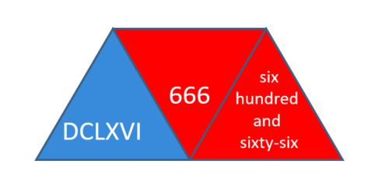
Year 5 Place Value Lesson 2
To be able to recognise and use Roman Numerals up to M (1,000)
Talking time:
Success Criteria: Must: I can use concrete resources to represent Roman Numerals up to C (100); Should: I can represent numbers up to C (100) using Roman Numerals; Could: I can represent numbers up to M (1,000) using Roman Numerals.
Each diagram shows a number in numerals, words and Roman Numerals.
Complete the diagram:
thirdspacelearning.com Specialist 1-to-1 maths interventions and curriculum resources

Slide 22
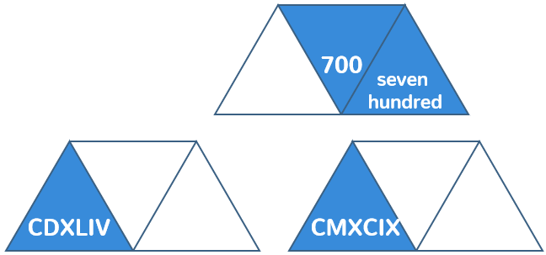
Year 5 Place Value Lesson 2
To be able to recognise and use Roman Numerals up to M (1,000)
Activity 2:
Success Criteria: Must: I can use concrete resources to represent Roman Numerals up to C (100); Should: I can represent numbers up to C (100) using Roman Numerals; Could: I can represent numbers up to M (1,000) using Roman Numerals.
Each diagram shows a number in numerals, words and Roman Numerals.
Complete the diagram:
thirdspacelearning.com Specialist 1-to-1 maths interventions and curriculum resources

Slide 23
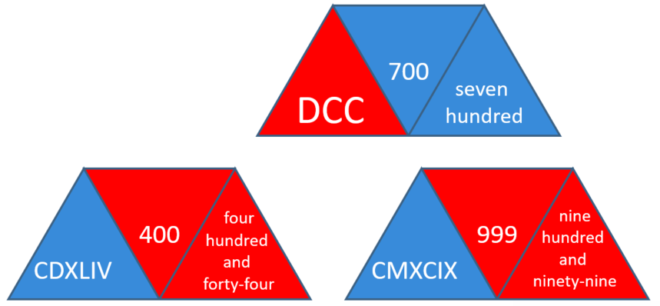
Year 5 Place Value Lesson 2
To be able to recognise and use Roman Numerals up to M (1,000)
Activity 2:
Success Criteria: Must: I can use concrete resources to represent Roman Numerals up to C (100); Should: I can represent numbers up to C (100) using Roman Numerals; Could: I can represent numbers up to M (1,000) using Roman Numerals.
Each diagram shows a number in numerals, words and Roman Numerals.
Complete the diagram:
thirdspacelearning.com Specialist 1-to-1 maths interventions and curriculum resources

Slide 24

Year 5 Place Value Lesson 2
To be able to recognise and use Roman Numerals up to M (1,000)
Talking time:
Success Criteria: Must: I can use concrete resources to represent Roman Numerals up to C (100); Should: I can represent numbers up to C (100) using Roman Numerals; Could: I can represent numbers up to M (1,000) using Roman Numerals.
Complete the function machine below:
thirdspacelearning.com Specialist 1-to-1 maths interventions and curriculum resources

Slide 25

Year 5 Place Value Lesson 2
To be able to recognise and use Roman Numerals up to M (1,000)
Talking time:
Success Criteria: Must: I can use concrete resources to represent Roman Numerals up to C (100); Should: I can represent represent numbers up to C (100) using Roman Numerals; Could: I can represent numbers up to M (1,000) using Roman Numerals.
Complete the function machine below:
thirdspacelearning.com Specialist 1-to-1 maths interventions and curriculum resources

Slide 26

Year 5 Place Value Lesson 2
To be able to recognise and use Roman Numerals up to M (1,000)
Talking time:
Success Criteria: Must: I can use concrete resources to represent Roman Numerals up to C (100); Should: I can represent numbers up to C (100) using Roman Numerals; Could: I can represent numbers up to M (1,000) using Roman Numerals.
Complete the function machine below:
thirdspacelearning.com Specialist 1-to-1 maths interventions and curriculum resources

Slide 27

Year 5 Place Value Lesson 2
To be able to recognise and use Roman Numerals up to M (1,000)
Talking time:
Success Criteria: Must: I can use concrete resources to represent Roman Numerals up to C (100); Should: I can represent numbers up to C (100) using Roman Numerals; Could: I can represent numbers up to M (1,000) using Roman Numerals.
Complete the function machine below:
thirdspacelearning.com Specialist 1-to-1 maths interventions and curriculum resources

Slide 28

Year 5 Place Value Lesson 2
To be able to recognise and use Roman Numerals up to M (1,000)
Talking time:
Success Criteria: Must: I can use concrete resources to represent Roman Numerals up to C (100); Should: I can represent numbers up to C (100) using Roman Numerals; Could: I can represent numbers up to M (1,000) using Roman Numerals.
Complete the function machine below:
thirdspacelearning.com Specialist 1-to-1 maths interventions and curriculum resources

Slide 29

Year 5 Place Value Lesson 2
To be able to recognise and use Roman Numerals up to M (1,000)
Talking time:
Success Criteria: Must: I can use concrete resources to represent Roman Numerals up to C (100); Should: I can represent numbers up to C (100) using Roman Numerals; Could: I can represent numbers up to M (1,000) using Roman Numerals.
Complete the function machine below:
thirdspacelearning.com Specialist 1-to-1 maths interventions and curriculum resources

Slide 30

Year 5 Place Value Lesson 2
To be able to recognise and use Roman Numerals up to M (1,000)
Talking time:
Success Criteria: Must: I can use concrete resources to represent Roman Numerals up to C (100); Should: I can represent numbers up to C (100) using Roman Numerals; Could: I can represent numbers up to M (1,000) using Roman Numerals.
Complete the function machine below:
thirdspacelearning.com Specialist 1-to-1 maths interventions and curriculum resources

Slide 31

Year 5 Place Value Lesson 2
To be able to recognise and use Roman Numerals up to M (1,000)
Talking time:
Success Criteria: Must: I can use concrete resources to represent Roman Numerals up to C (100); Should: I can represent numbers up to C (100) using Roman Numerals; Could: I can represent numbers up to M (1,000) using Roman Numerals.
Complete the function machine below:
thirdspacelearning.com Specialist 1-to-1 maths interventions and curriculum resources

Slide 32

Year 5 Place Value Lesson 2
To be able to recognise and use Roman Numerals up to M (1,000)
Talking time:
Success Criteria: Must: I can use concrete resources to represent Roman Numerals up to C (100); Should: I can represent numbers up to C (100) using Roman Numerals; Could: I can represent numbers up to M (1,000) using Roman Numerals.
Complete the function machine below:
thirdspacelearning.com Specialist 1-to-1 maths interventions and curriculum resources

Slide 33

Year 5 Place Value Lesson 2
To be able to recognise and use Roman Numerals up to M (1,000)
Talking time:
Success Criteria: Must: I can use concrete resources to represent Roman Numerals up to C (100); Should: I can represent numbers up to C (100) using Roman Numerals; Could: I can represent numbers up to M (1,000) using Roman Numerals.
Complete the function machine below:
thirdspacelearning.com Specialist 1-to-1 maths interventions and curriculum resources

Slide 34
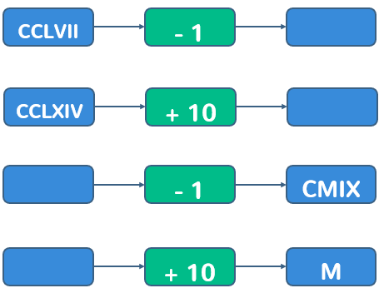
Year 5 Place Value Lesson 2
To be able to recognise and use Roman Numerals up to M (1,000)
Activity 3:
Success Criteria: Must: I can use concrete resources to represent Roman Numerals up to C (100); Should: I can represent numbers up to C (100) using Roman Numerals; Could: I can represent numbers up to M (1,000) using Roman Numerals.
Complete the function machine below:
a)
b)
c)
d)
thirdspacelearning.com Specialist 1-to-1 maths interventions and curriculum resources

Slide 35
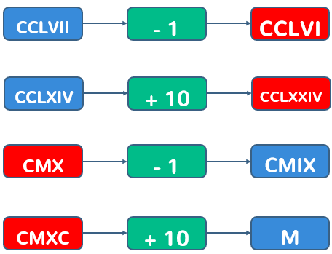
Year 5 Place Value Lesson 2
To be able to recognise and use Roman Numerals up to M (1,000)
Activity 3:
Success Criteria: Must: I can use concrete resources to represent Roman Numerals up to C (100); Should: I can represent numbers up to C (100) using Roman Numerals; Could: I can represent numbers up to M (1,000) using Roman Numerals.
Complete the function machine below:
a)
b)
c)
d)
thirdspacelearning.com Specialist 1-to-1 maths interventions and curriculum resources

Slide 36

Year 5 Place Value Lesson 2
To be able to recognise and use Roman Numerals up to M (1,000)
Activity 4:
Success Criteria: Must: I can use concrete resources to represent Roman Numerals up to C (100); Should: I can represent numbers up to C (100) using Roman Numerals; Could: I can represent numbers up to M (1,000) using Roman Numerals.
Solve the following Roman Numeral calculation:
How many calculations, using Roman Numerals, can you write to get the same total?
thirdspacelearning.com Specialist 1-to-1 maths interventions and curriculum resources

Slide 37
Year 5 Place Value Lesson 2
To be able to recognise and use Roman Numerals up to M (1,000)
Activity 4:
Success Criteria: Must: I can use concrete resources to represent Roman Numerals up to C (100); Should: I can represent numbers up to C (100) using Roman Numerals; Could: I can represent numbers up to M (1,000) using Roman Numerals.
Solve the following Roman Numeral calculation:
How many calculations, using Roman Numerals, can you write to get the same total?
Possible answers:
D + C = DC
DCC – C = DC
DXCIX + I = DC
DCI – I = DC
DCX – X = DC etc.
thirdspacelearning.com Specialist 1-to-1 maths interventions and curriculum resources

Slide 38

Year 5 Place Value Lesson 2
To be able to recognise and use Roman Numerals up to M (1,000)
Evaluation:
Success Criteria: Must: I can use concrete resources to represent Roman Numerals up to C (100); Should: I can represent numbers up to C (100) using Roman Numerals; Could: I can represent numbers up to M (1,000) using Roman Numerals.
Chen says, “I can remember my Roman Numerals backwards. My Dog Chases Lizards – X-ray Vision Intently.”
Do you find this sentence more helpful than
I Value Xylophones Like Cows Dig Milk - if so, why?
Answer. Prove. Explain.
thirdspacelearning.com Specialist 1-to-1 maths interventions and curriculum resources
Notes:
Children may find mnemonics helpful, they may not, in terms of metacognition (thinking about thinking) it is worthwhile for the children to consider it as a strategy and in time choose whether to use known mnemonics or write their own. Or not.

