Slide 1

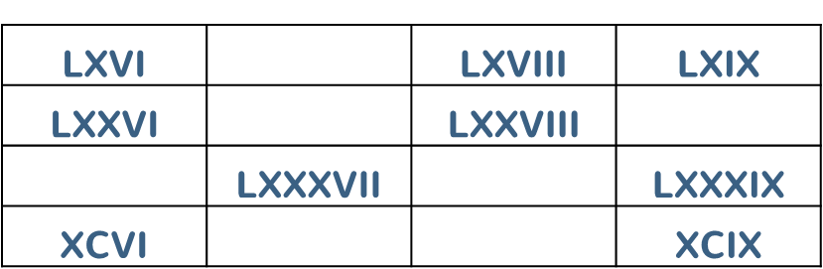
Year 5 Place Value Lesson 3
To be able to round to the nearest 10, 100 and 1,000
Starter:
Success Criteria: Must: I can use concrete resources to round to the nearest 1,000; Should: I can use pictorial representations to round to the nearest 1,000, 100 and 10; Could: I can round to the nearest 1,000, 100 and 10 using numeral representations.
Here is part of a Roman Numeral hundred square.
Complete the missing values.
Extension Can you notice any patterns?
thirdspacelearning.com Specialist 1-to-1 maths interventions and curriculum resources

Slide 2
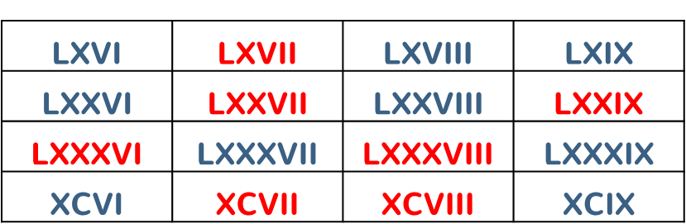
Year 5 Place Value Lesson 3
To be able to round to the nearest 10, 100 and 1,000
Success Criteria: Must: I can use concrete resources to round to the nearest 1,000; Should: I can use pictorial representations to round to the nearest 1,000, 100 and 10; Could: I can round to the nearest 1,000, 100 and 10 using numeral representations.
Starter:
Here is part of a Roman Numeral hundred square.
Complete the missing values.
Extension Each column increases by ten more as you go down each time; each row increases by one more as you move right each time.
thirdspacelearning.com Specialist 1-to-1 maths interventions and curriculum resources

Slide 3

Year 5 Place Value Lesson 3
To be able to round to the nearest 10, 100 and 1,000
Talking time:
Which multiple of 10 is the number closer to?
Success Criteria: Must: I can use concrete resources to round to the nearest 1,000; Should: I can use pictorial representations to round to the nearest 1,000, 100 and 10; Could: I can round to the nearest 1,000, 100 and 10 using numeral representations.
thirdspacelearning.com Specialist 1-to-1 maths interventions and curriculum resources

Slide 4

Year 5 Place Value Lesson 3
To be able to round to the nearest 10, 100 and 1,000
Talking time:
Which multiple of 10 is the number closer to?
Success Criteria: Must: I can use concrete resources to round to the nearest 1,000; Should: I can use pictorial representations to round to the nearest 1,000, 100 and 10; Could: I can round to the nearest 1,000, 100 and 10 using numeral representations.
thirdspacelearning.com Specialist 1-to-1 maths interventions and curriculum resources

Slide 5

Year 5 Place Value Lesson 3
To be able to round to the nearest 10, 100 and 1,000
Talking time:
Which multiple of 10 is the number closer to?
Success Criteria: Must: I can use concrete resources to round to the nearest 1,000; Should: I can use pictorial representations to round to the nearest 1,000, 100 and 10; Could: I can round to the nearest 1,000, 100 and 10 using numeral representations.
thirdspacelearning.com Specialist 1-to-1 maths interventions and curriculum resources

Slide 6

Year 5 Place Value Lesson 3
To be able to round to the nearest 10, 100 and 1,000
Talking time:
Which multiple of 10 is the number closer to?
Success Criteria: Must: I can use concrete resources to round to the nearest 1,000; Should: I can use pictorial representations to round to the nearest 1,000, 100 and 10; Could: I can round to the nearest 1,000, 100 and 10 using numeral representations.
thirdspacelearning.com Specialist 1-to-1 maths interventions and curriculum resources

Slide 7

Year 5 Place Value Lesson 3
To be able to round to the nearest 10, 100 and 1,000
Talking time:
Which multiple of 10 is the number closer to?
Success Criteria: Must: I can use concrete resources to round to the nearest 1,000; Should: I can use pictorial representations to round to the nearest 1,000, 100 and 10; Could: I can round to the nearest 1,000, 100 and 10 using numeral representations.
thirdspacelearning.com Specialist 1-to-1 maths interventions and curriculum resources

Slide 8

Year 5 Place Value Lesson 3
To be able to round to the nearest 10, 100 and 1,000
Talking time:
Which multiple of 10 is the number closer to?
Success Criteria: Must: I can use concrete resources to round to the nearest 1,000; Should: I can use pictorial representations to round to the nearest 1,000, 100 and 10; Could: I can round to the nearest 1,000, 100 and 10 using numeral representations.
thirdspacelearning.com Specialist 1-to-1 maths interventions and curriculum resources

Slide 9

Year 5 Place Value Lesson 3
To be able to round to the nearest 10, 100 and 1,000
Talking time:
Which multiple of 100 is the number closer to?
Success Criteria: Must: I can use concrete resources to round to the nearest 1,000; Should: I can use pictorial representations to round to the nearest 1,000, 100 and 10; Could: I can round to the nearest 1,000, 100 and 10 using numeral representations.
thirdspacelearning.com Specialist 1-to-1 maths interventions and curriculum resources

Slide 10

Year 5 Place Value Lesson 3
To be able to round to the nearest 10, 100 and 1,000
Talking time:
Which multiple of 100 is the number closer to?
Success Criteria: Must: I can use concrete resources to round to the nearest 1,000; Should: I can use pictorial representations to round to the nearest 1,000, 100 and 10; Could: I can round to the nearest 1,000, 100 and 10 using numeral representations.
thirdspacelearning.com Specialist 1-to-1 maths interventions and curriculum resources

Slide 11

Year 5 Place Value Lesson 3
To be able to round to the nearest 10, 100 and 1,000
Talking time:
Which multiple of 100 is the number closer to?
Success Criteria: Must: I can use concrete resources to round to the nearest 1,000; Should: I can use pictorial representations to round to the nearest 1,000, 100 and 10; Could: I can round to the nearest 1,000, 100 and 10 using numeral representations.
thirdspacelearning.com Specialist 1-to-1 maths interventions and curriculum resources

Slide 12

Year 5 Place Value Lesson 3
To be able to round to the nearest 10, 100 and 1,000
Talking time:
Which multiple of 100 is the number closer to?
Success Criteria: Must: I can use concrete resources to round to the nearest 1,000; Should: I can use pictorial representations to round to the nearest 1,000, 100 and 10; Could: I can round to the nearest 1,000, 100 and 10 using numeral representations.
thirdspacelearning.com Specialist 1-to-1 maths interventions and curriculum resources

Slide 13

Year 5 Place Value Lesson 3
To be able to round to the nearest 10, 100 and 1,000
Talking time:
Which multiple of 100 is the number closer to?
Success Criteria: Must: I can use concrete resources to round to the nearest 1,000; Should: I can use pictorial representations to round to the nearest 1,000, 100 and 10; Could: I can round to the nearest 1,000, 100 and 10 using numeral representations.
thirdspacelearning.com Specialist 1-to-1 maths interventions and curriculum resources

Slide 14

Year 5 Place Value Lesson 3
To be able to round to the nearest 10, 100 and 1,000
Talking time:
Which multiple of 100 is the number closer to?
Success Criteria: Must: I can use concrete resources to round to the nearest 1,000; Should: I can use pictorial representations to round to the nearest 1,000, 100 and 10; Could: I can round to the nearest 1,000, 100 and 10 using numeral representations.
thirdspacelearning.com Specialist 1-to-1 maths interventions and curriculum resources

Slide 15

Year 5 Place Value Lesson 3
To be able to round to the nearest 10, 100 and 1,000
Talking time:
Which multiple of 100 is the number closer to?
Success Criteria: Must: I can use concrete resources to round to the nearest 1,000; Should: I can use pictorial representations to round to the nearest 1,000, 100 and 10; Could: I can round to the nearest 1,000, 100 and 10 using numeral representations.
thirdspacelearning.com Specialist 1-to-1 maths interventions and curriculum resources

Slide 16

Year 5 Place Value Lesson 3
To be able to round to the nearest 10, 100 and 1,000
Talking time:
Which multiple of 100 is the number closer to?
Success Criteria: Must: I can use concrete resources to round to the nearest 1,000; Should: I can use pictorial representations to round to the nearest 1,000, 100 and 10; Could: I can round to the nearest 1,000, 100 and 10 using numeral representations.
thirdspacelearning.com Specialist 1-to-1 maths interventions and curriculum resources

Slide 17

Year 5 Place Value Lesson 3
To be able to round to the nearest 10, 100 and 1,000
Talking time:
Which multiple of 1000 is the number closer to?
Success Criteria: Must: I can use concrete resources to round to the nearest 1,000; Should: I can use pictorial representations to round to the nearest 1,000, 100 and 10; Could: I can round to the nearest 1,000, 100 and 10 using numeral representations.
thirdspacelearning.com Specialist 1-to-1 maths interventions and curriculum resources

Slide 18

Year 5 Place Value Lesson 3
To be able to round to the nearest 10, 100 and 1,000
Talking time:
Which multiple of 1000 is the number closer to?
Success Criteria: Must: I can use concrete resources to round to the nearest 1,000; Should: I can use pictorial representations to round to the nearest 1,000, 100 and 10; Could: I can round to the nearest 1,000, 100 and 10 using numeral representations.
thirdspacelearning.com Specialist 1-to-1 maths interventions and curriculum resources

Slide 19

Year 5 Place Value Lesson 3
To be able to round to the nearest 10, 100 and 1,000
Talking time:
Which multiple of 1000 is the number closer to?
Success Criteria: Must: I can use concrete resources to round to the nearest 1,000; Should: I can use pictorial representations to round to the nearest 1,000, 100 and 10; Could: I can round to the nearest 1,000, 100 and 10 using numeral representations.
thirdspacelearning.com Specialist 1-to-1 maths interventions and curriculum resources

Slide 20

Year 5 Place Value Lesson 3
To be able to round to the nearest 10, 100 and 1,000
Talking time:
Which multiple of 1000 is the number closer to?
Success Criteria: Must: I can use concrete resources to round to the nearest 1,000; Should: I can use pictorial representations to round to the nearest 1,000, 100 and 10; Could: I can round to the nearest 1,000, 100 and 10 using numeral representations.
thirdspacelearning.com Specialist 1-to-1 maths interventions and curriculum resources

Slide 21

Year 5 Place Value Lesson 3
To be able to round to the nearest 10, 100 and 1,000
Talking time:
Which multiple of 1000 is the number closer to?
Success Criteria: Must: I can use concrete resources to round to the nearest 1,000; Should: I can use pictorial representations to round to the nearest 1,000, 100 and 10; Could: I can round to the nearest 1,000, 100 and 10 using numeral representations.
thirdspacelearning.com Specialist 1-to-1 maths interventions and curriculum resources

Slide 22

Year 5 Place Value Lesson 3
To be able to round to the nearest 10, 100 and 1,000
Talking time:
Which multiple of 1000 is the number closer to?
Success Criteria: Must: I can use concrete resources to round to the nearest 1,000; Should: I can use pictorial representations to round to the nearest 1,000, 100 and 10; Could: I can round to the nearest 1,000, 100 and 10 using numeral representations.
thirdspacelearning.com Specialist 1-to-1 maths interventions and curriculum resources

Slide 23
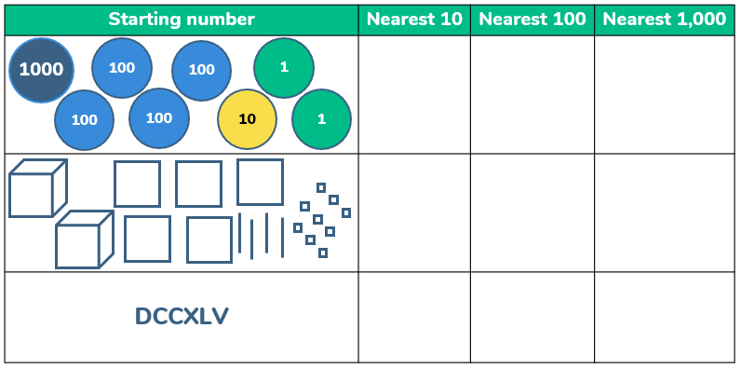
Year 5 Place Value Lesson 3
To be able to round to the nearest 10, 100 and 1,000
Activity 1:
Complete the table:
Success Criteria: Must: I can use concrete resources to round to the nearest 1,000; Should: I can use pictorial representations to round to the nearest 1,000, 100 and 10; Could: I can round to the nearest 1,000, 100 and 10 using numeral representations.
thirdspacelearning.com Specialist 1-to-1 maths interventions and curriculum resources

Slide 24
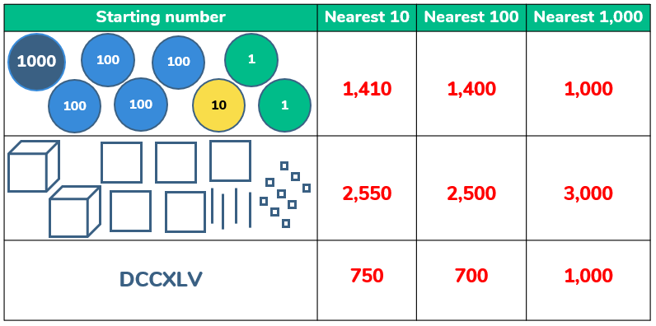
Year 5 Place Value Lesson 3
To be able to round to the nearest 10, 100 and 1,000
Activity 1:
Complete the table:
Success Criteria: Must: I can use concrete resources to round to the nearest 1,000; Should: I can use pictorial representations to round to the nearest 1,000, 100 and 10; Could: I can round to the nearest 1,000, 100 and 10 using numeral representations.
thirdspacelearning.com Specialist 1-to-1 maths interventions and curriculum resources

Slide 25
Year 5 Place Value Lesson 3
To be able to round to the nearest 10, 100 and 1,000
Activity 2:
For each number, find five numbers that round to it ,to the nearest 100.
Success Criteria: Must: I can use concrete resources to round to the nearest 1,000; Should: I can use pictorial representations to round to the nearest 1,000, 100 and 10; Could: I can round to the nearest 1,000, 100 and 10 using numeral representations.
400
9,000
7,800
thirdspacelearning.com Specialist 1-to-1 maths interventions and curriculum resources

Slide 26
Year 5 Place Value Lesson 3
To be able to round to the nearest 10, 100 and 1,000
Activity 3:
Complete the table below:
Success Criteria: Must: I can use concrete resources to round to the nearest 1,000; Should: I can use pictorial representations to round to the nearest 1,000, 100 and 10; Could: I can round to the nearest 1,000, 100 and 10 using numeral representations.
Start Number | Nearest 10 | Nearest 100 | Nearest 1,000
254
2,349
 | 5,880
thirdspacelearning.com Specialist 1-to-1 maths interventions and curriculum resources

Slide 27
Year 5 Place Value Lesson 3
To be able to round to the nearest 10, 100 and 1,000
Activity 3:
Complete the table below:
Success Criteria: Must: I can use concrete resources to round to the nearest 1,000; Should: I can use pictorial representations to round to the nearest 1,000, 100 and 10; Could: I can round to the nearest 1,000, 100 and 10 using numeral representations.
Start Number | Nearest 10 | Nearest 100 | Nearest 1,000
254 | 250 | 300 | 0
2,349 | 2,350 | 2,300 | 2,000
Range: 5,875 – 5,884 | 5,880 | 5,900 | 6,000
thirdspacelearning.com Specialist 1-to-1 maths interventions and curriculum resources

Slide 28
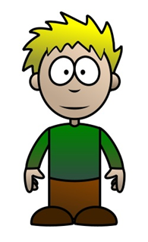
Year 5 Place Value Lesson 3
To be able to round to the nearest 10, 100 and 1,000
Activity 4:
James says, “My number rounded to the nearest thousand is 2,000, rounded to the nearest 100 is 2,300, rounded to the nearest ten is 2,250.”
Answer. Prove. Explain.
Success Criteria: Must: I can use concrete resources to round to the nearest 1,000; Should: I can use pictorial representations to round to the nearest 1,000, 100 and 10; Could: I can round to the nearest 1,000, 100 and 10 using numeral representations.
Extension Can you write a similar word problem?
thirdspacelearning.com Specialist 1-to-1 maths interventions and curriculum resources

Slide 29
Year 5 Place Value Lesson 3
To be able to round to the nearest 10, 100 and 1,000
Activity 4:
James says, “My number rounded to the nearest thousand is 2,000, rounded to the nearest 100 is 2,300, rounded to the nearest ten is 2,250.”
Answer. Prove. Explain.
James’ number can only be 2,250, 2,251, 2,252, 2,253, or 2,254, because it has to round up to 2,300 to the nearest hundred, but also round down to 2,250 to the nearest ten.
Success Criteria: Must: I can use concrete resources to round to the nearest 1,000; Should: I can use pictorial representations to round to the nearest 1,000, 100 and 10; Could: I can round to the nearest 1,000, 100 and 10 using numeral representations.
Extension Can you write a similar pattern?
thirdspacelearning.com Specialist 1-to-1 maths interventions and curriculum resources

Slide 30
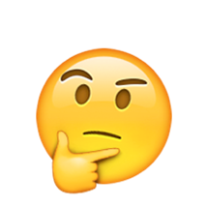
Year 5 Place Value Lesson 3
To be able to round to the nearest 10, 100 and 1,000
Evaluation:
Chen says, “3,451 rounded to the nearest hundred is 3,500.”
Chen is correct.
Explain why Chen is correct.
Success Criteria: Must: I can use concrete resources to round to the nearest 1,000; Should: I can use pictorial representations to round to the nearest 1,000, 100 and 10; Could: I can round to the nearest 1,000, 100 and 10 using numeral representations.
Extension Can you write a similar pattern?
thirdspacelearning.com Specialist 1-to-1 maths interventions and curriculum resources

Slide 31
Year 5 Place Value Lesson 3
To be able to round to the nearest 10, 100 and 1,000
Evaluation:
Chen says, “3,451 rounded to the nearest hundred is 3,500.”
Chen is correct.
Explain why Chen is correct.
Chen is correct, because to round up to the nearest hundred, you must look at the tens column. If the digit in the relevant column is 5 or more (6, 7, 8 or 9), you round up. So, 3,451 is 3,500 to the nearest hundred.
Success Criteria: Must: I can use concrete resources to round to the nearest 1,000; Should: I can use pictorial representations to round to the nearest 1,000, 100 and 10; Could: I can round to the nearest 1,000, 100 and 10 using numeral representations.
Extension Can you write a similar pattern?
thirdspacelearning.com Specialist 1-to-1 maths interventions and curriculum resources

